Slide 1
Our Ecological Footprint

Slide 2
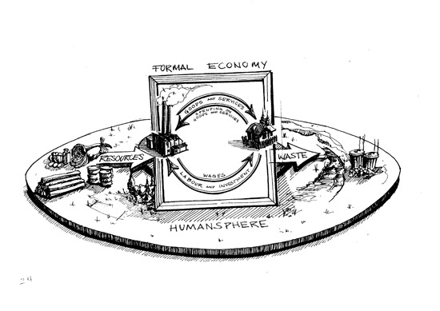
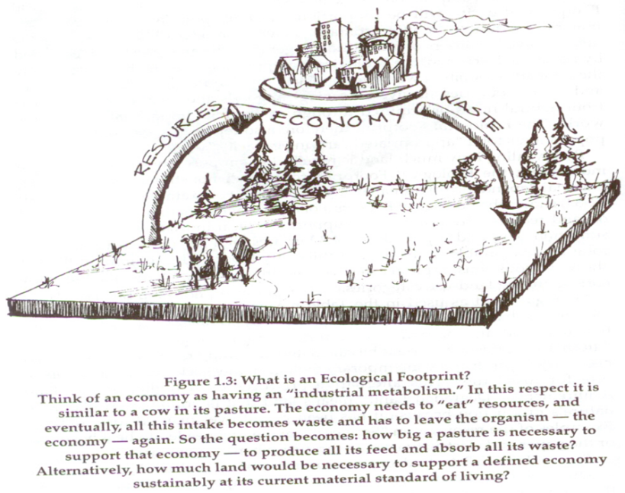
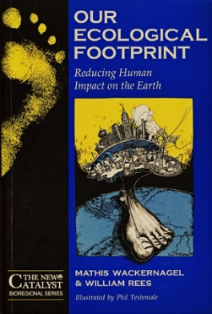
What is an Ecological Footprint?
Image: Phil Testemale in Wackernagel and Rees, 1996)

Slide 3
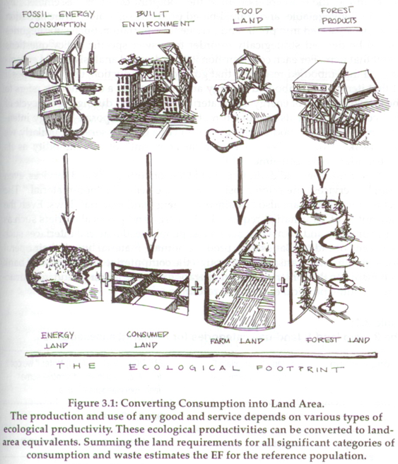
Image: Phil Testemale in Wackernagel and Rees, 1996)

Slide 4
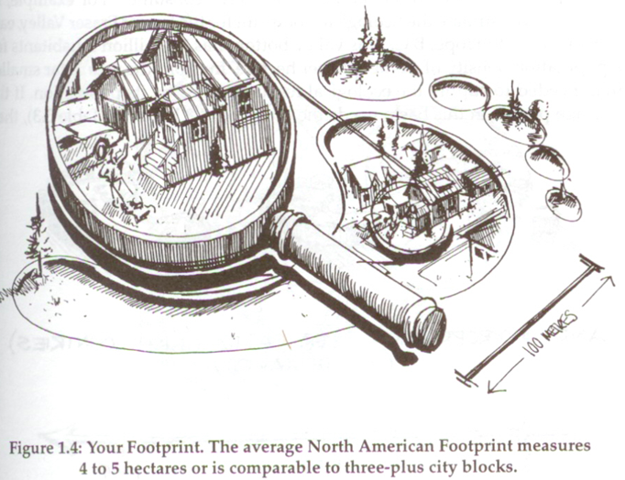
Image: Phil Testemale in Wackernagel and Rees, 1996)

Slide 5
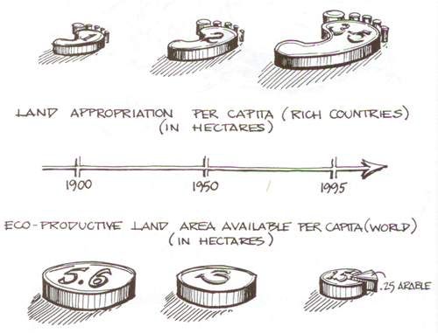
Image: Phil Testemale in Wackernagel and Rees, 1996)

Slide 6
“Most [high income economies] are running massive unsustainable ecological deficits with the rest of the world. Technology and trade have merely obscured this relational truth by displacing the negative consequences of growth to distant ecosystems and the future. Rising productivity and incomes produce overweening confidence in human ingenuity while imposing ever-larger ecological footprints on the Earth.”
- William Rees, UBC

Slide 7
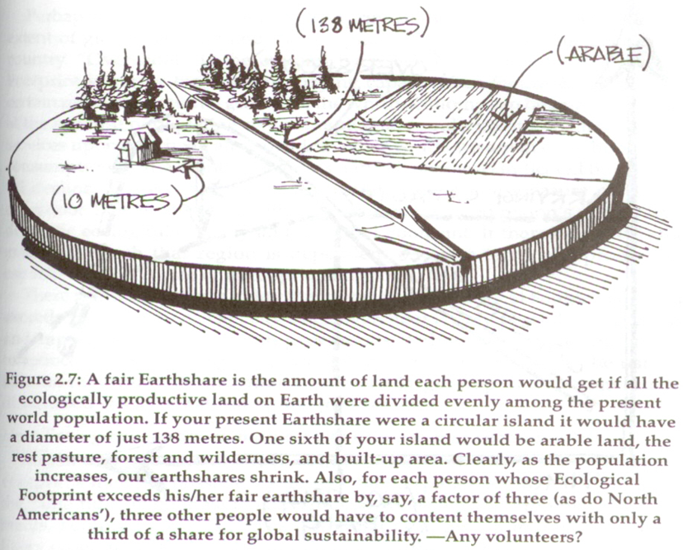
Image: Phil Testemale in Wackernagel and Rees, 1996)

Slide 8
“The UN Development Programme estimates that a child born in an industrialized country contributes more to consumption and production over its lifetime than do 30–50 children born in developing countries.”
- UNEP Industry and Environment, 1999

Slide 9
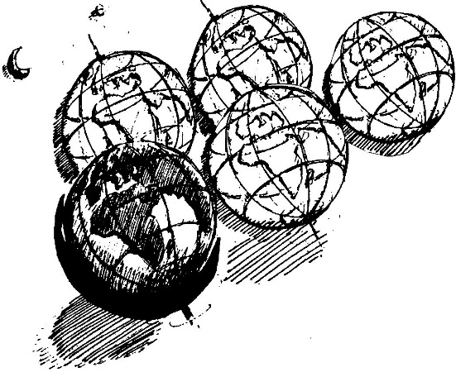
Missing: 4 Phantom Planets
REES (in the 1990s): If today’s entire world population enjoyed the same consumer lifestyles as residents of North America, it would take 4additional Earth-like planets to accommodate everyone sustainably!
[The World Ecological Footprint network now places this at 5]

Slide 10
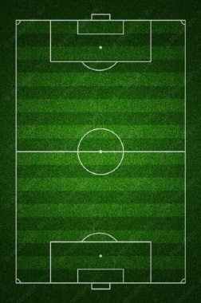
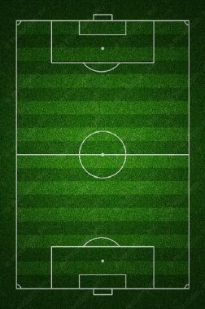
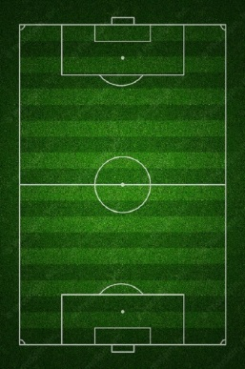
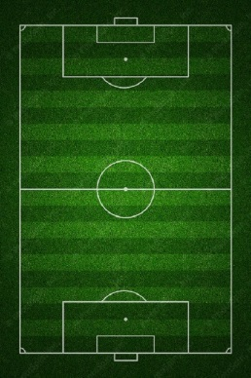
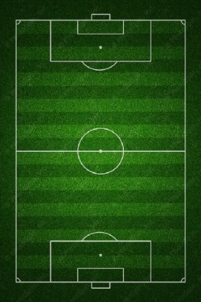
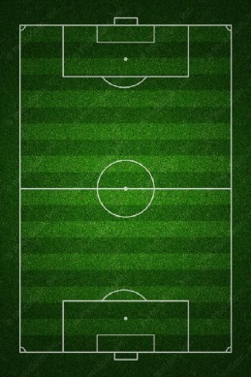
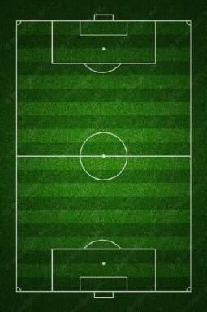
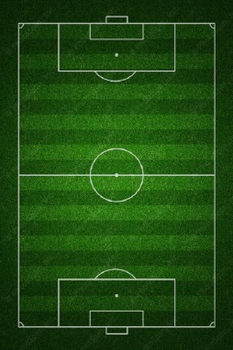
soccer field = ~2 acres (~0.8 ha)
Canadian average footprint = 7 gha (~9 soccer fields worth of biological capacity)

Slide 11
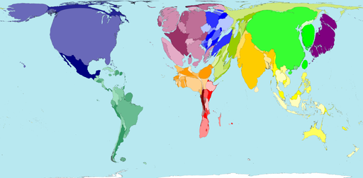
The Ecological Footprint – World Map
309 M
1.34 B
Source: http://www.worldmapper.org/display.php?selected=322

Slide 12
The Footprint Quiz
www.footprintnetwork.org/en/index.php/GFN/page/calculators

