Slide 1
Bias in the media

Slide 2
Credibility of resources
Terms to review as a class:
Paradigm
Facts
Opinions
Bias
Cognitive Dissonance

Slide 3
Credibility of resources
New terms we need to know:
Ethnocentricity is believing that one race or cultural group is better than others.
Propaganda communication that has the purpose of influencing the opinions and attitudes of a group of people toward or against a cause by giving only one side of the story.
Doublespeak is the use of language that distorts the true meaning on purpose.

Slide 4

A matter of perspective
What do YOU see?
Image taken from:
Vercillo, K. (Oct. 30, 2012). Two Faces or a Vase? Old or Young Lady? 10 Simple but Wonderful Optical Illusions. Hub Pages. Taken on Oct. 30/15 from hubpages.com/art/Two-Faces-or-a-Vase-10-Simple-but-Wonderful-Optical-Illusions.

Slide 5
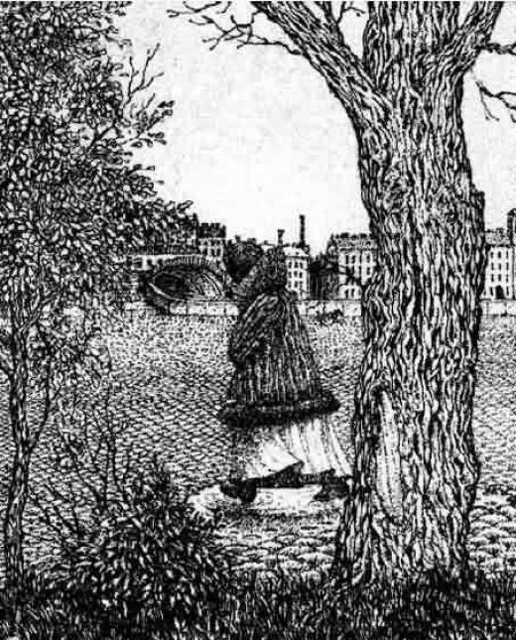
A matter of perspective
What do YOU see?
Image taken from:
Vercillo, K. (Oct. 30, 2012). Two Faces or a Vase? Old or Young Lady? 10 Simple but Wonderful Optical Illusions. Hub Pages. Taken on Oct. 30/15 from hubpages.com/art/Two-Faces-or-a-Vase-10-Simple-but-Wonderful-Optical-Illusions.

Slide 6
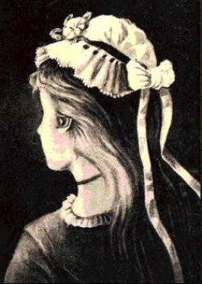
A matter of perspective
What do YOU see?
Image taken from:
Vercillo, K. (Oct. 30, 2012). Two Faces or a Vase? Old or Young Lady? 10 Simple but Wonderful Optical Illusions. Hub Pages. Taken on Oct. 30/15 from hubpages.com/art/Two-Faces-or-a-Vase-10-Simple-but-Wonderful-Optical-Illusions.
.

Slide 7
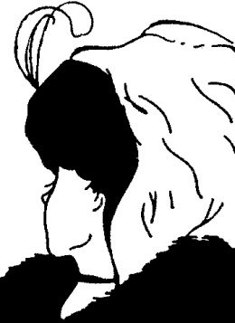
A matter of perspective
What do YOU see?
Image taken from:
Vercillo, K. (Oct. 30, 2012). Two Faces or a Vase? Old or Young Lady? 10 Simple but Wonderful Optical Illusions. Hub Pages. Taken on Oct. 30/15 from hubpages.com/art/Two-Faces-or-a-Vase-10-Simple-but-Wonderful-Optical-Illusions.
.

Slide 8

A matter of perspective
What do YOU see?
Image taken from:
Officially Bored. Optical Illusions Page 2. Taken on Oct. 30/15 from www.officiallybored.net/page74.htm
.

Slide 9
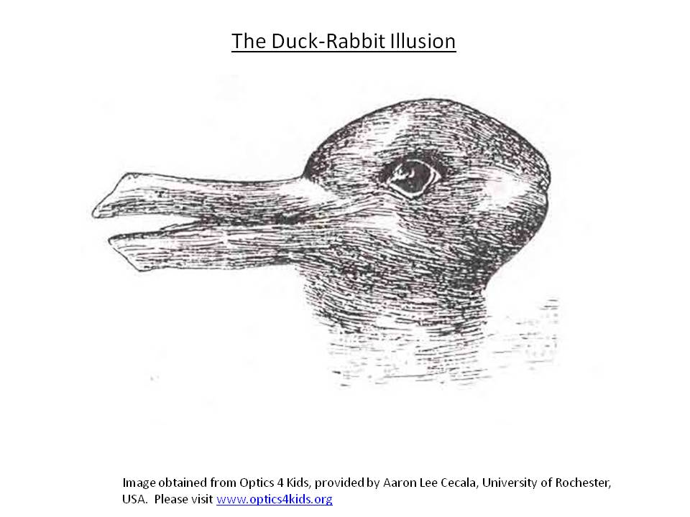
A matter of perspective
What do YOU see?

Slide 10
Perception
What influences how we see the world around us?
How do these influences differ depending on…
Where you live?
Your biology?
Your income levels?
Other issues?
List the top 10 things that you think influence your perception of the world around you.
This list will show you what is influencing your paradigm.

Slide 11
Bias in the media
People are never entirely neutral. Everyone has a paradigm.
Since media is created by people, it is also never entirely neutral.
People who create the news choose what they tell, who they interview and what quotes to publish. All of this is influenced by their paradigm.
For this reason the media story you receive is not necessarily “the truth,” but instead it is one person’s perception of the truth.

Slide 12
Bias in the media
Our news is brought to us by a surprisingly small number of organizations.
3 major TV news services use microwave and satellite to relay their camera footage to TV networks all over the world.
Viznews (British)
UPIIN (British-US)
CBS Newsfilm (owned by VIACOM)

Slide 13
Bias in the media
This means most of our international news is reported from an American or European viewpoint.
Here is the emphasis on “international” news that we see in Canada:
US 34%
Europe 28%
Asia /Australia 17%
Latin America 11%
Middle East 6%
Africa 4%

Slide 14
Bias in the media—Headlines
September 1, 1983: A Soviet interceptor plane blows up a Korean passenger jet. The New York Times Editorial, “Murder in the Air”:
“There is no conceivable excuse for any nation shooting down a harmless airliner… no circumstance whatever justifies attacking an innocent plane.”
July 3, 1988: US forces blow up an Iranian passenger get. The New York Times Editorial.

Slide 15
Bias in the media—Headlines
“While horrifying, it was nonetheless an accident… the onus for avoiding such accidents in the future rests on civilian aircraft: avoid combat zones, fly high, acknowledge warnings.”
July 21, 2014: An outrage compounded by mystery. The New York Times Editorial.
“Innocent victims are sadly common in conflicts, but whoever unleashed a lethal missile not knowing how to distinguish between a military and a civilian plane is not only irresponsible and stupid, but a war criminal.”

Slide 16
The global media
The media is plays a major role in developing global economic, political, social, cultural and environmental opinions.
Access to media is also not equal. There is a disparity in access between rich vs. poor, groups in power versus those that are marginalized.
If people are unaware of situations and the underlying causes, how can they work for change?

Slide 17
The global media
It is often felt that in a democratic society, information should also be democratic and access should be protected.
Do you think that this is always the case?
What are scenarios that you can imagine that may allow information in a democratic society to be slanted or biased?
How much propaganda do you feel you are exposed to?

Slide 18
Examining bias in the media
The class will now be divided into four groups. Each group is going to receive a different article.
On your own, read the article and summarize the information it presents.
As a group develop a summary of the article.
What has happened?
Where did it happen?
Why is it happening?
Who is involved?
When did this happen?
How is it happening?
Did your group have an overall positive or negative impression of the government in Venezuela after reading the article? Explain your reasoning.
Prepare to share your article and analysis with the class.

Slide 19
Examining bias in the media
Once the class has shared their articles and interpretations, discuss the following:
How different were your impressions after reading the four articles?
Why do you think this incident was depicted in such differing ways?
How does geopolitics play a role in bias in the media?
What do you think is the real story of Venezuela?

