Slide 1
Art in the street
What is art?
Graffiti…art or vandalism?

Slide 2
Discussion questions
What is graffiti?
Is graffiti art?
How do you know?

Slide 3
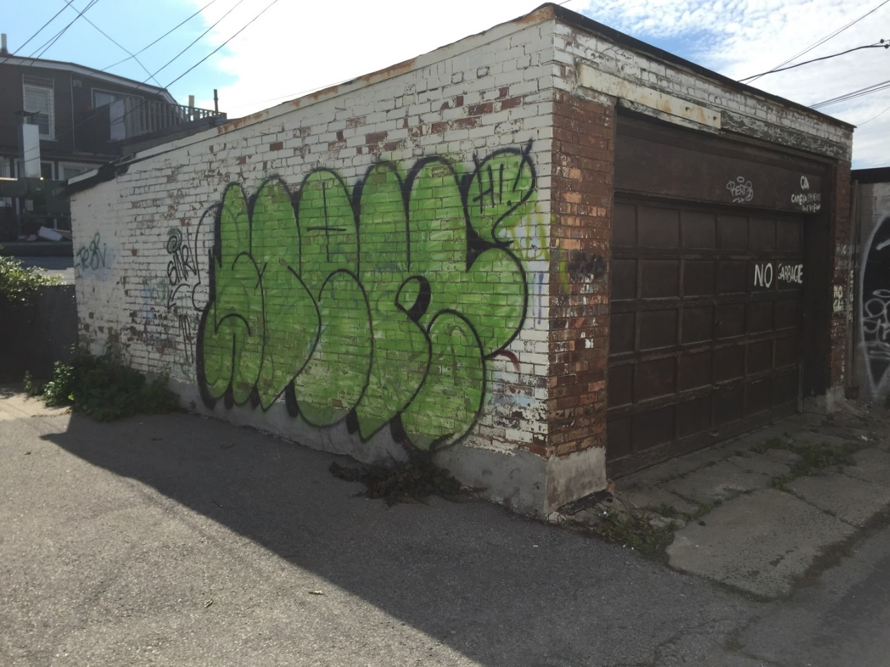
Is this a piece of art or graffiti?

Slide 4
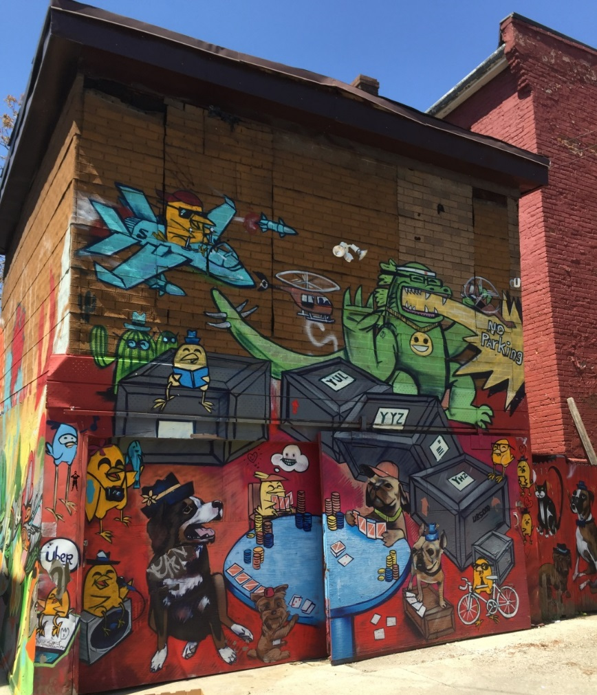
Is this a piece of art or graffiti?

Slide 5
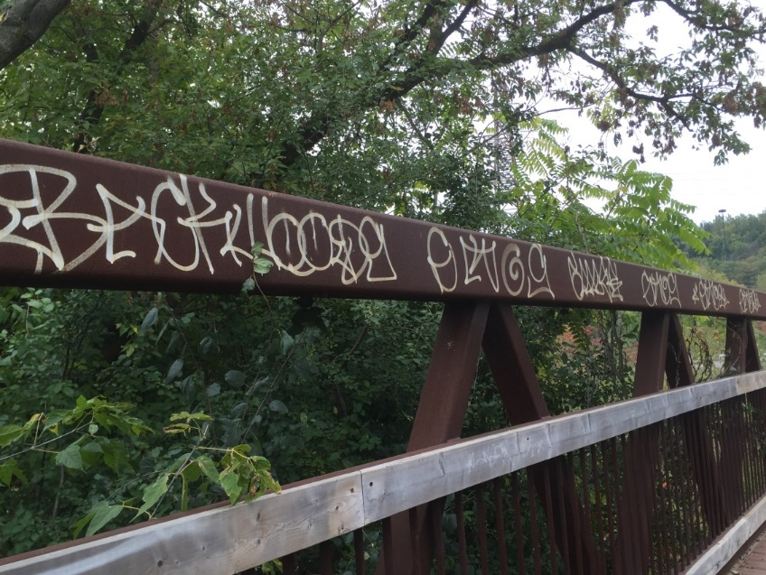
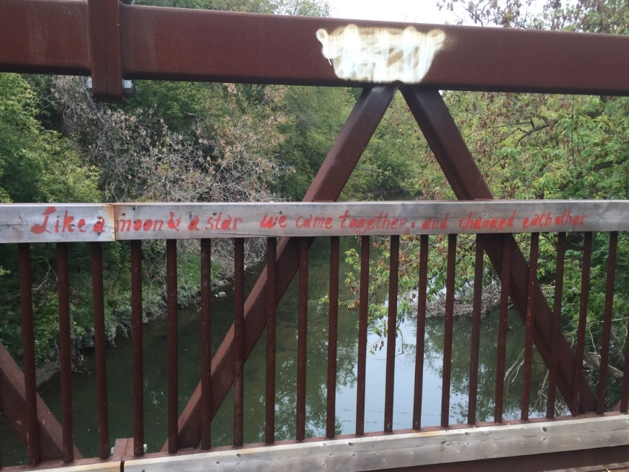
Graffiti or art?
Like a moon & a star we came together and changed each other
.

Slide 6
Is this a piece of art or graffiti?
Did you differently about the images shown? Explain.
Is there a difference between art and graffiti?
What is the purpose of graffiti?
How does graffiti influence society?

Slide 7
Art on the street
You are now going to look at various examples of street art from Canada, Norway and Venezuela.
Examine the following images. As you look at them ask yourself:
Is there a common thread to the images?
How do I feel looking at these images? Note any reactions or feelings that they evoke.
How is the street art different in each of the countries?

Slide 8
Art on the street
How do you view the country given the images you have seen.
Would seeing these images have any influence on people living within the given society? If so, explain.
Does this form of art have value?

Slide 9
Norway
Images by Taina Kanerva

Slide 10
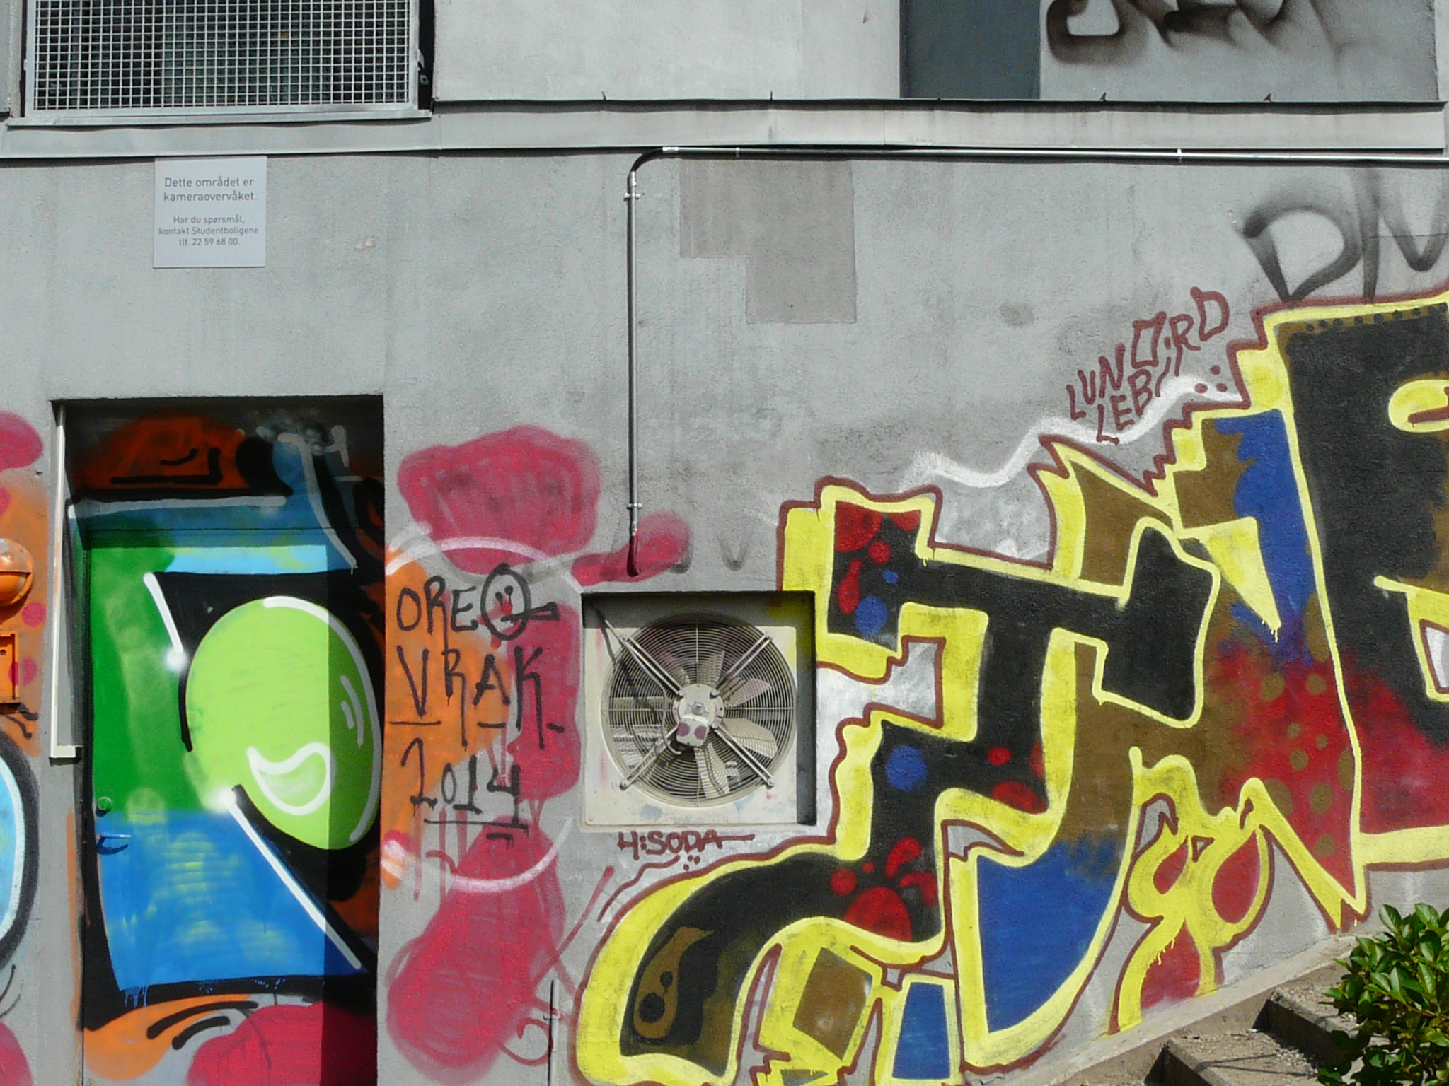

Slide 11
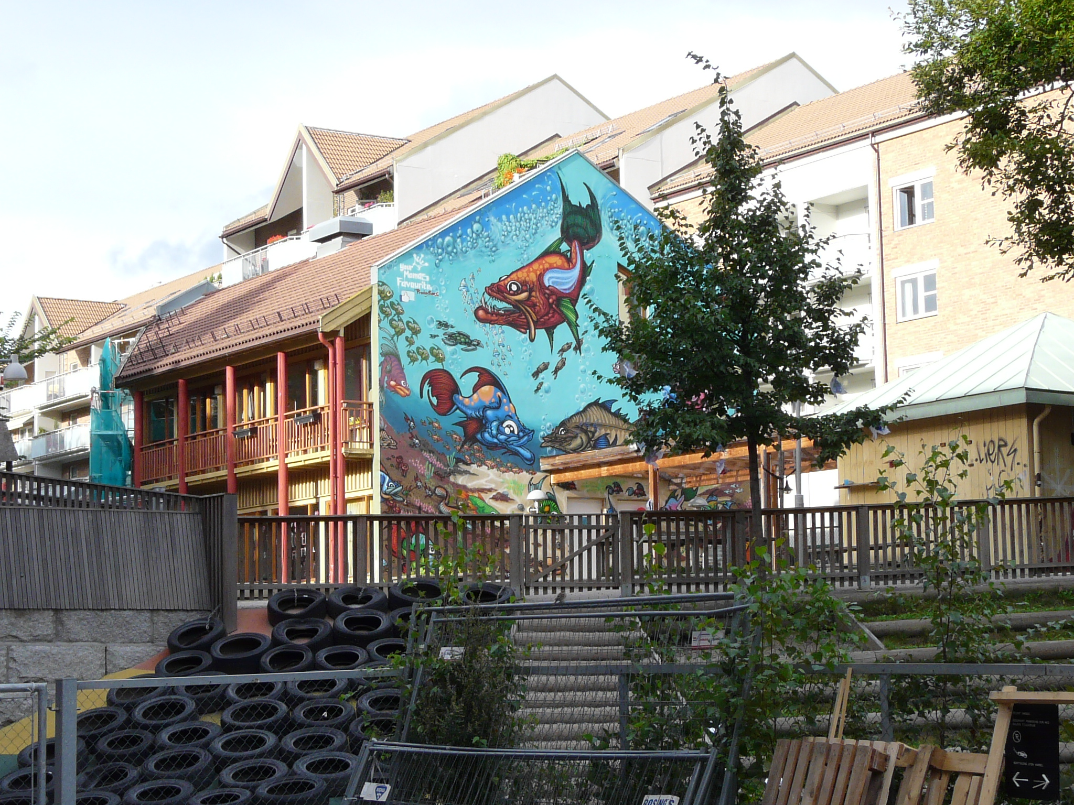

Slide 12
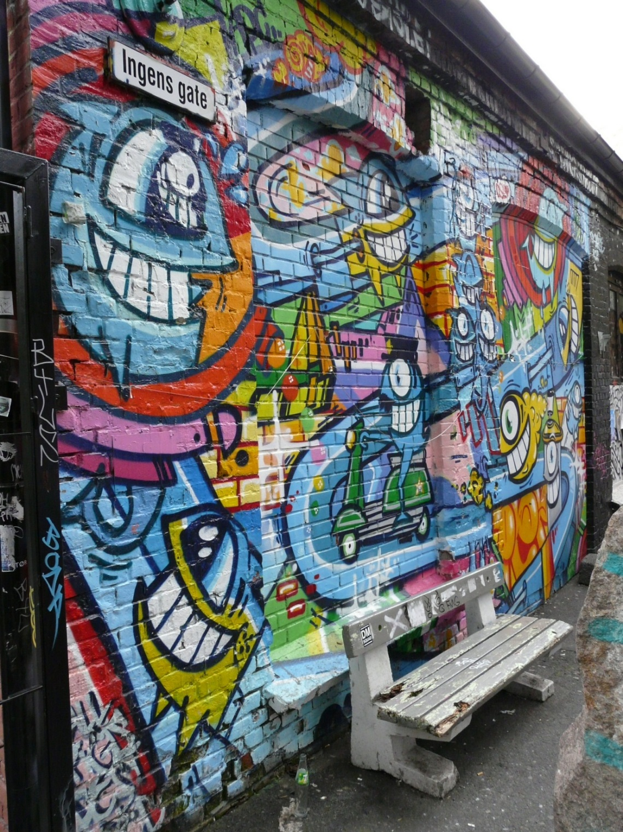

Slide 13
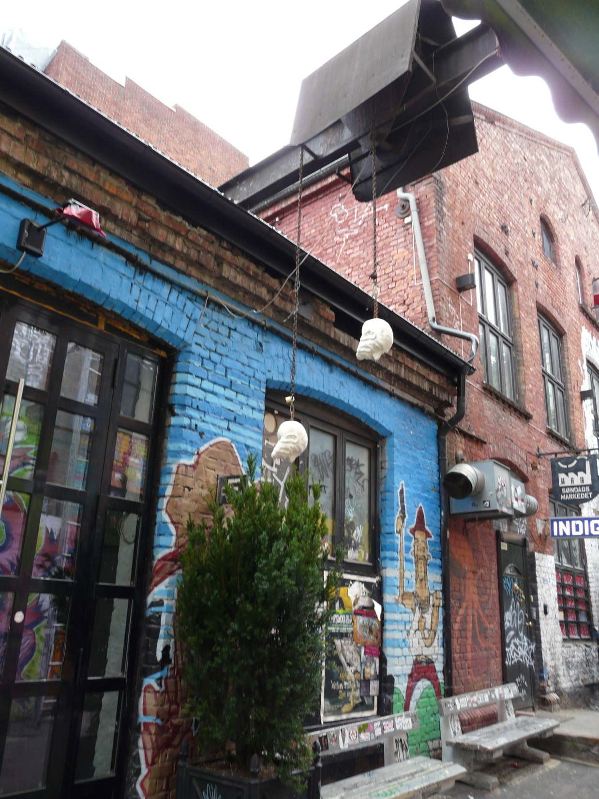

Slide 14
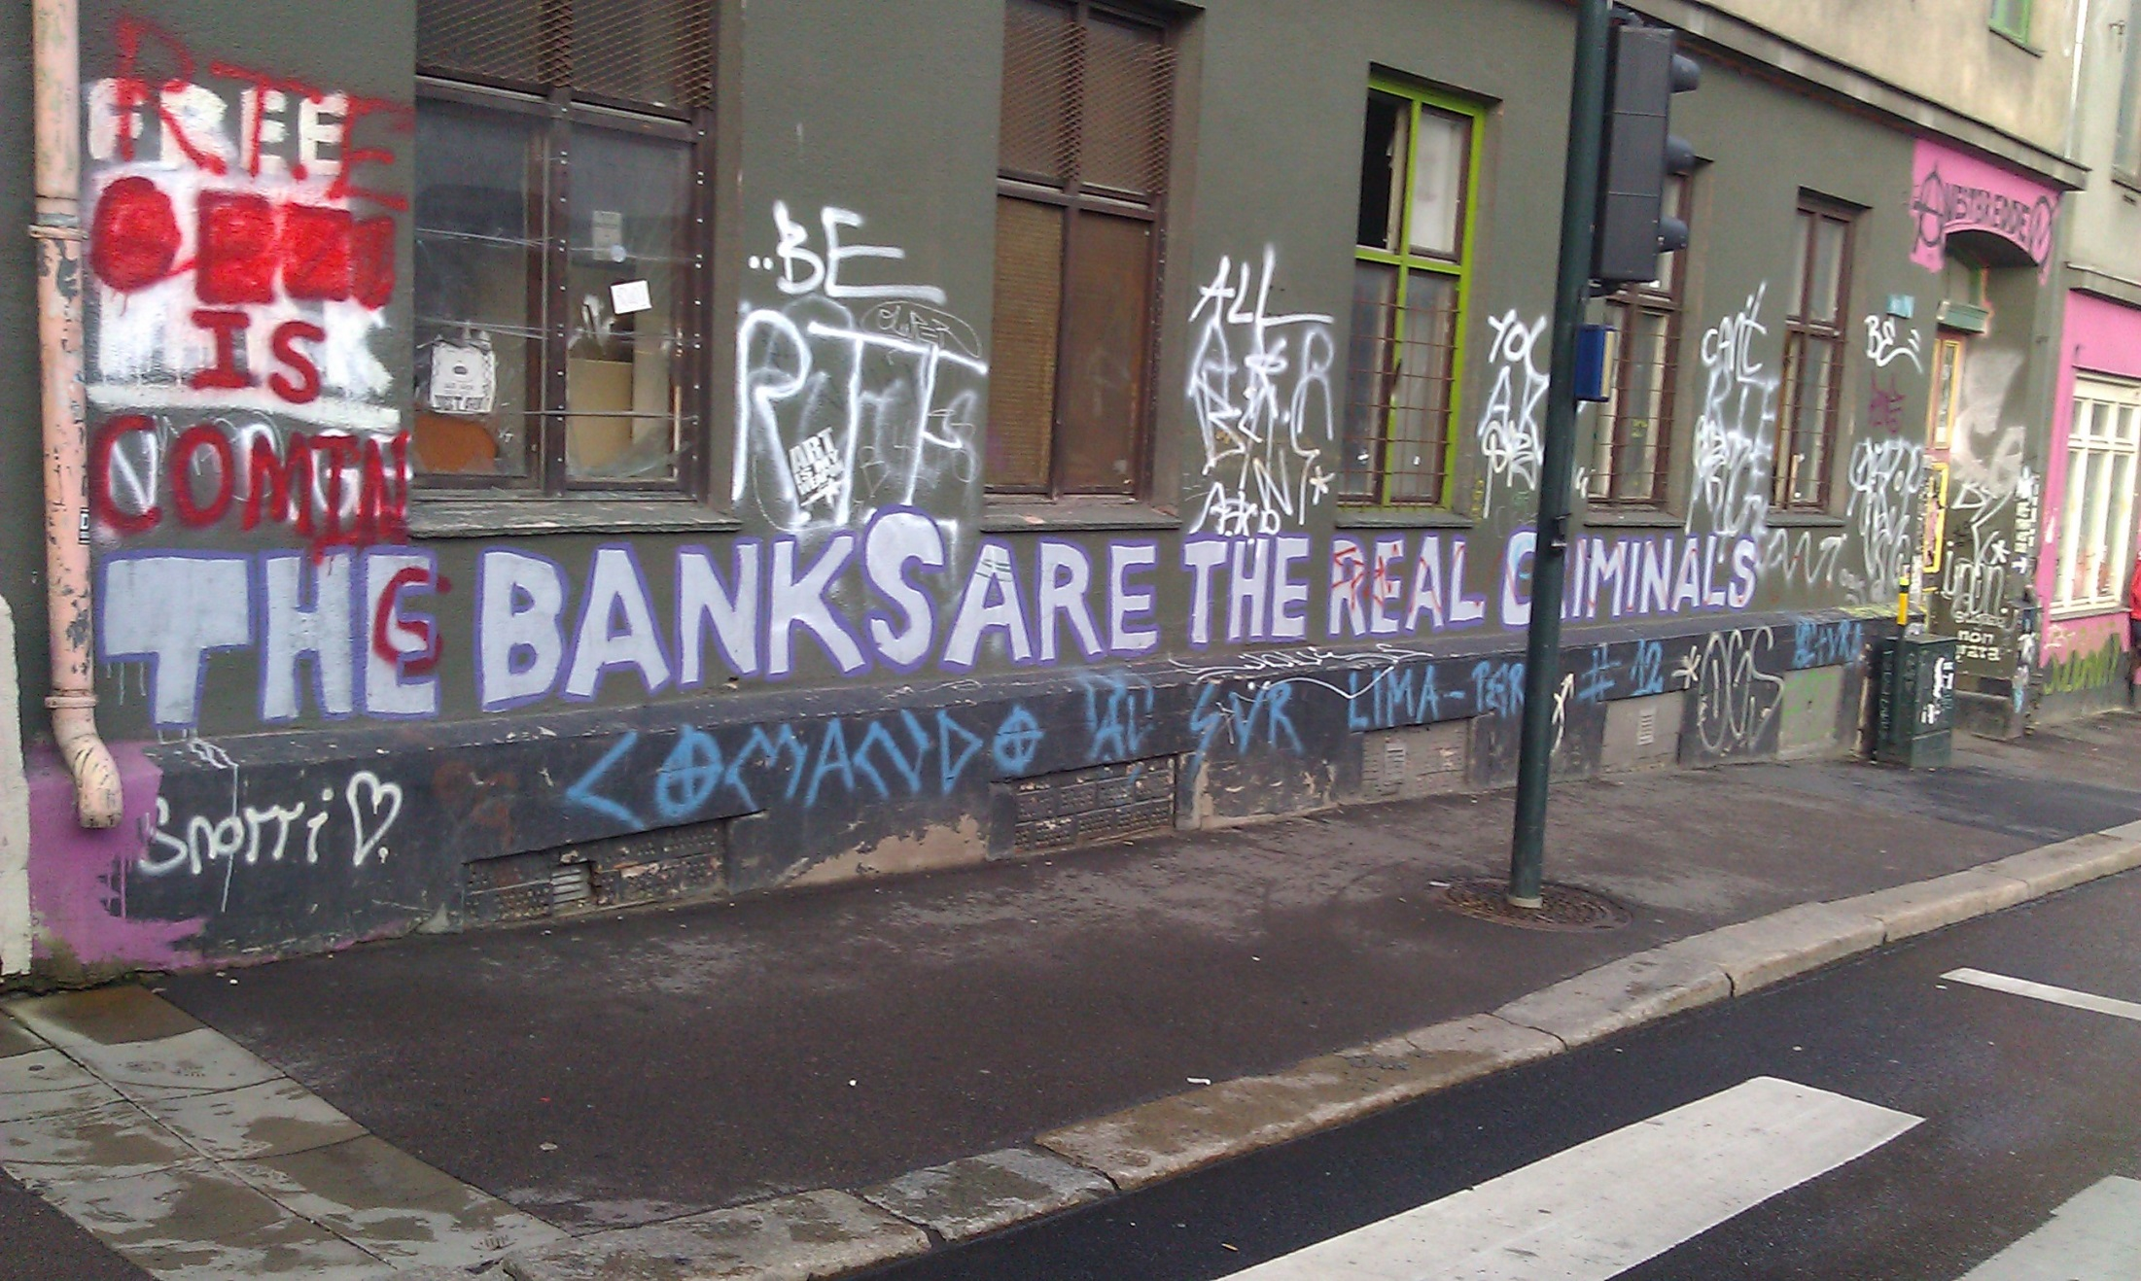

Slide 15
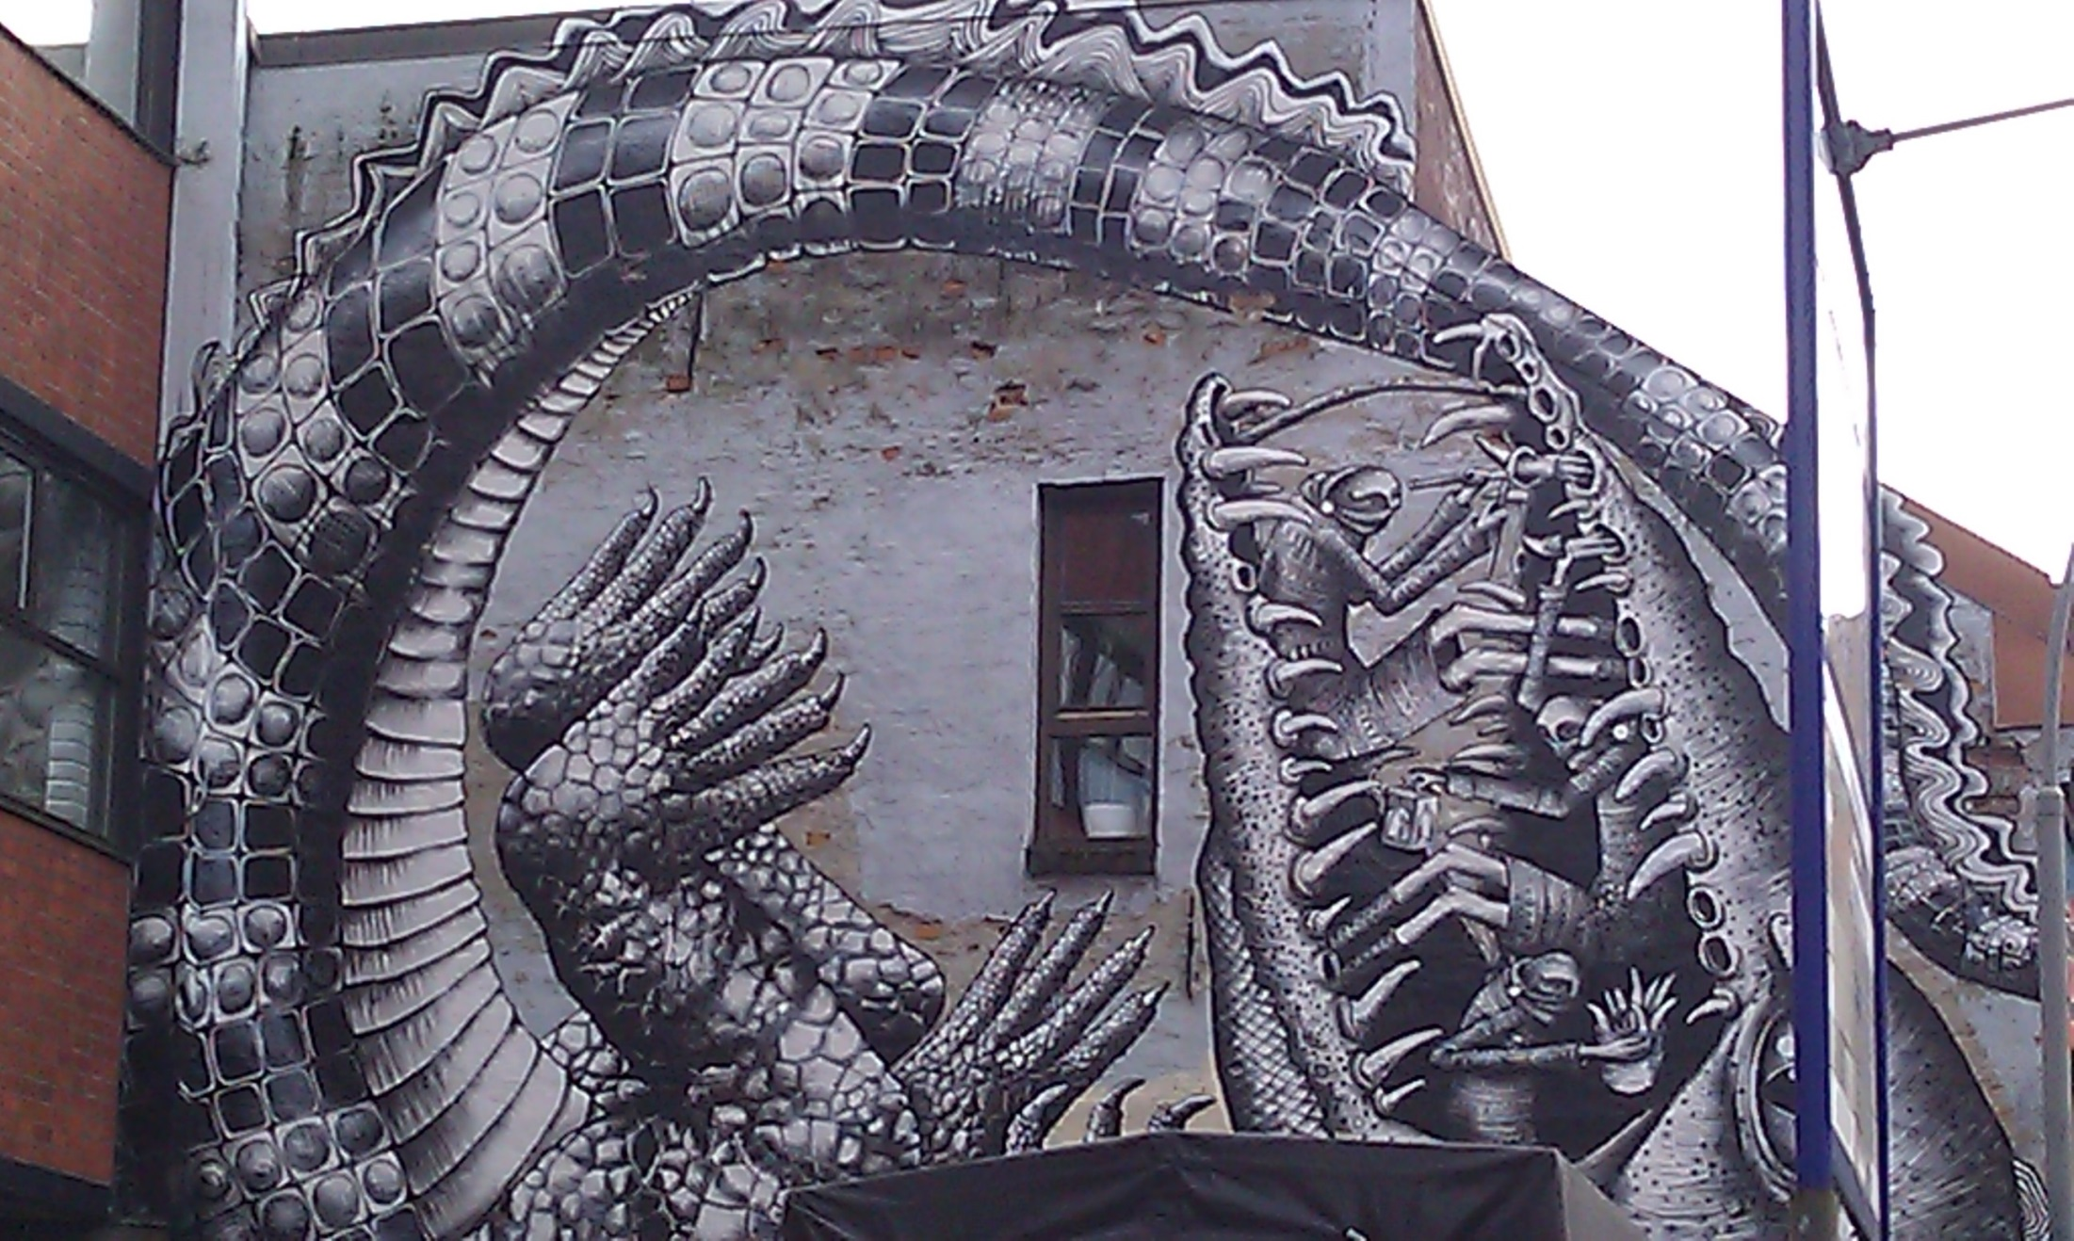

Slide 16
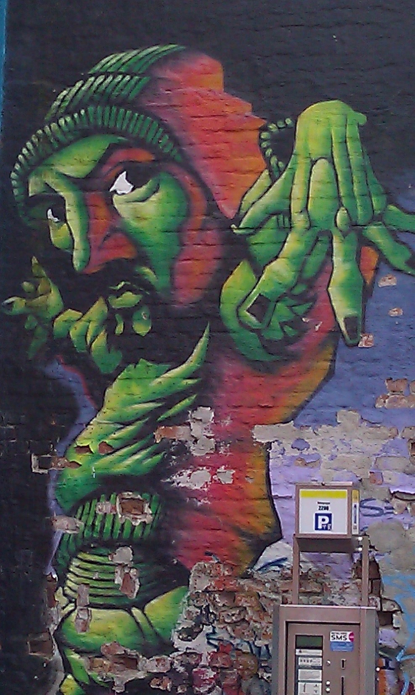

Slide 17
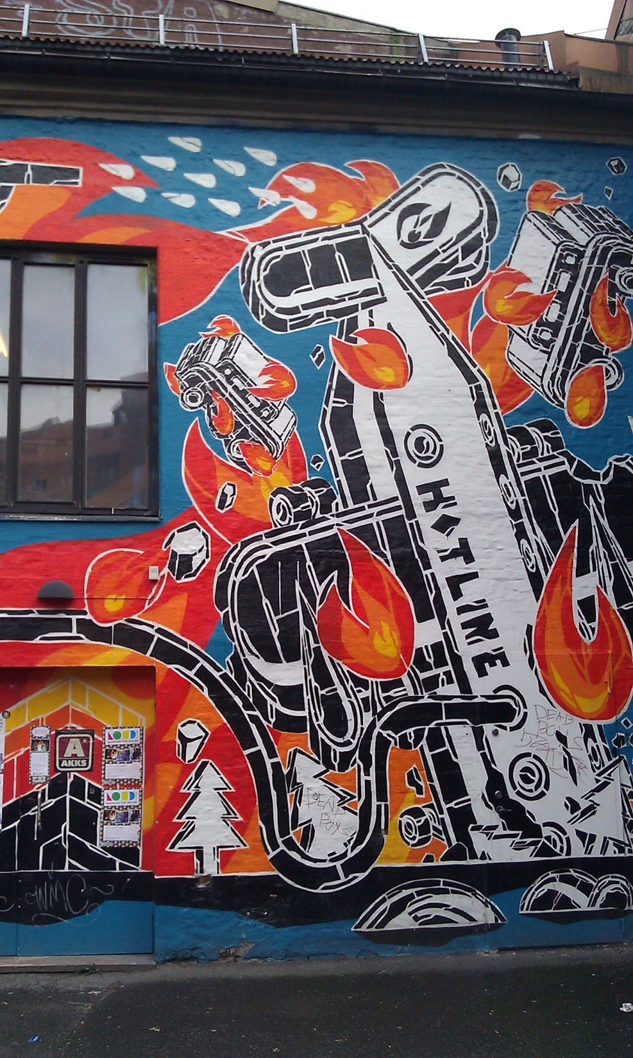

Slide 18
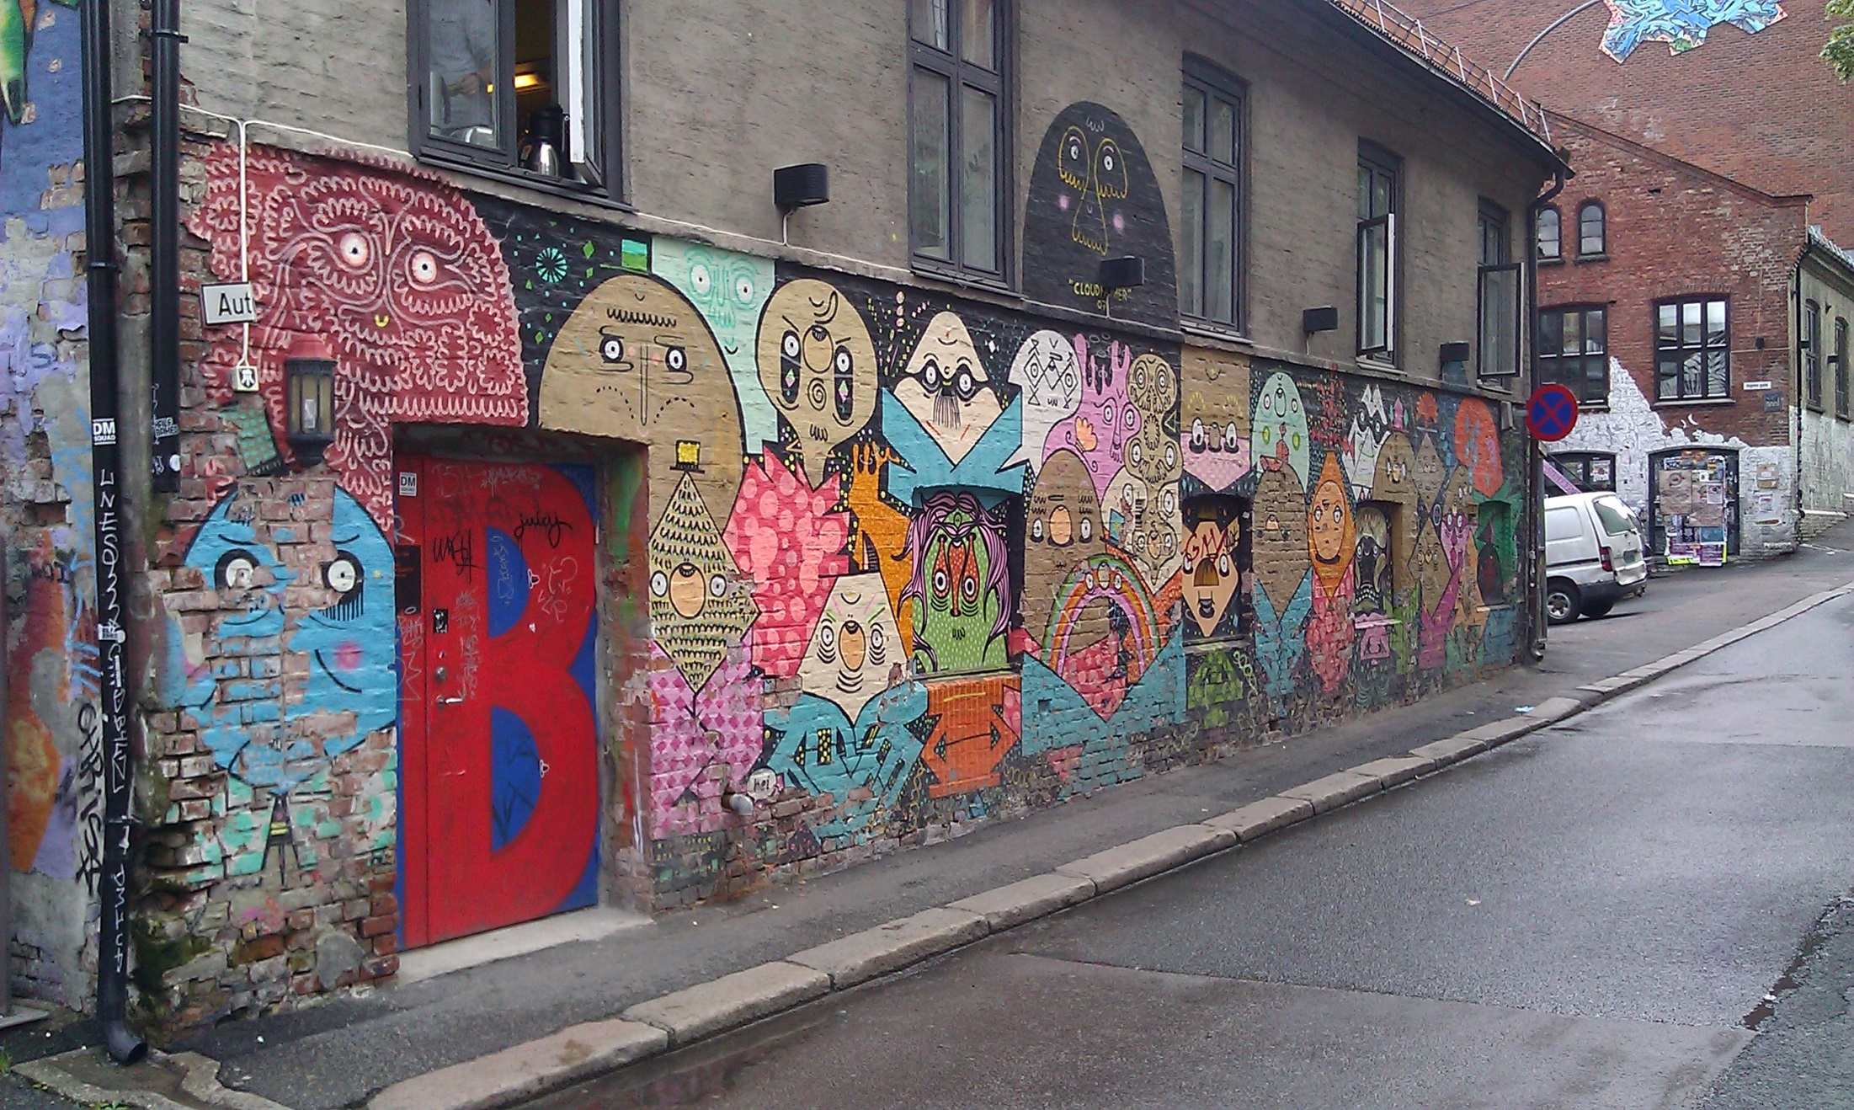

Slide 19
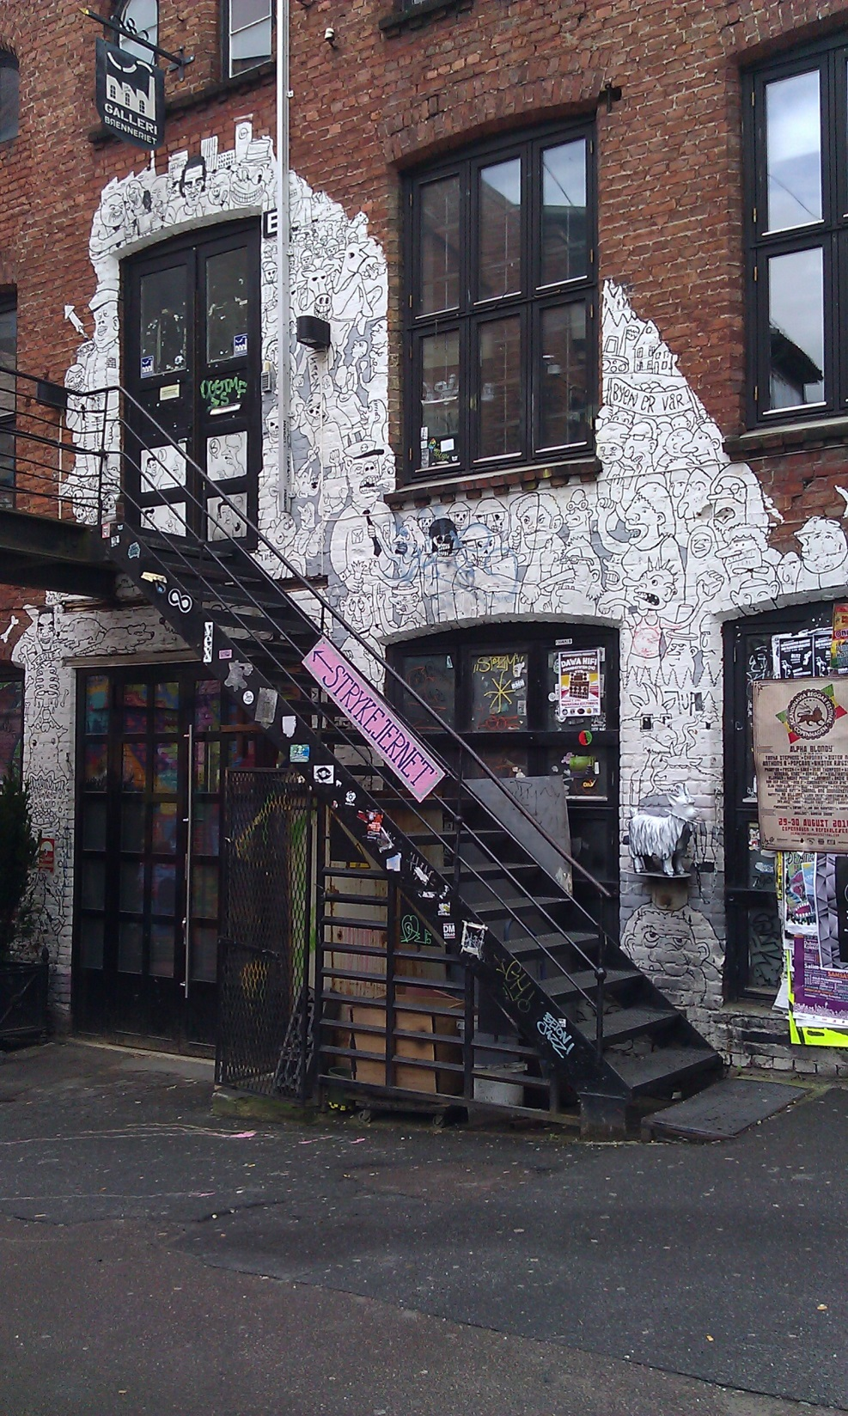

Slide 20
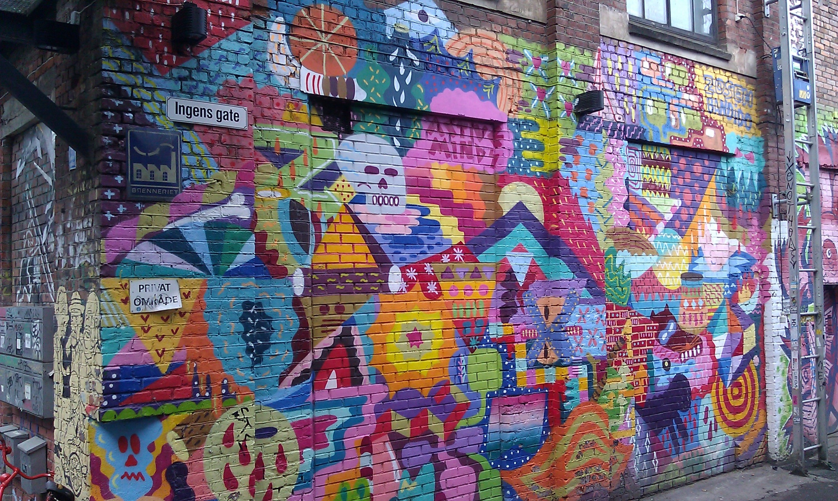

Slide 21
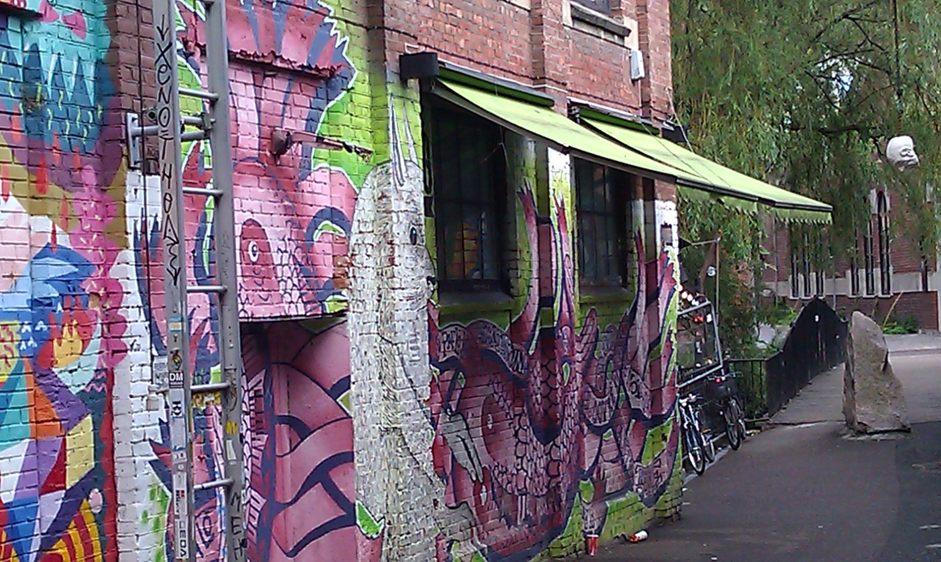

Slide 22
Venezuela
Images by Taina Kanerva
and Michelle Chambers

Slide 23
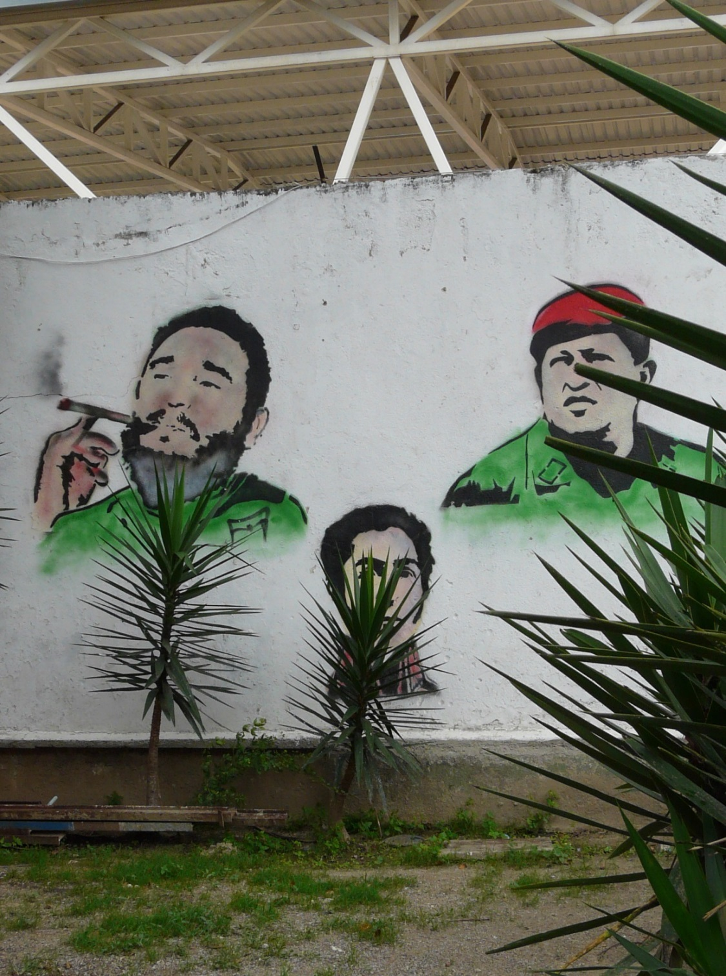

Slide 24
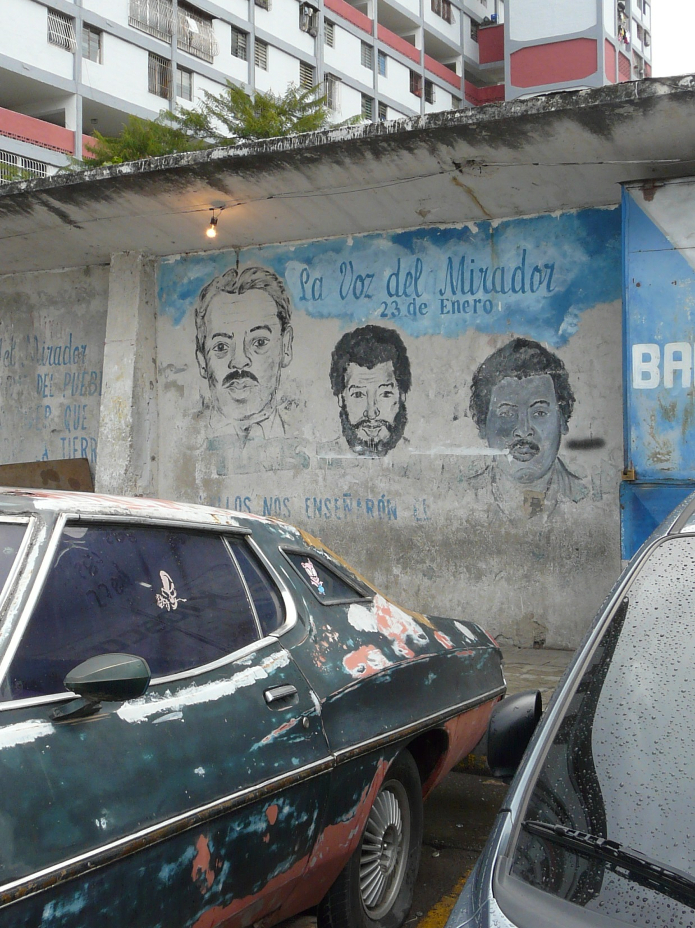

Slide 25
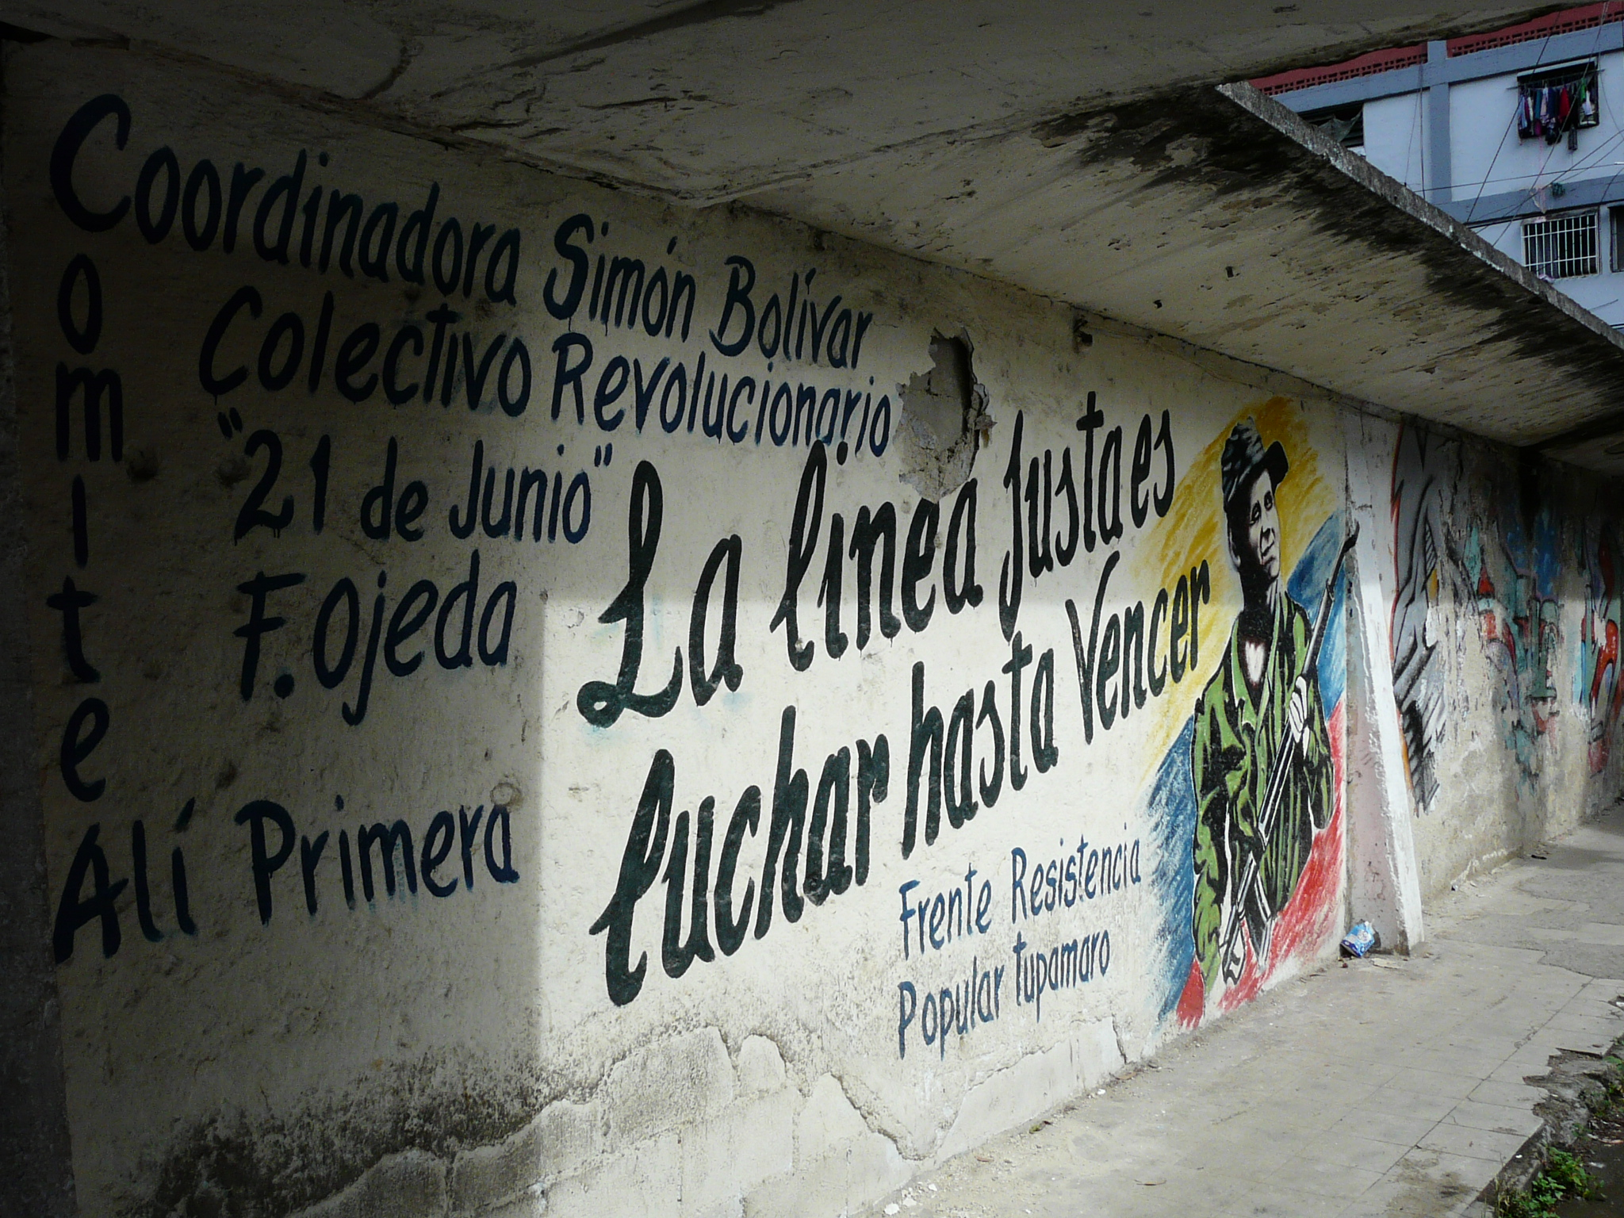

Slide 26
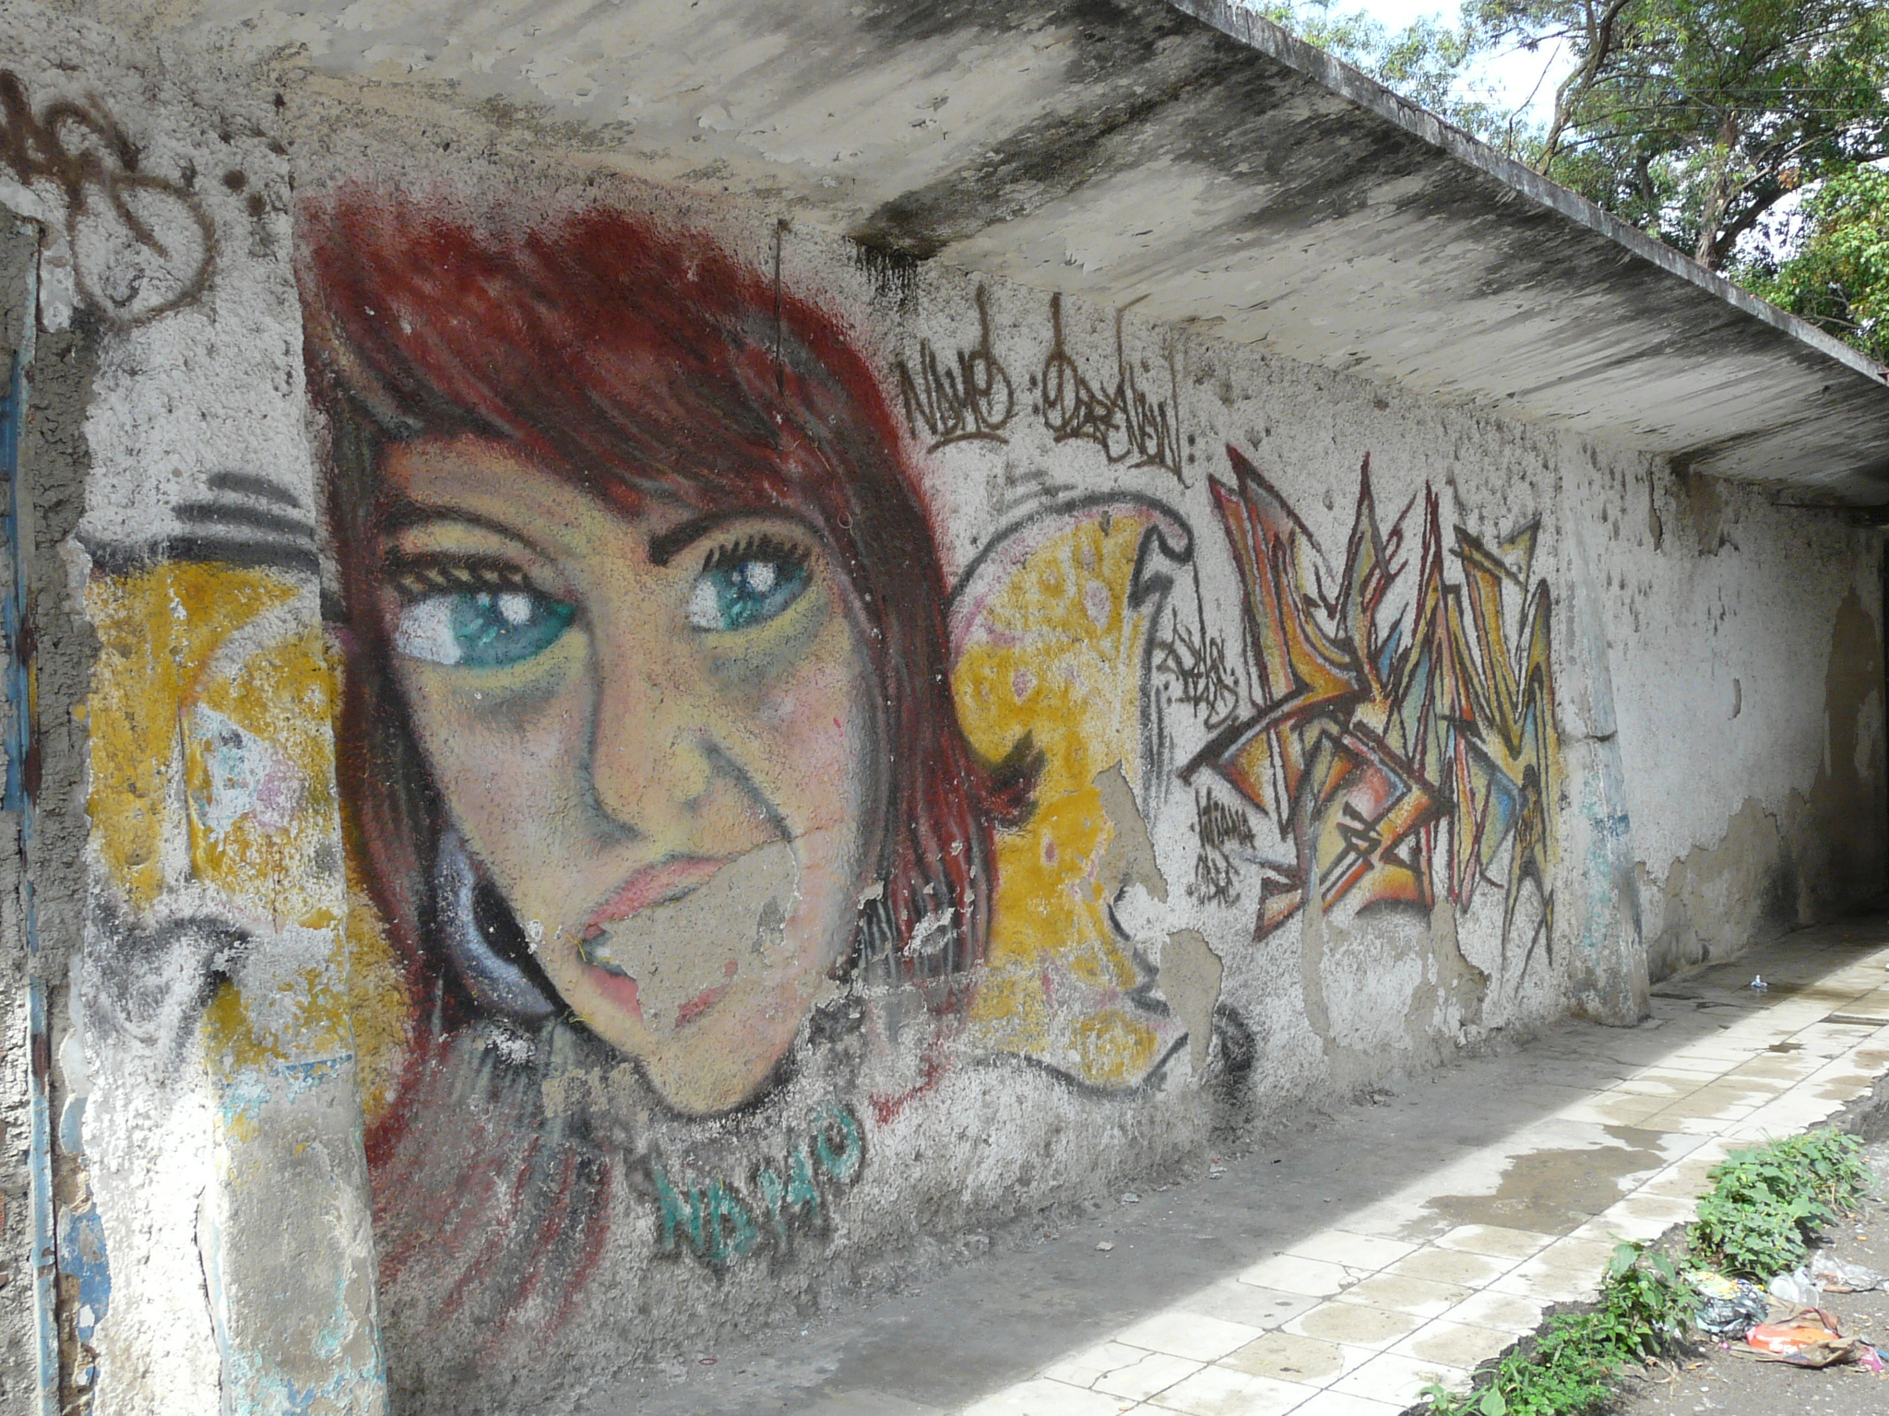

Slide 27
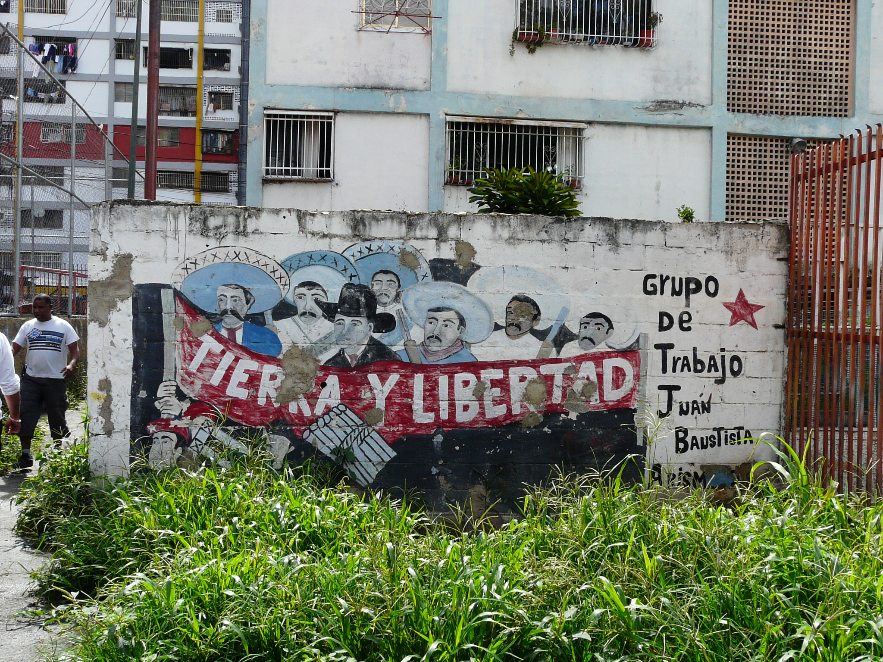

Slide 28
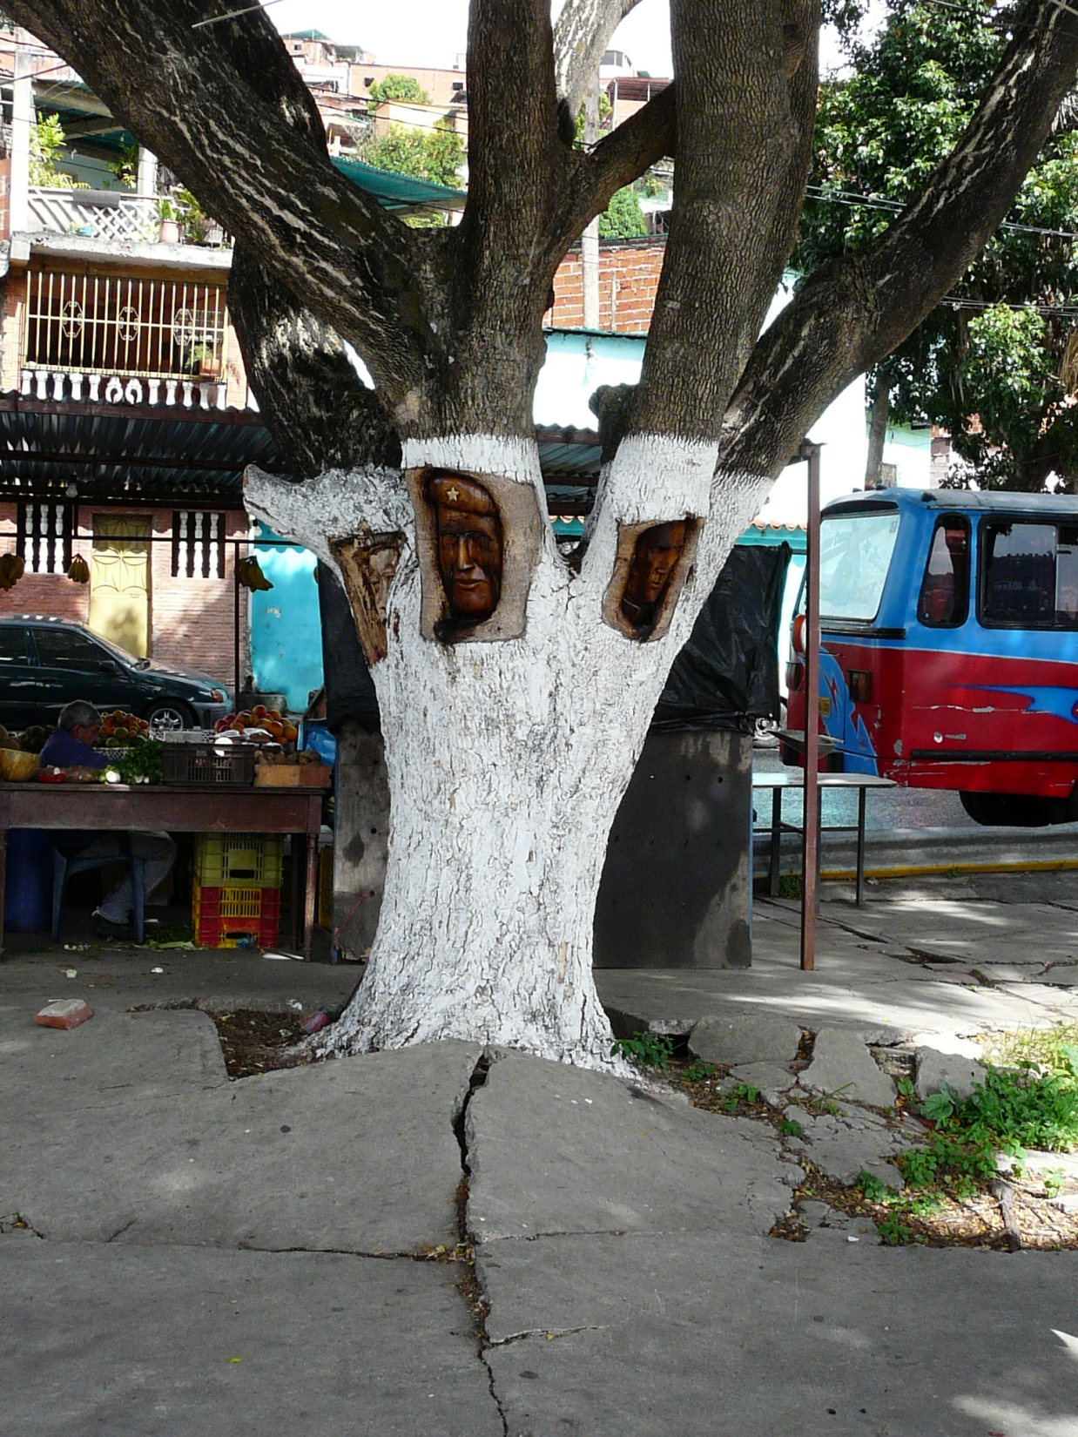

Slide 29
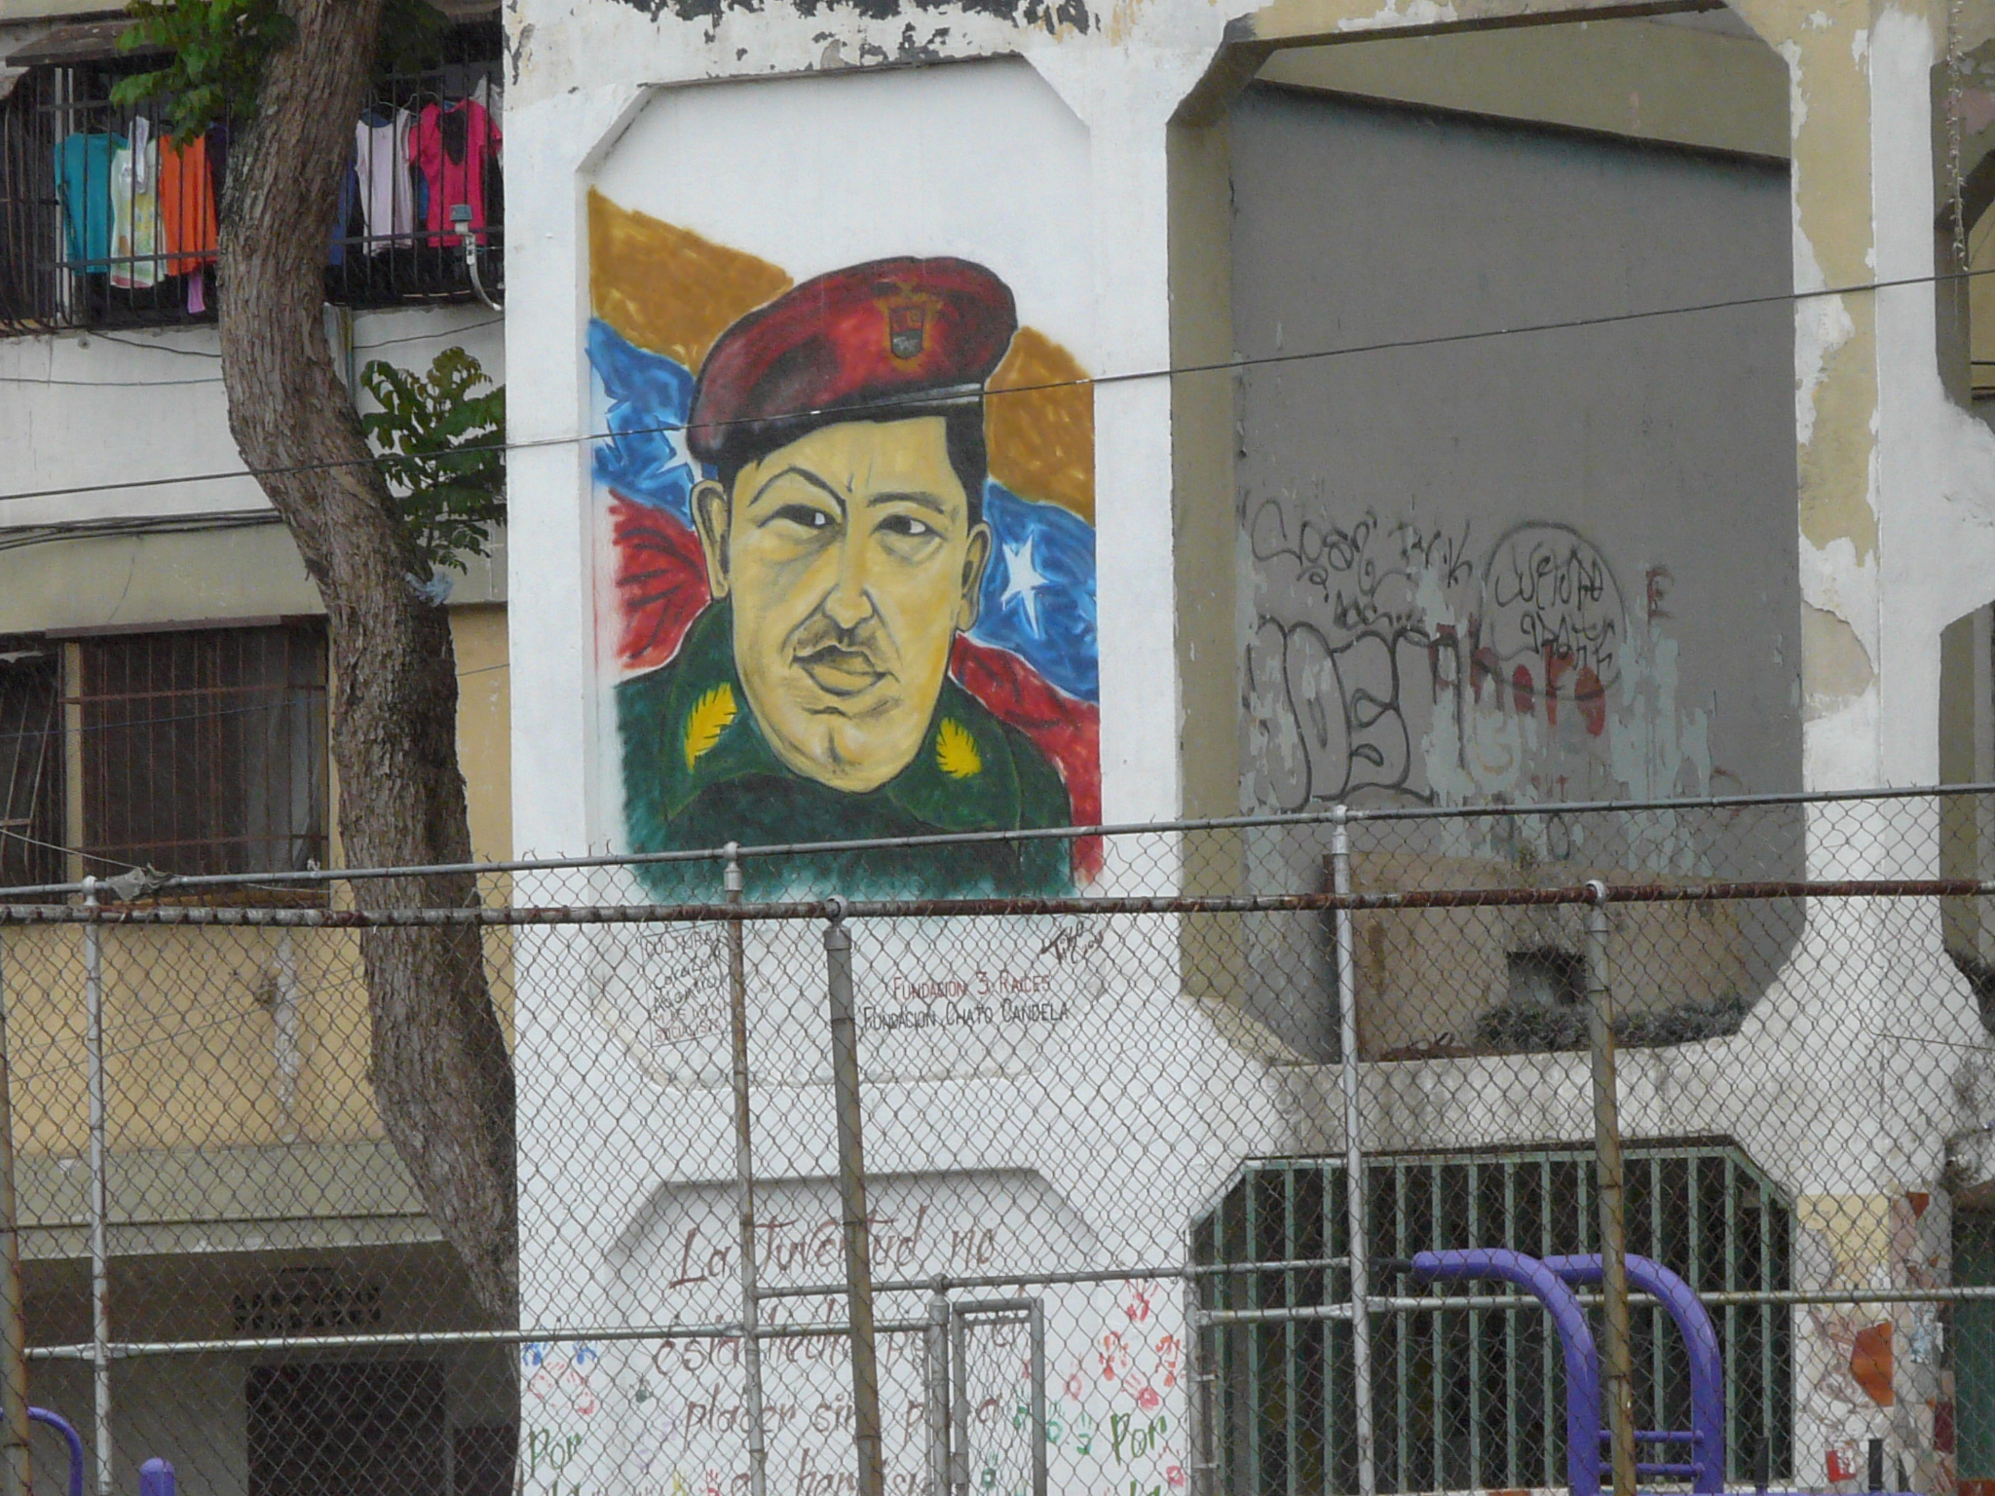

Slide 30
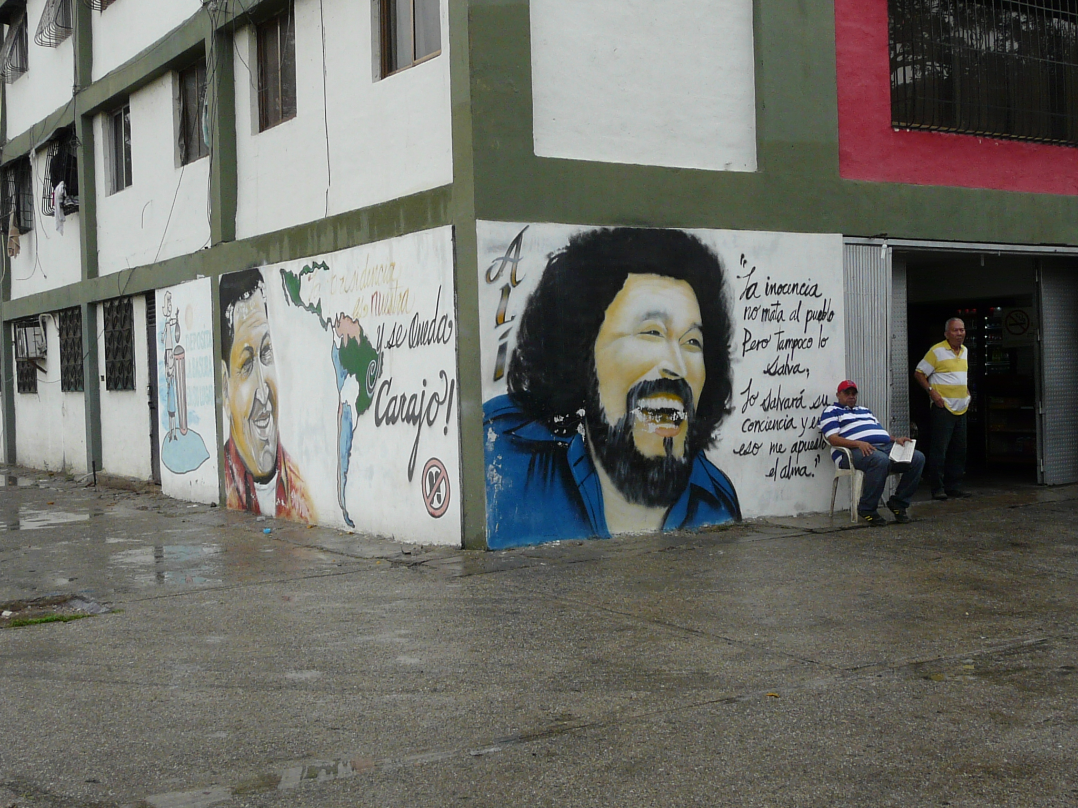

Slide 31
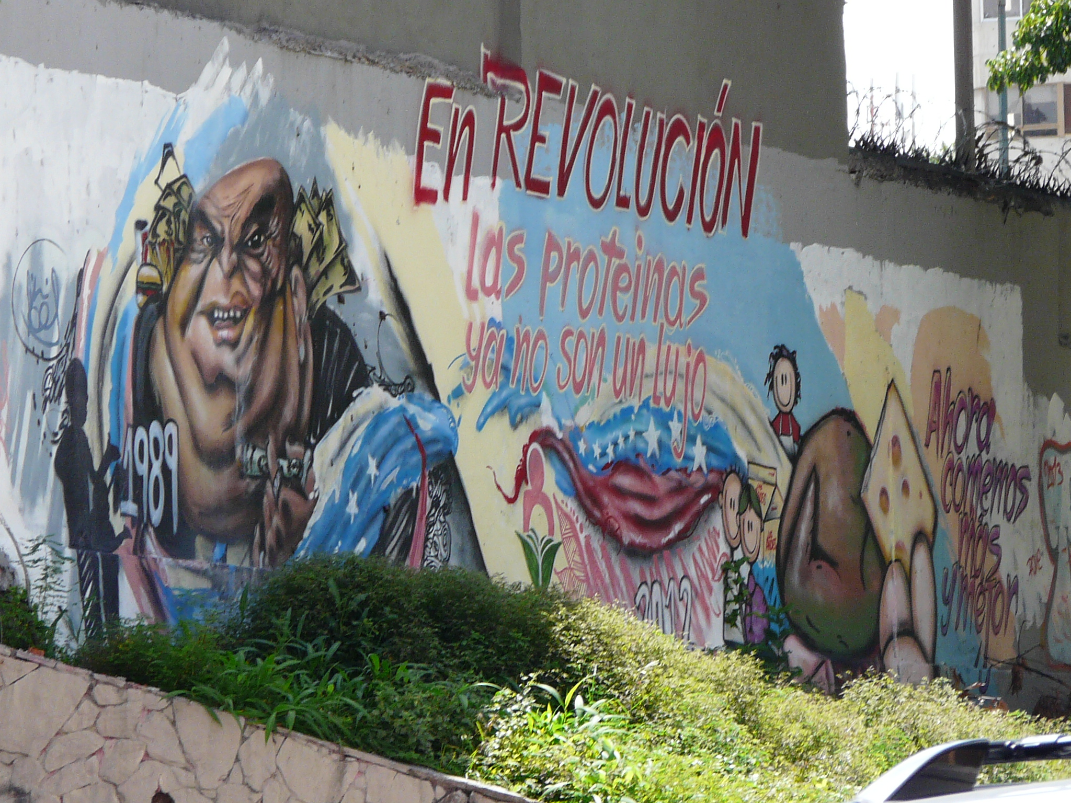

Slide 32
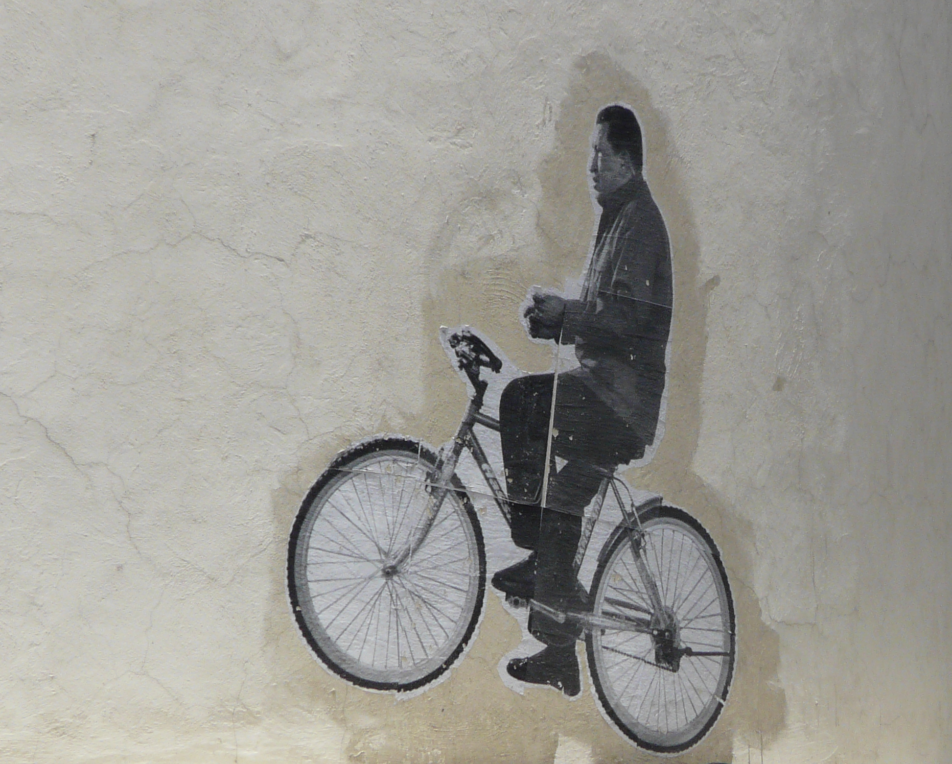

Slide 33
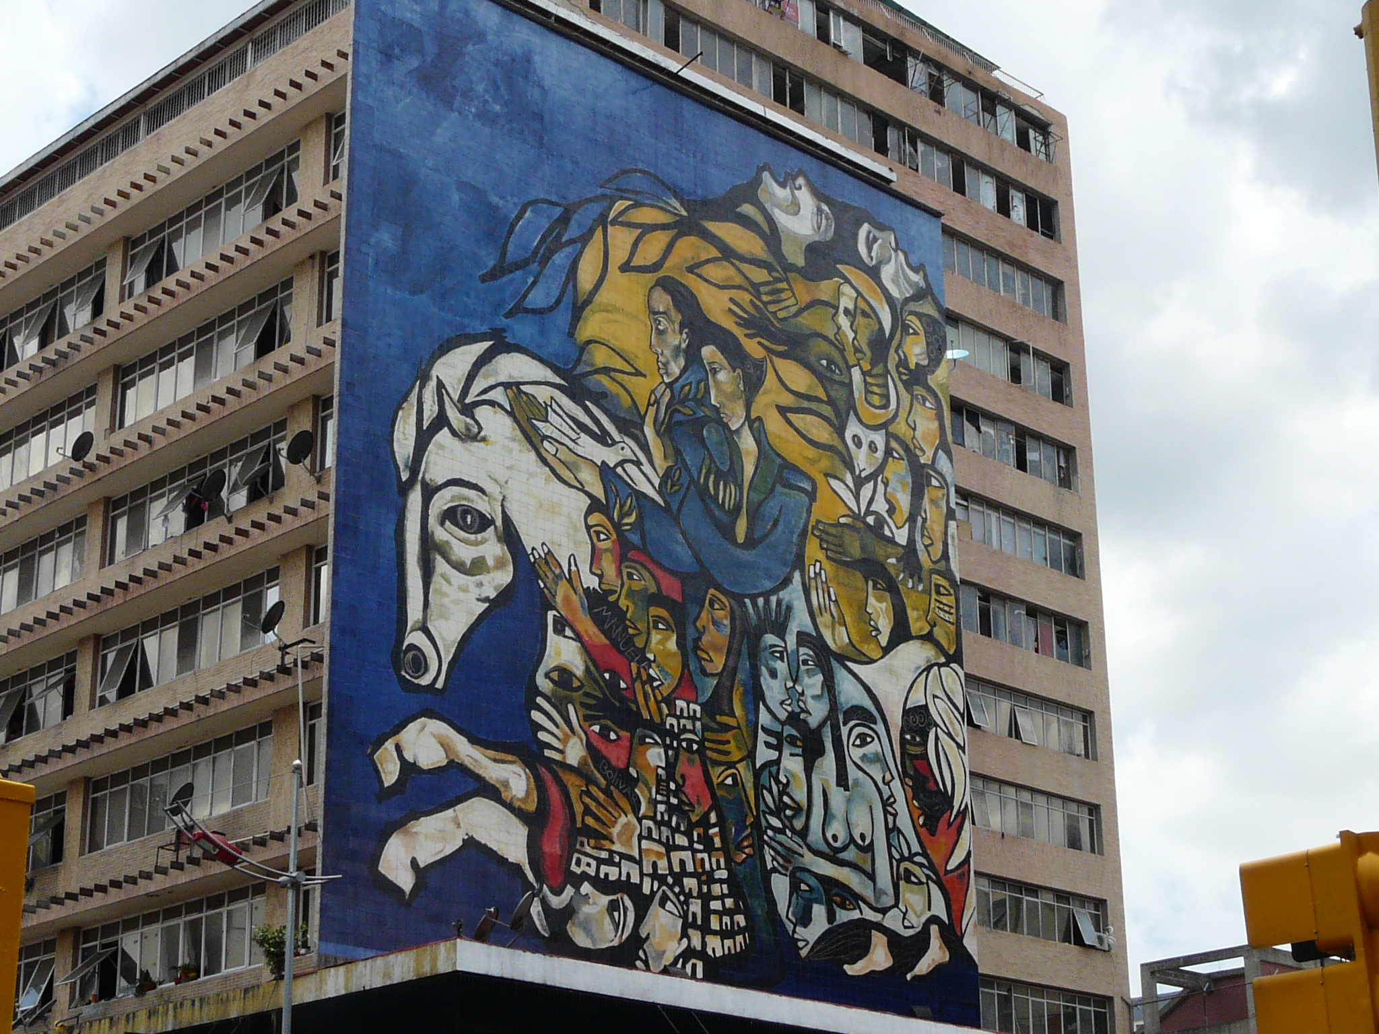

Slide 34
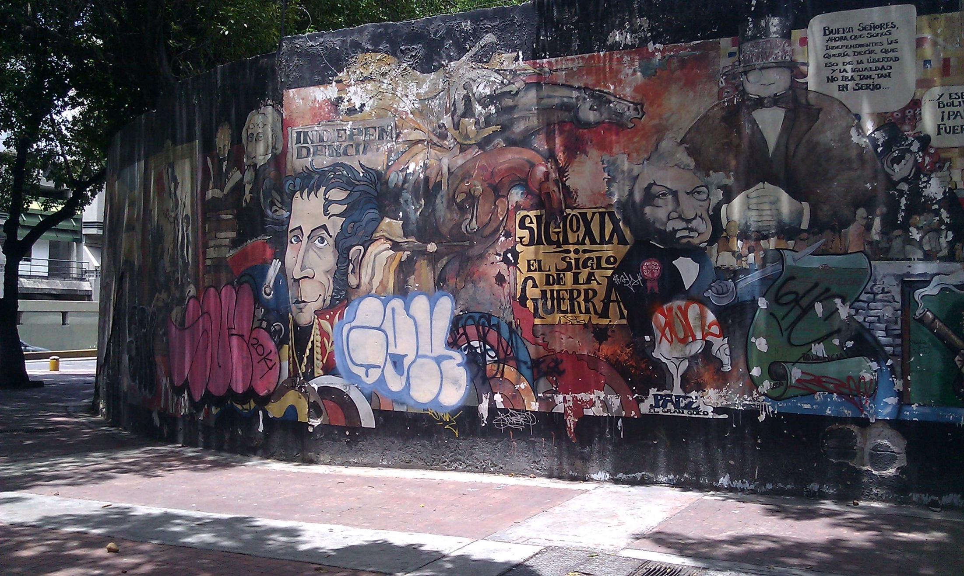

Slide 35
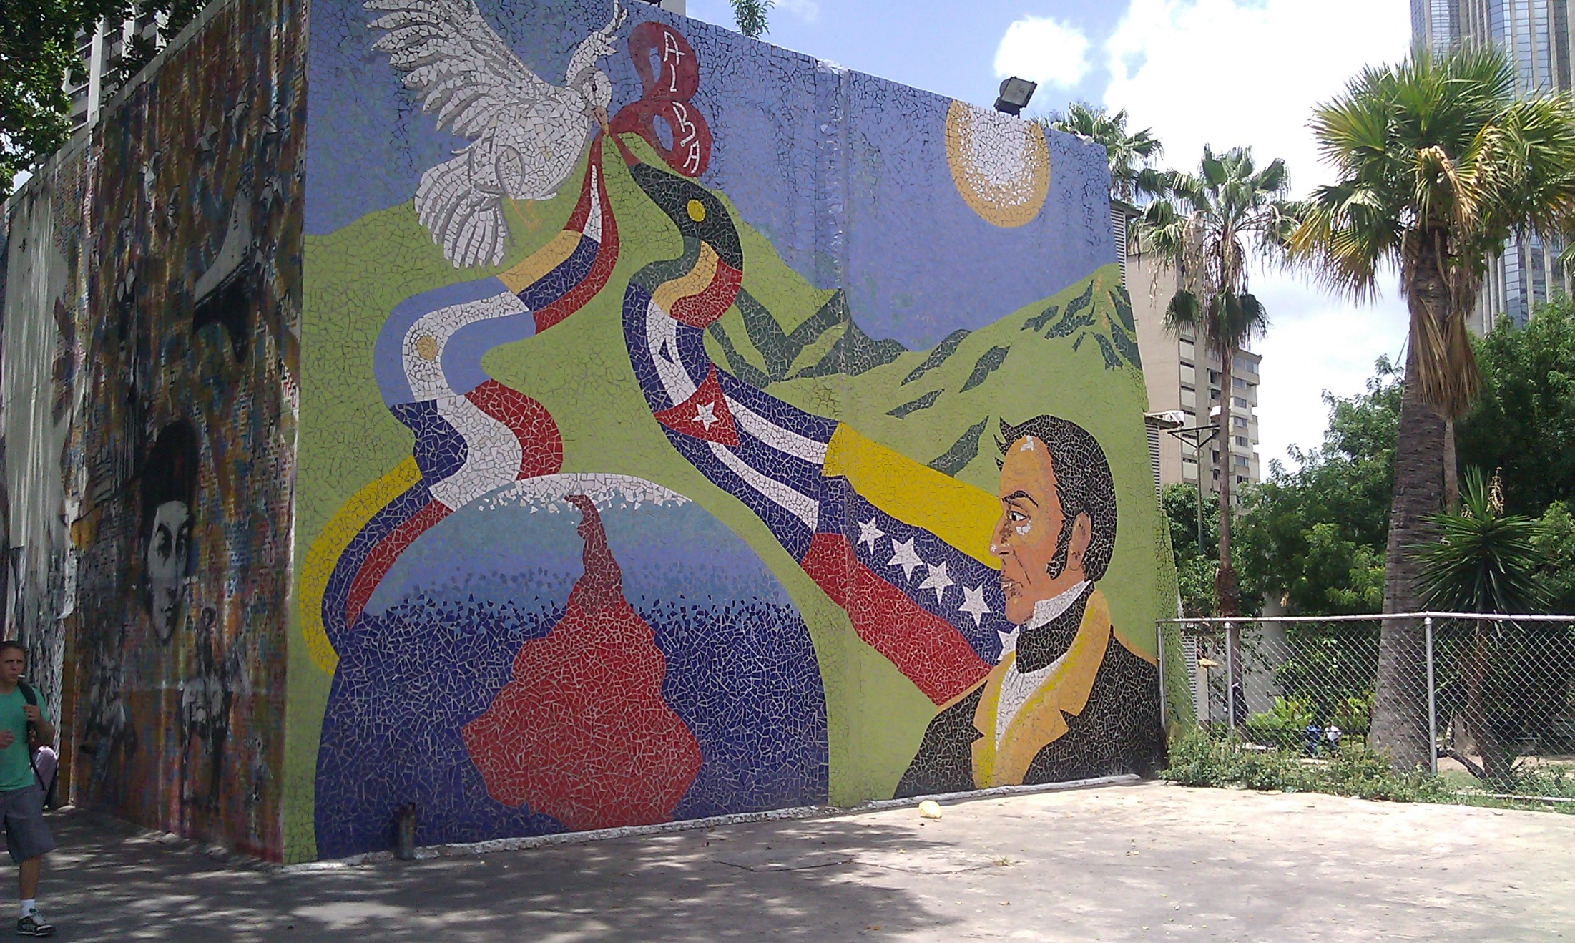

Slide 36
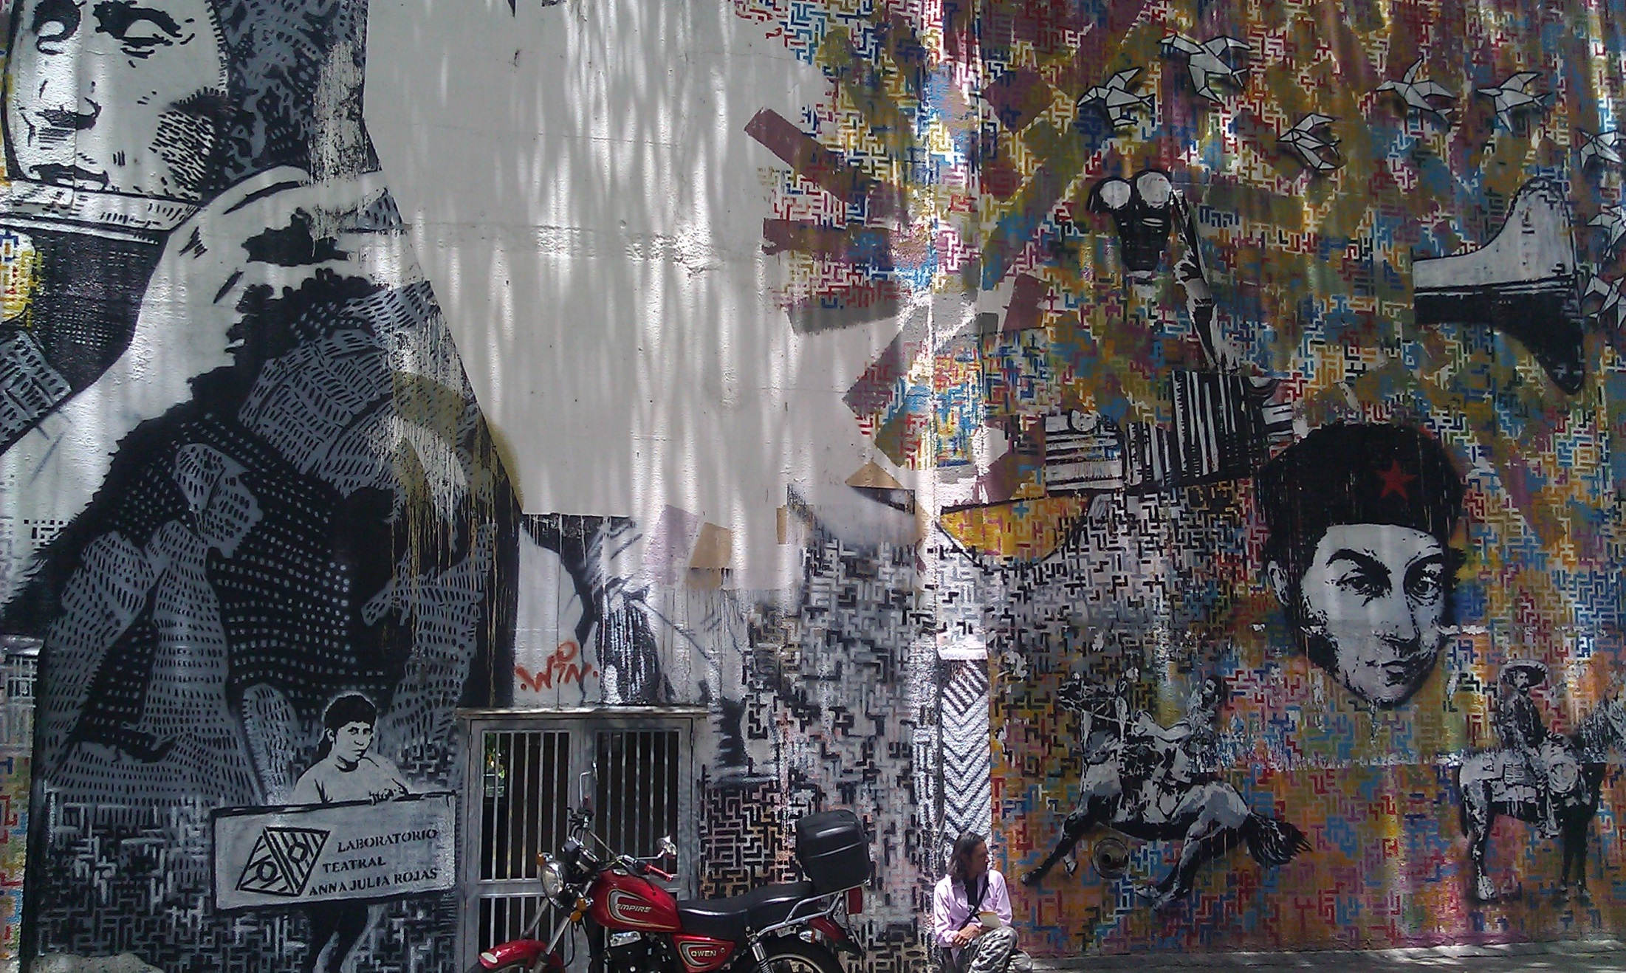

Slide 37
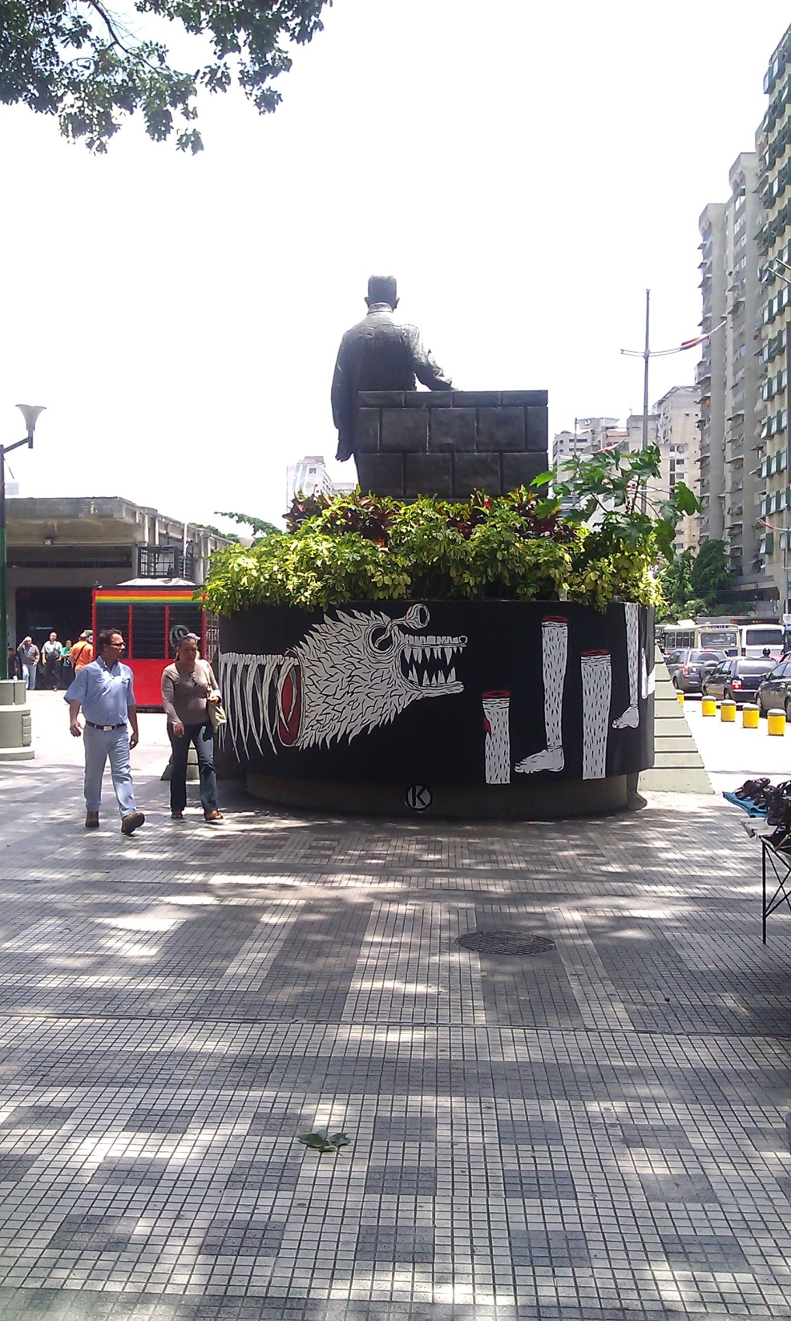

Slide 38
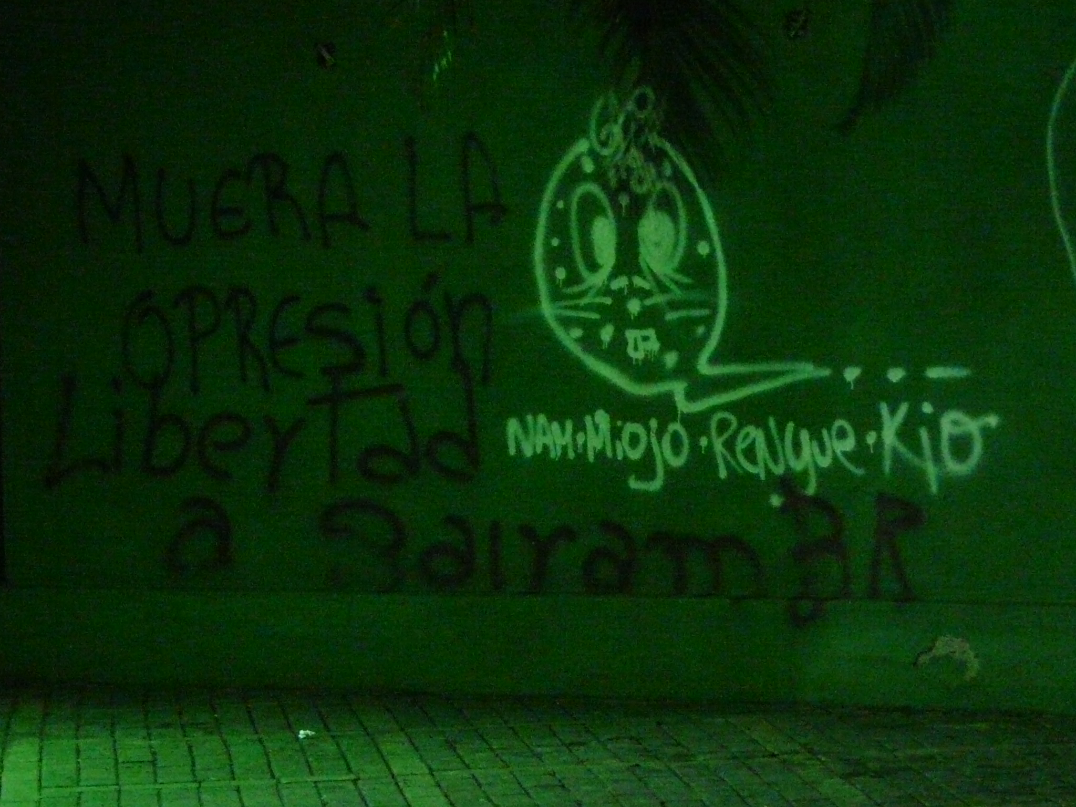

Slide 39
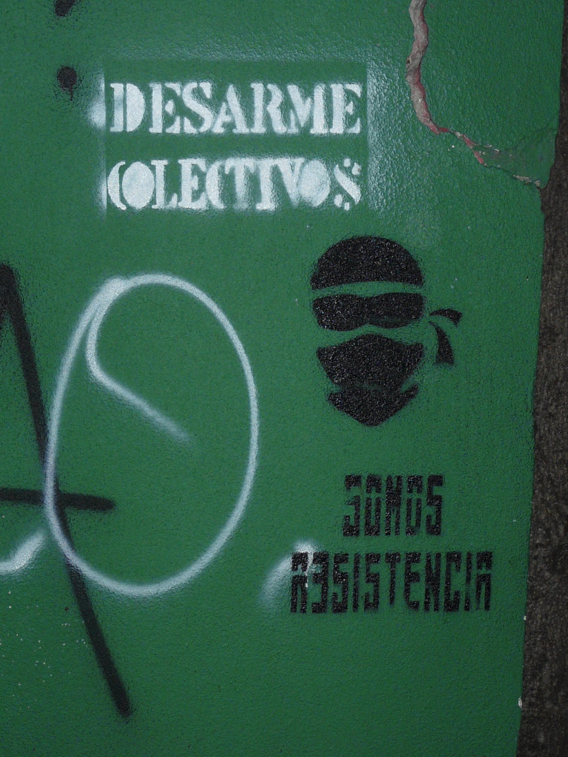
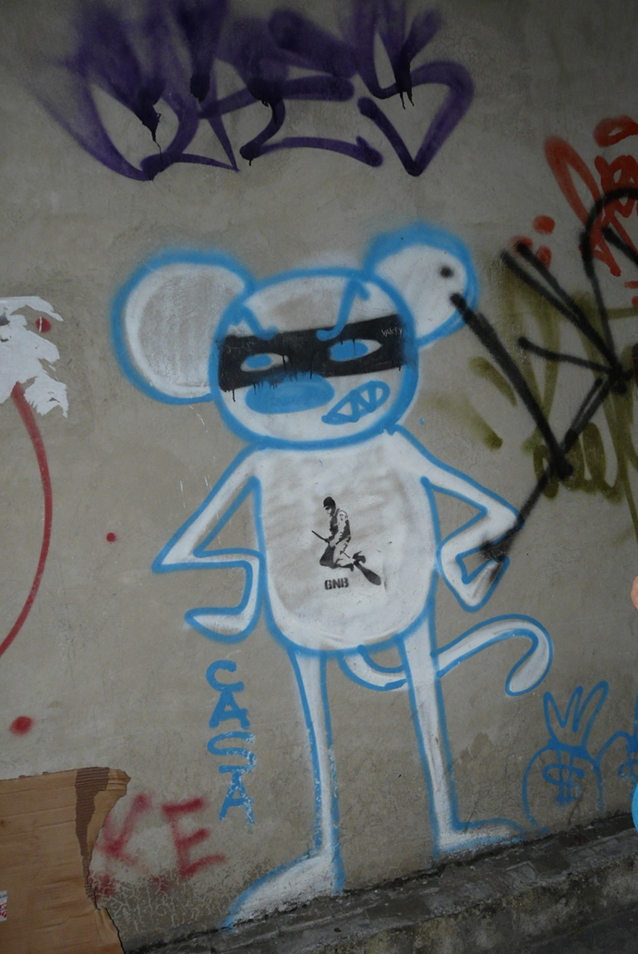

Slide 40
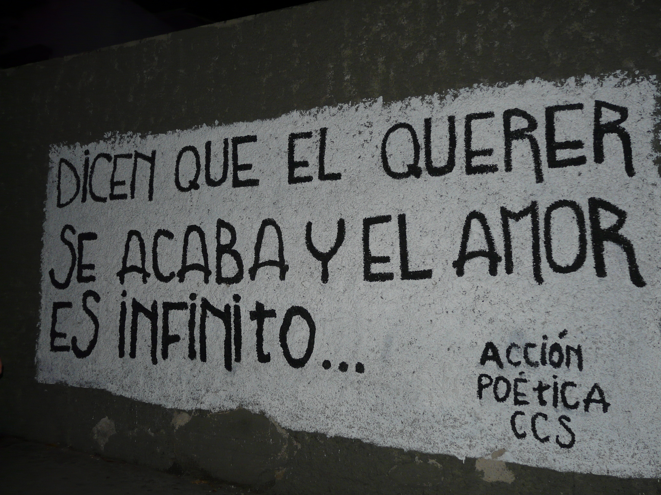
They say that the wanting to be just and the love is infinite

Slide 41
Canada
Images by Taina Kanerva

Slide 42


Slide 43
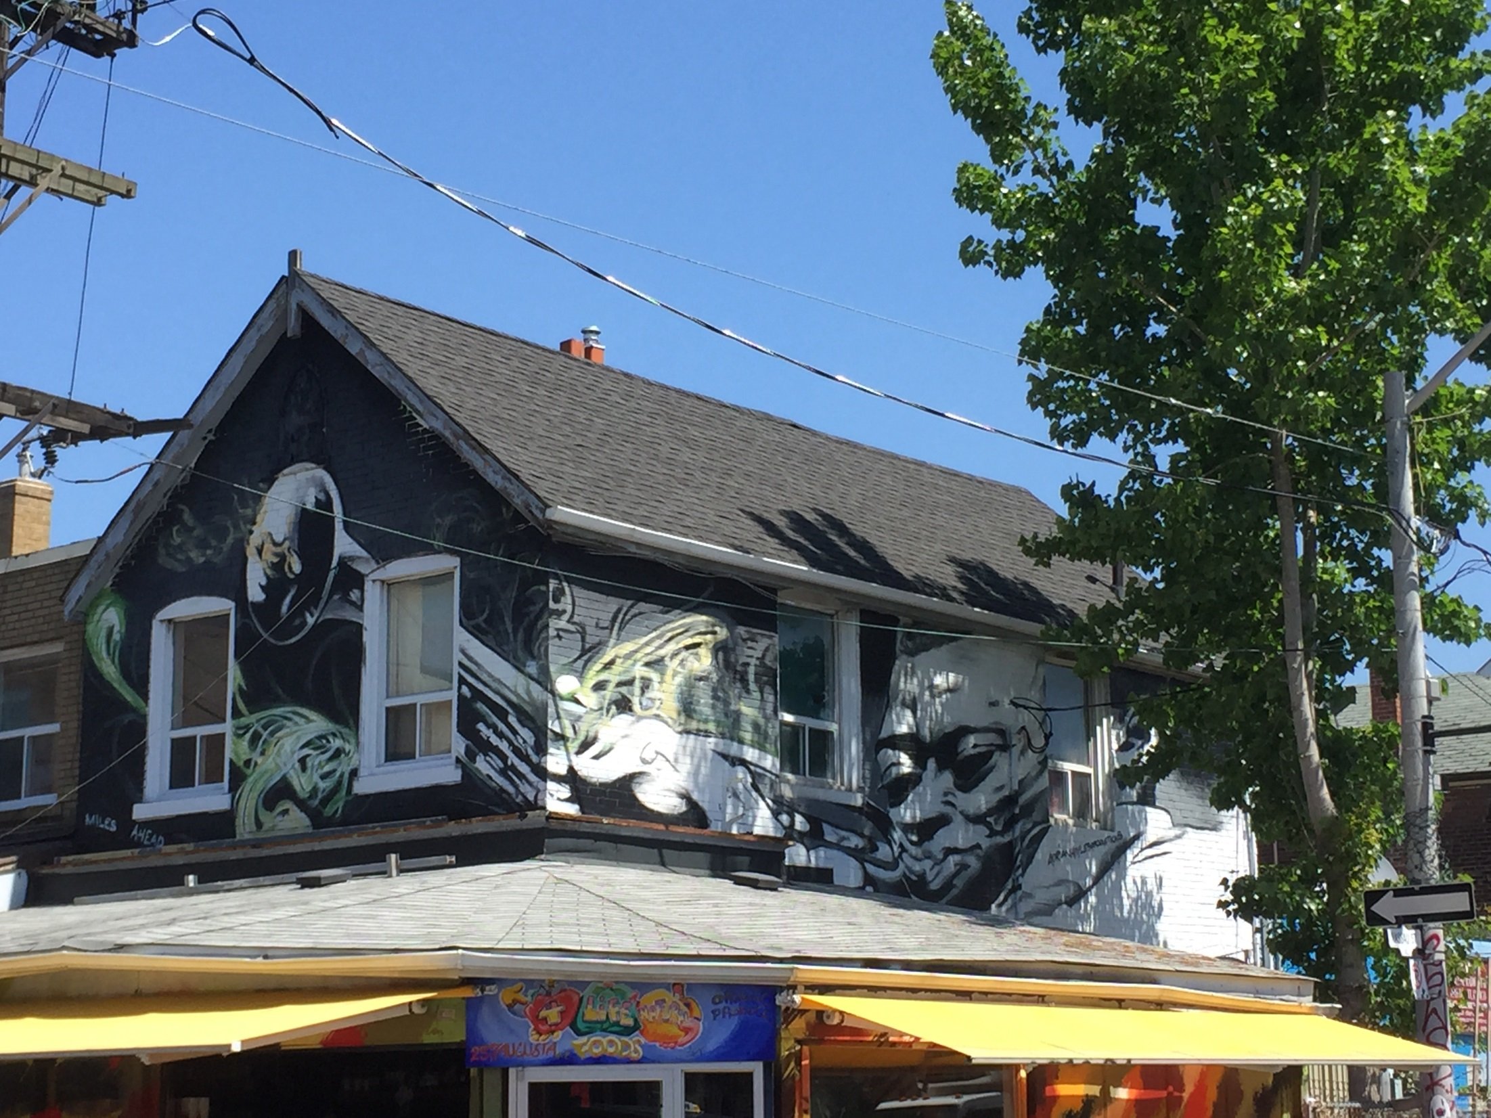

Slide 44
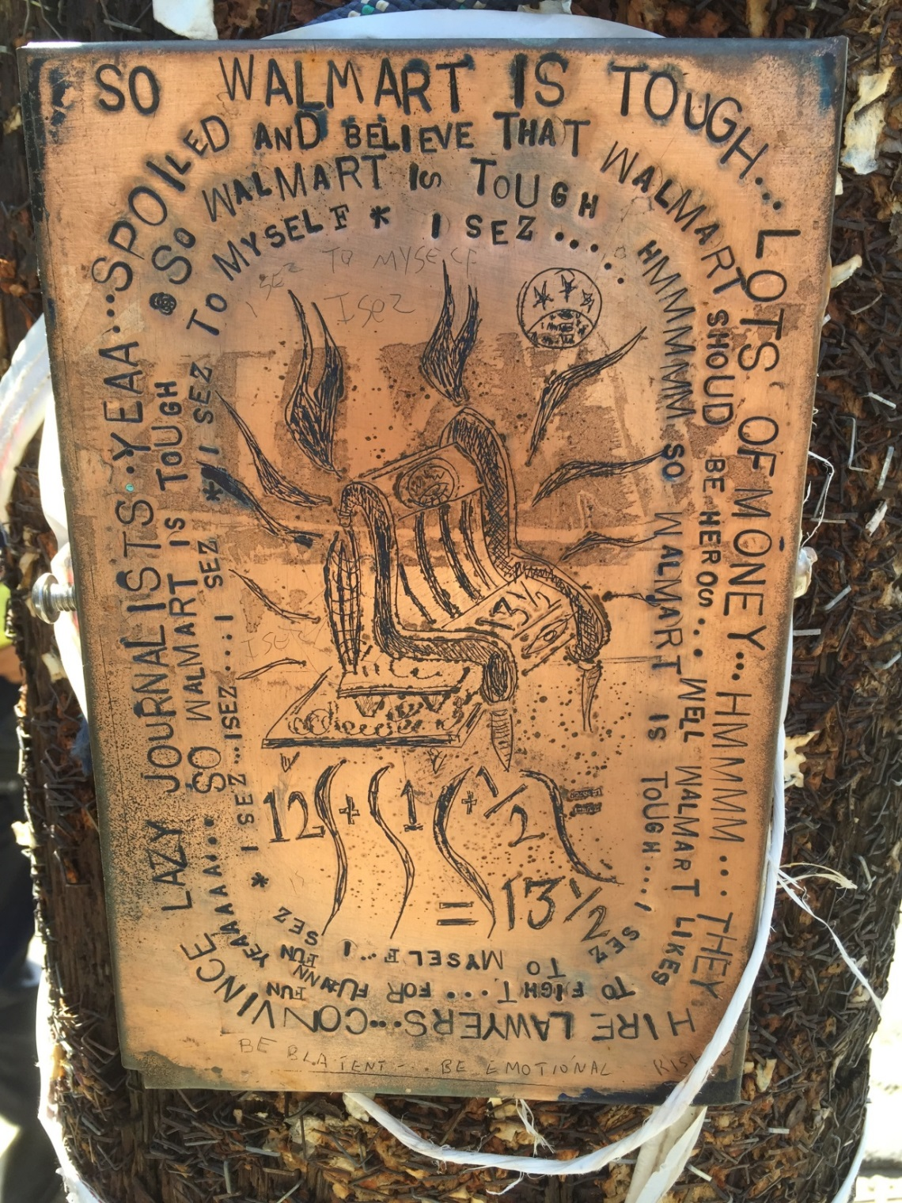

Slide 45
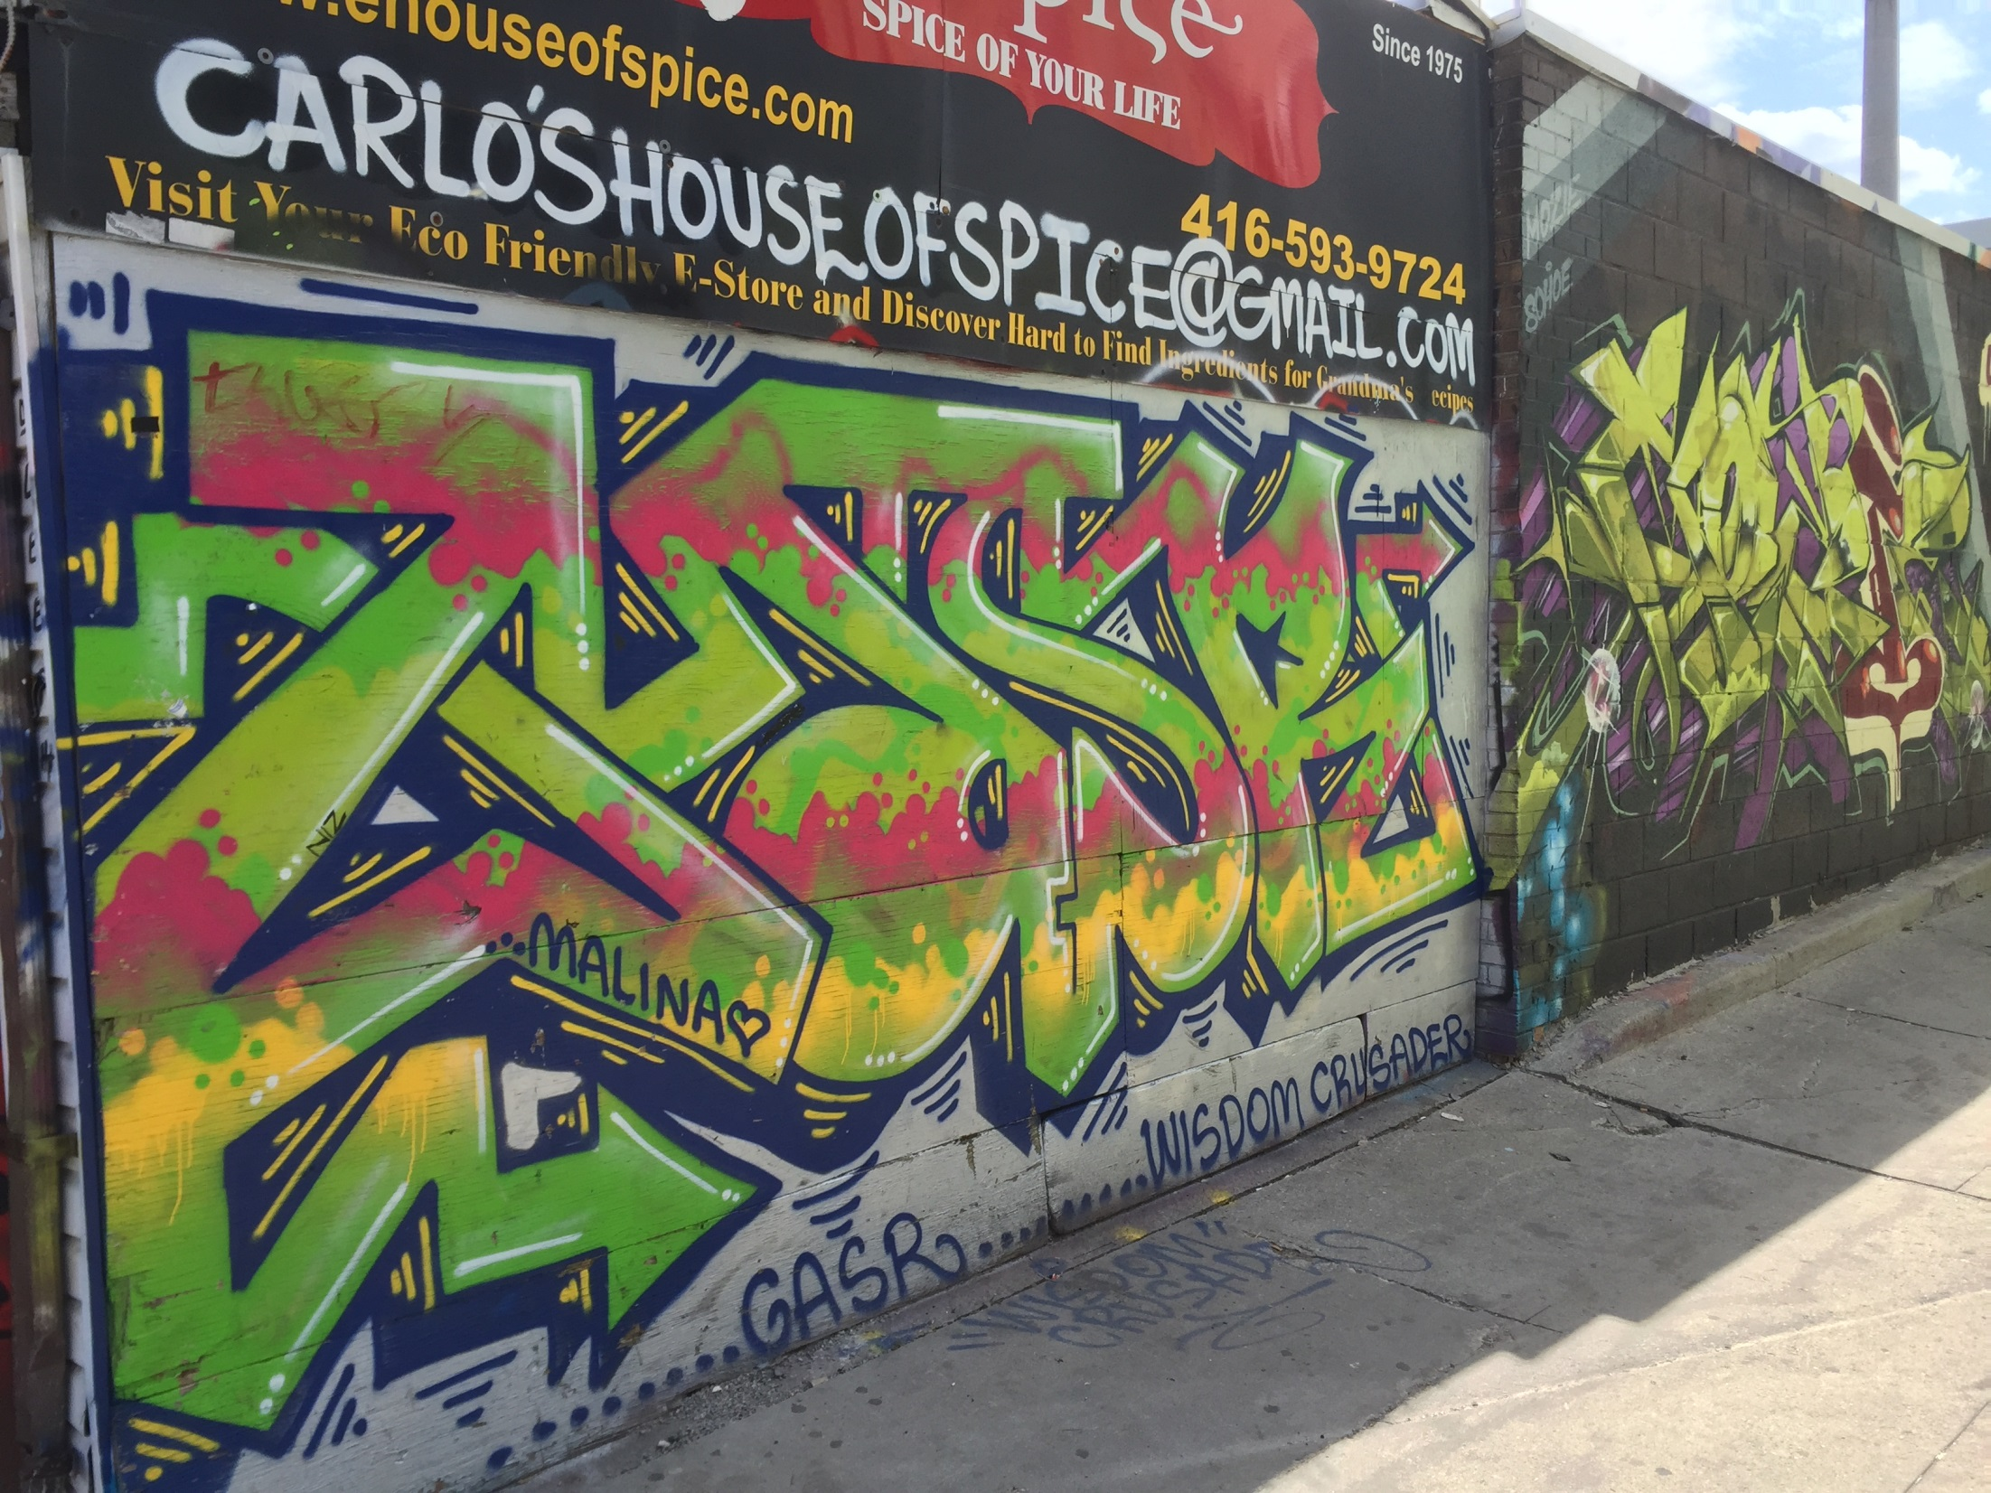

Slide 46
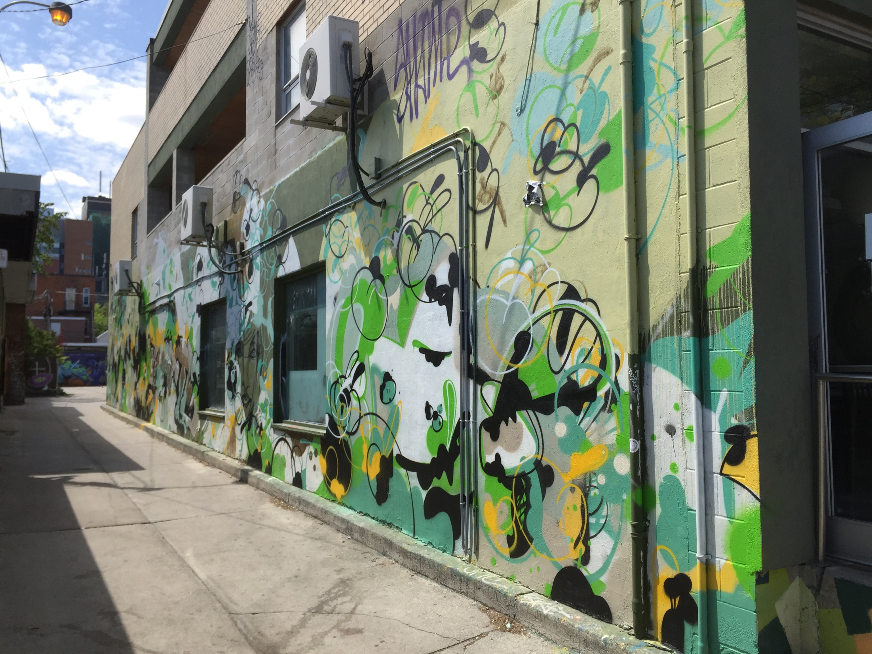

Slide 47
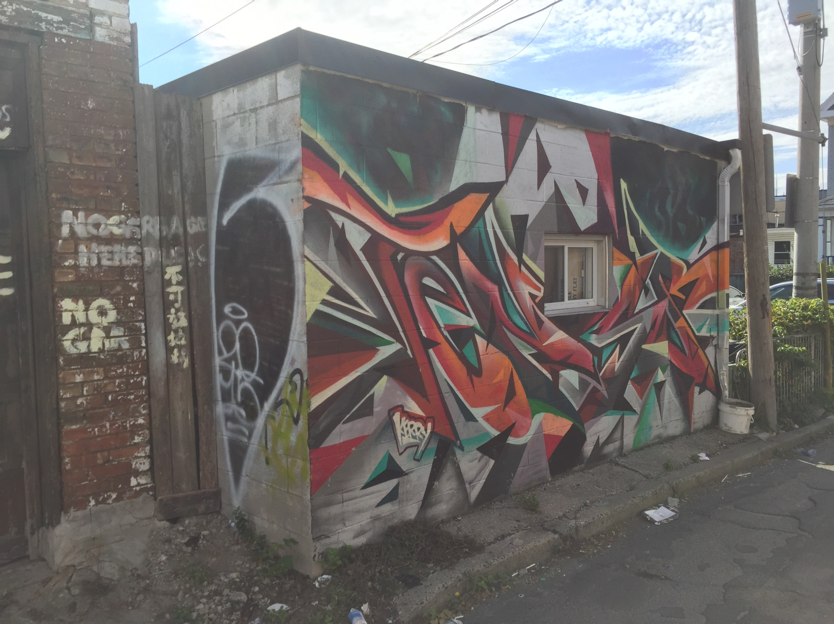

Slide 48
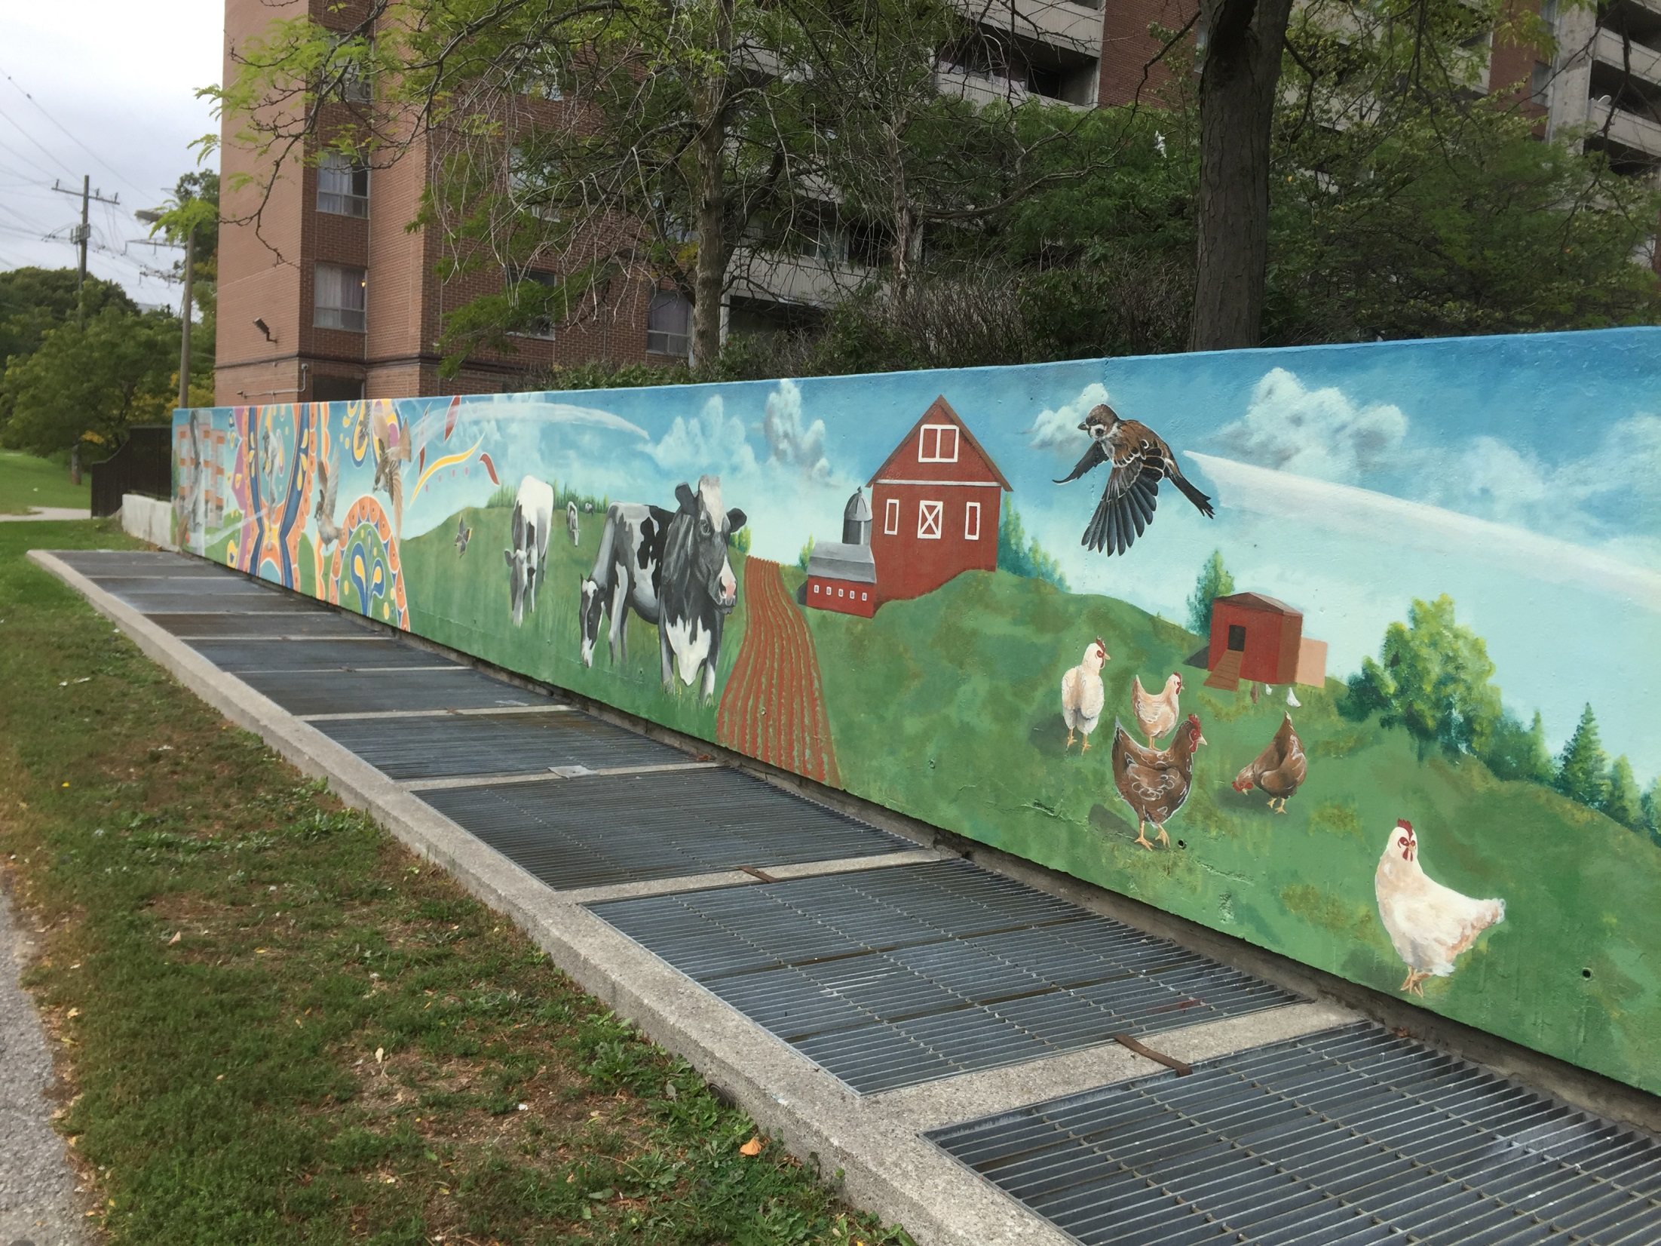

Slide 49
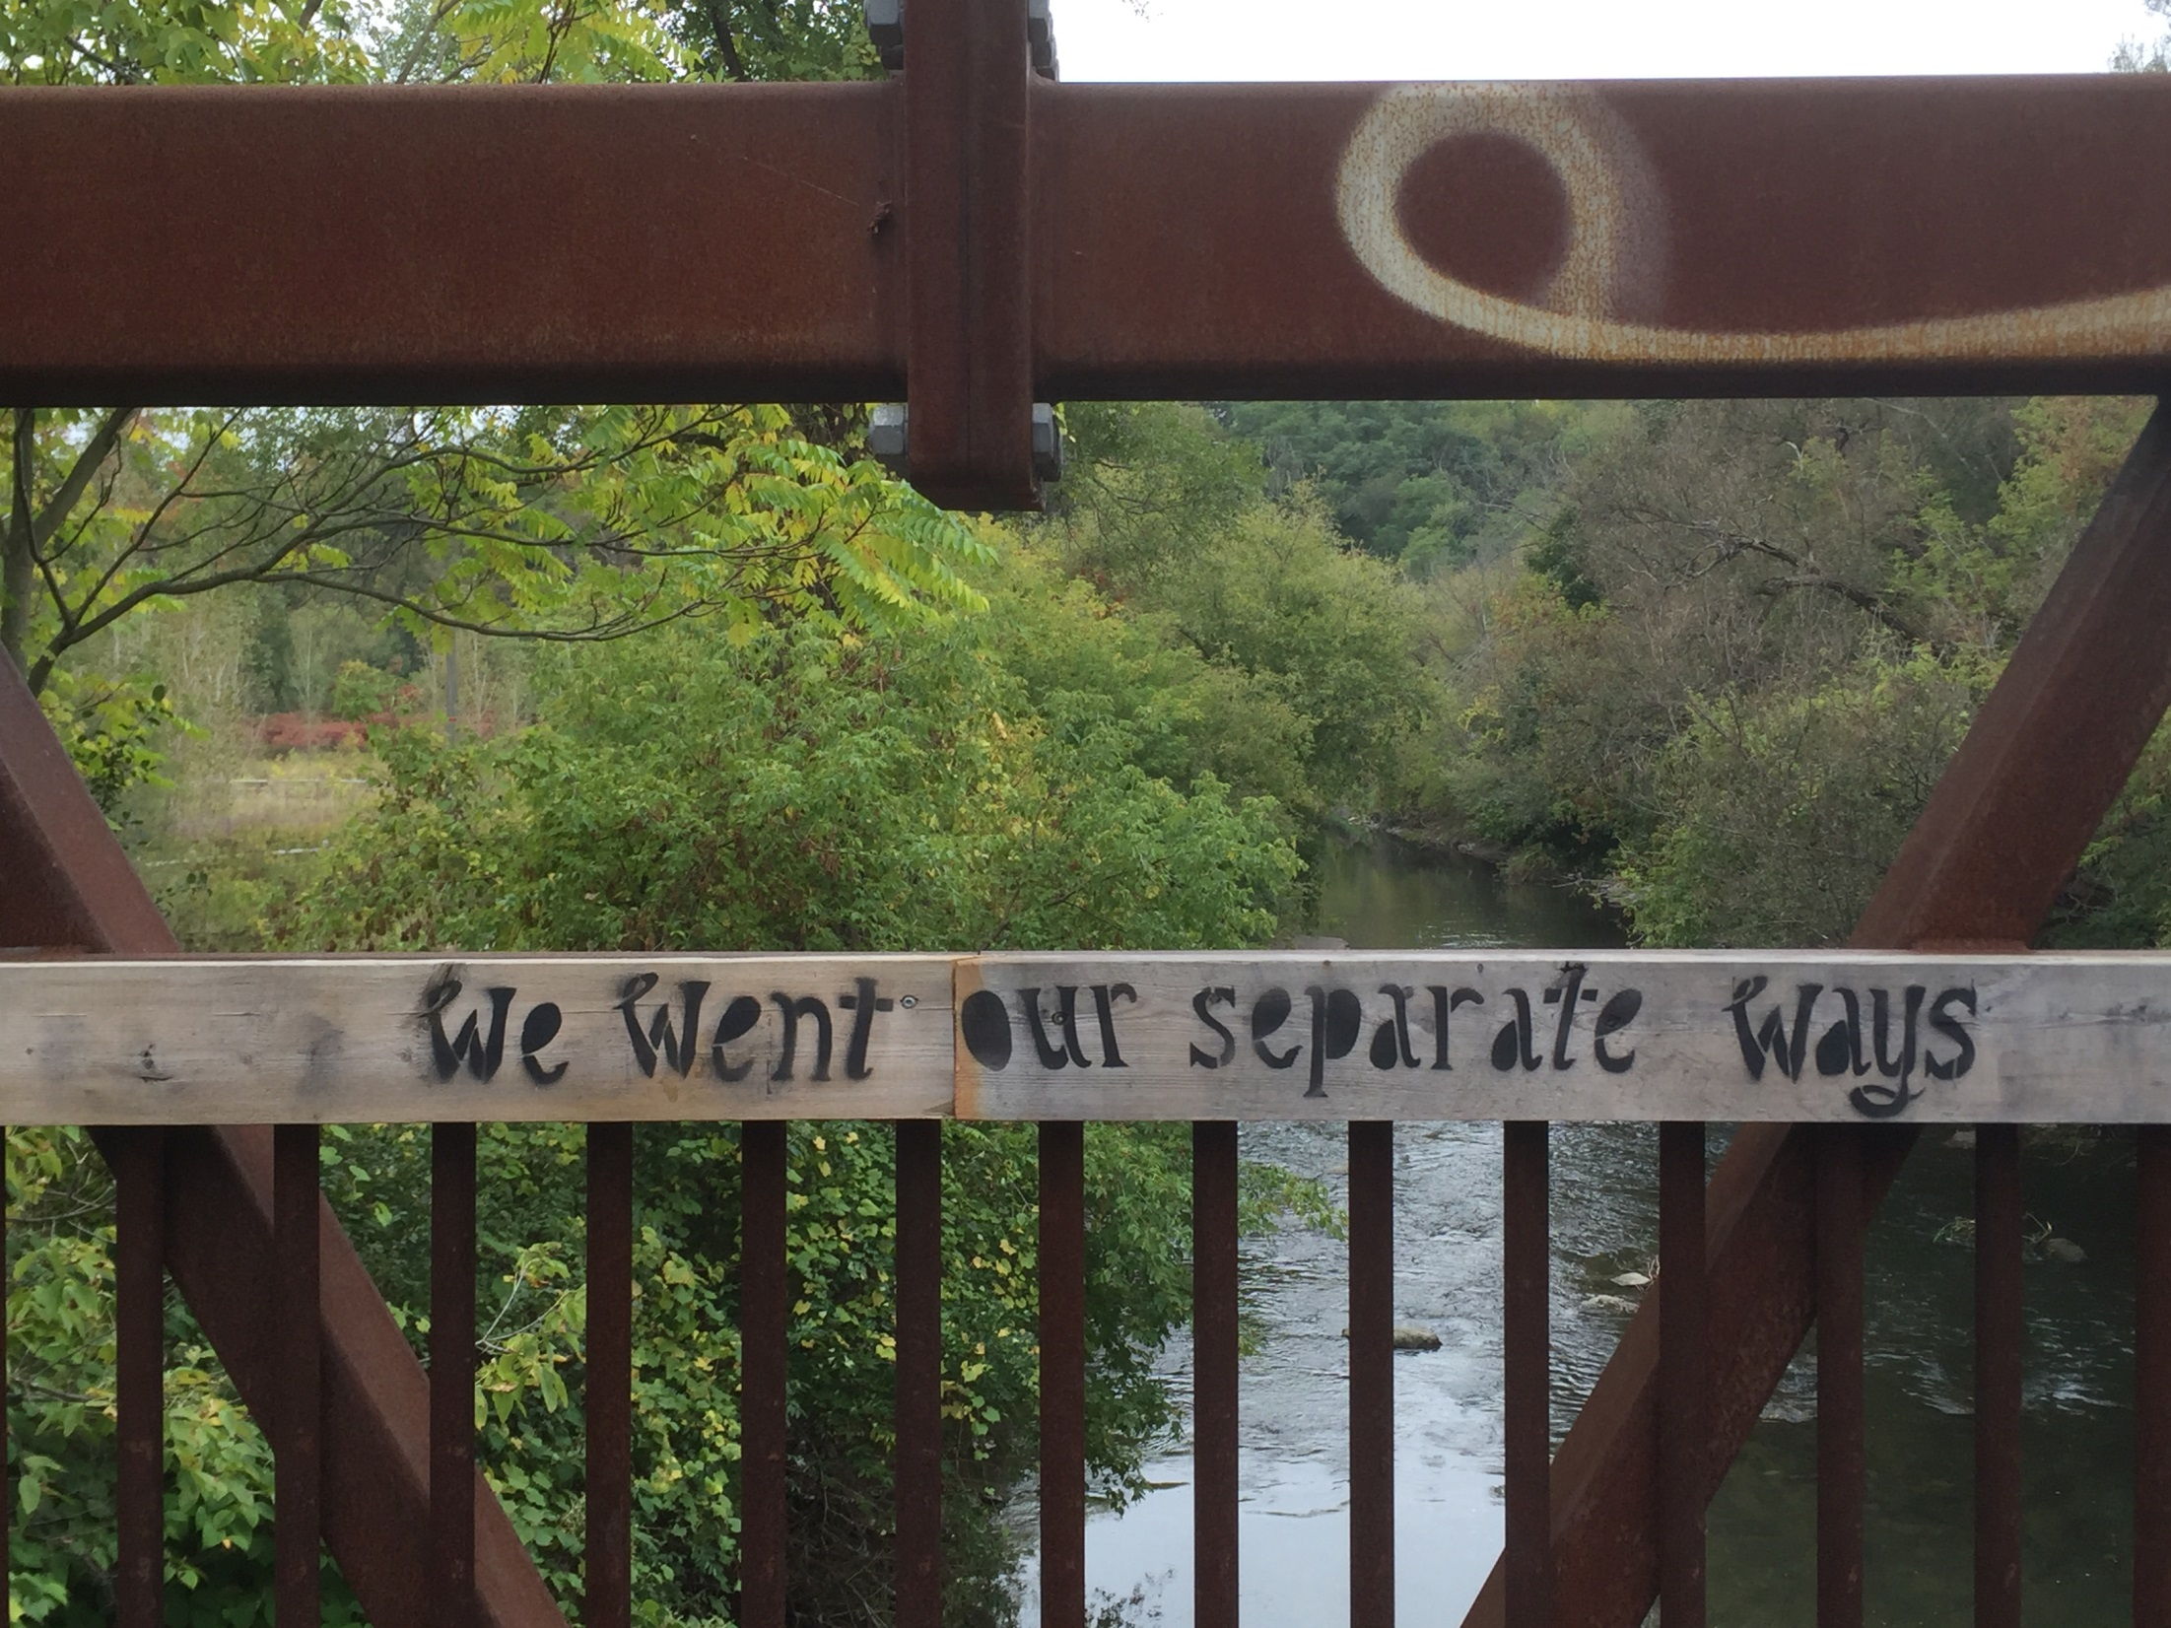

Slide 50
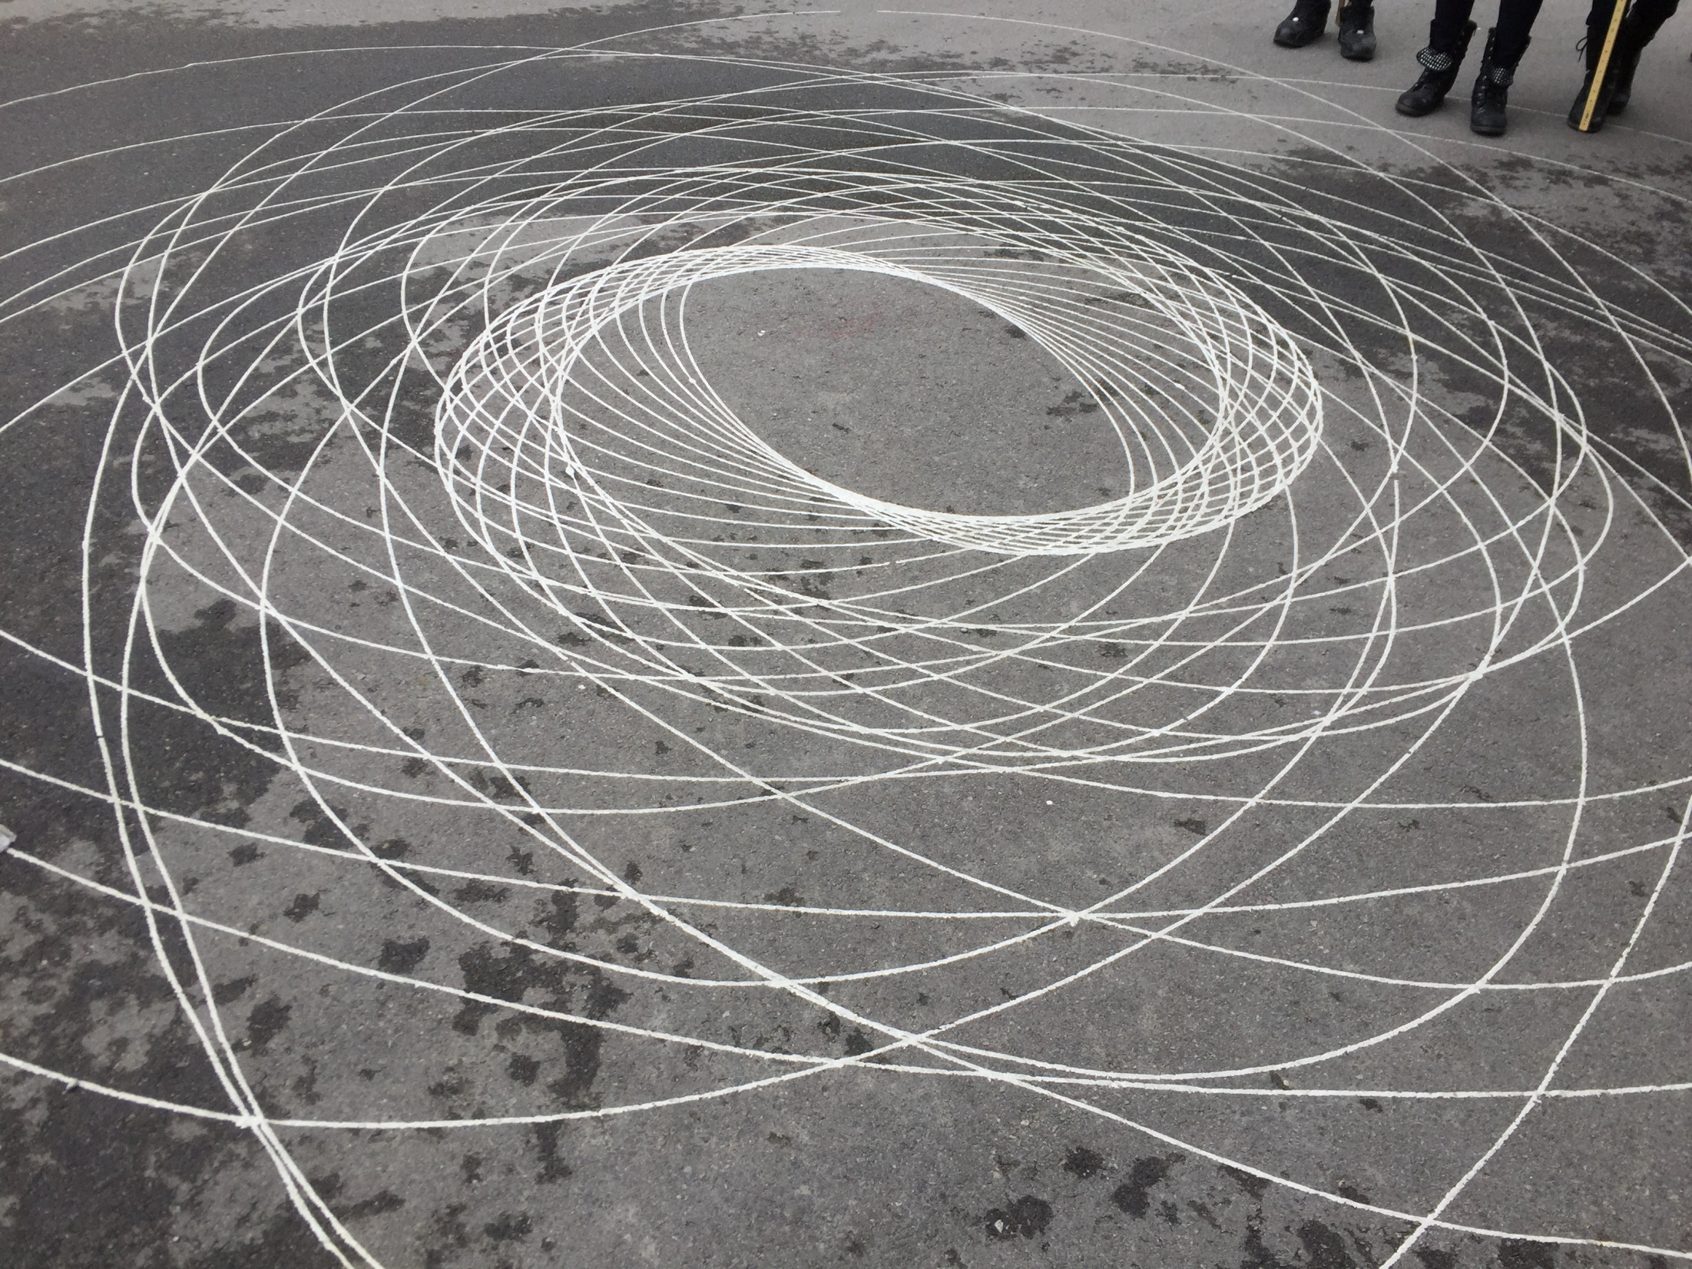

Slide 51
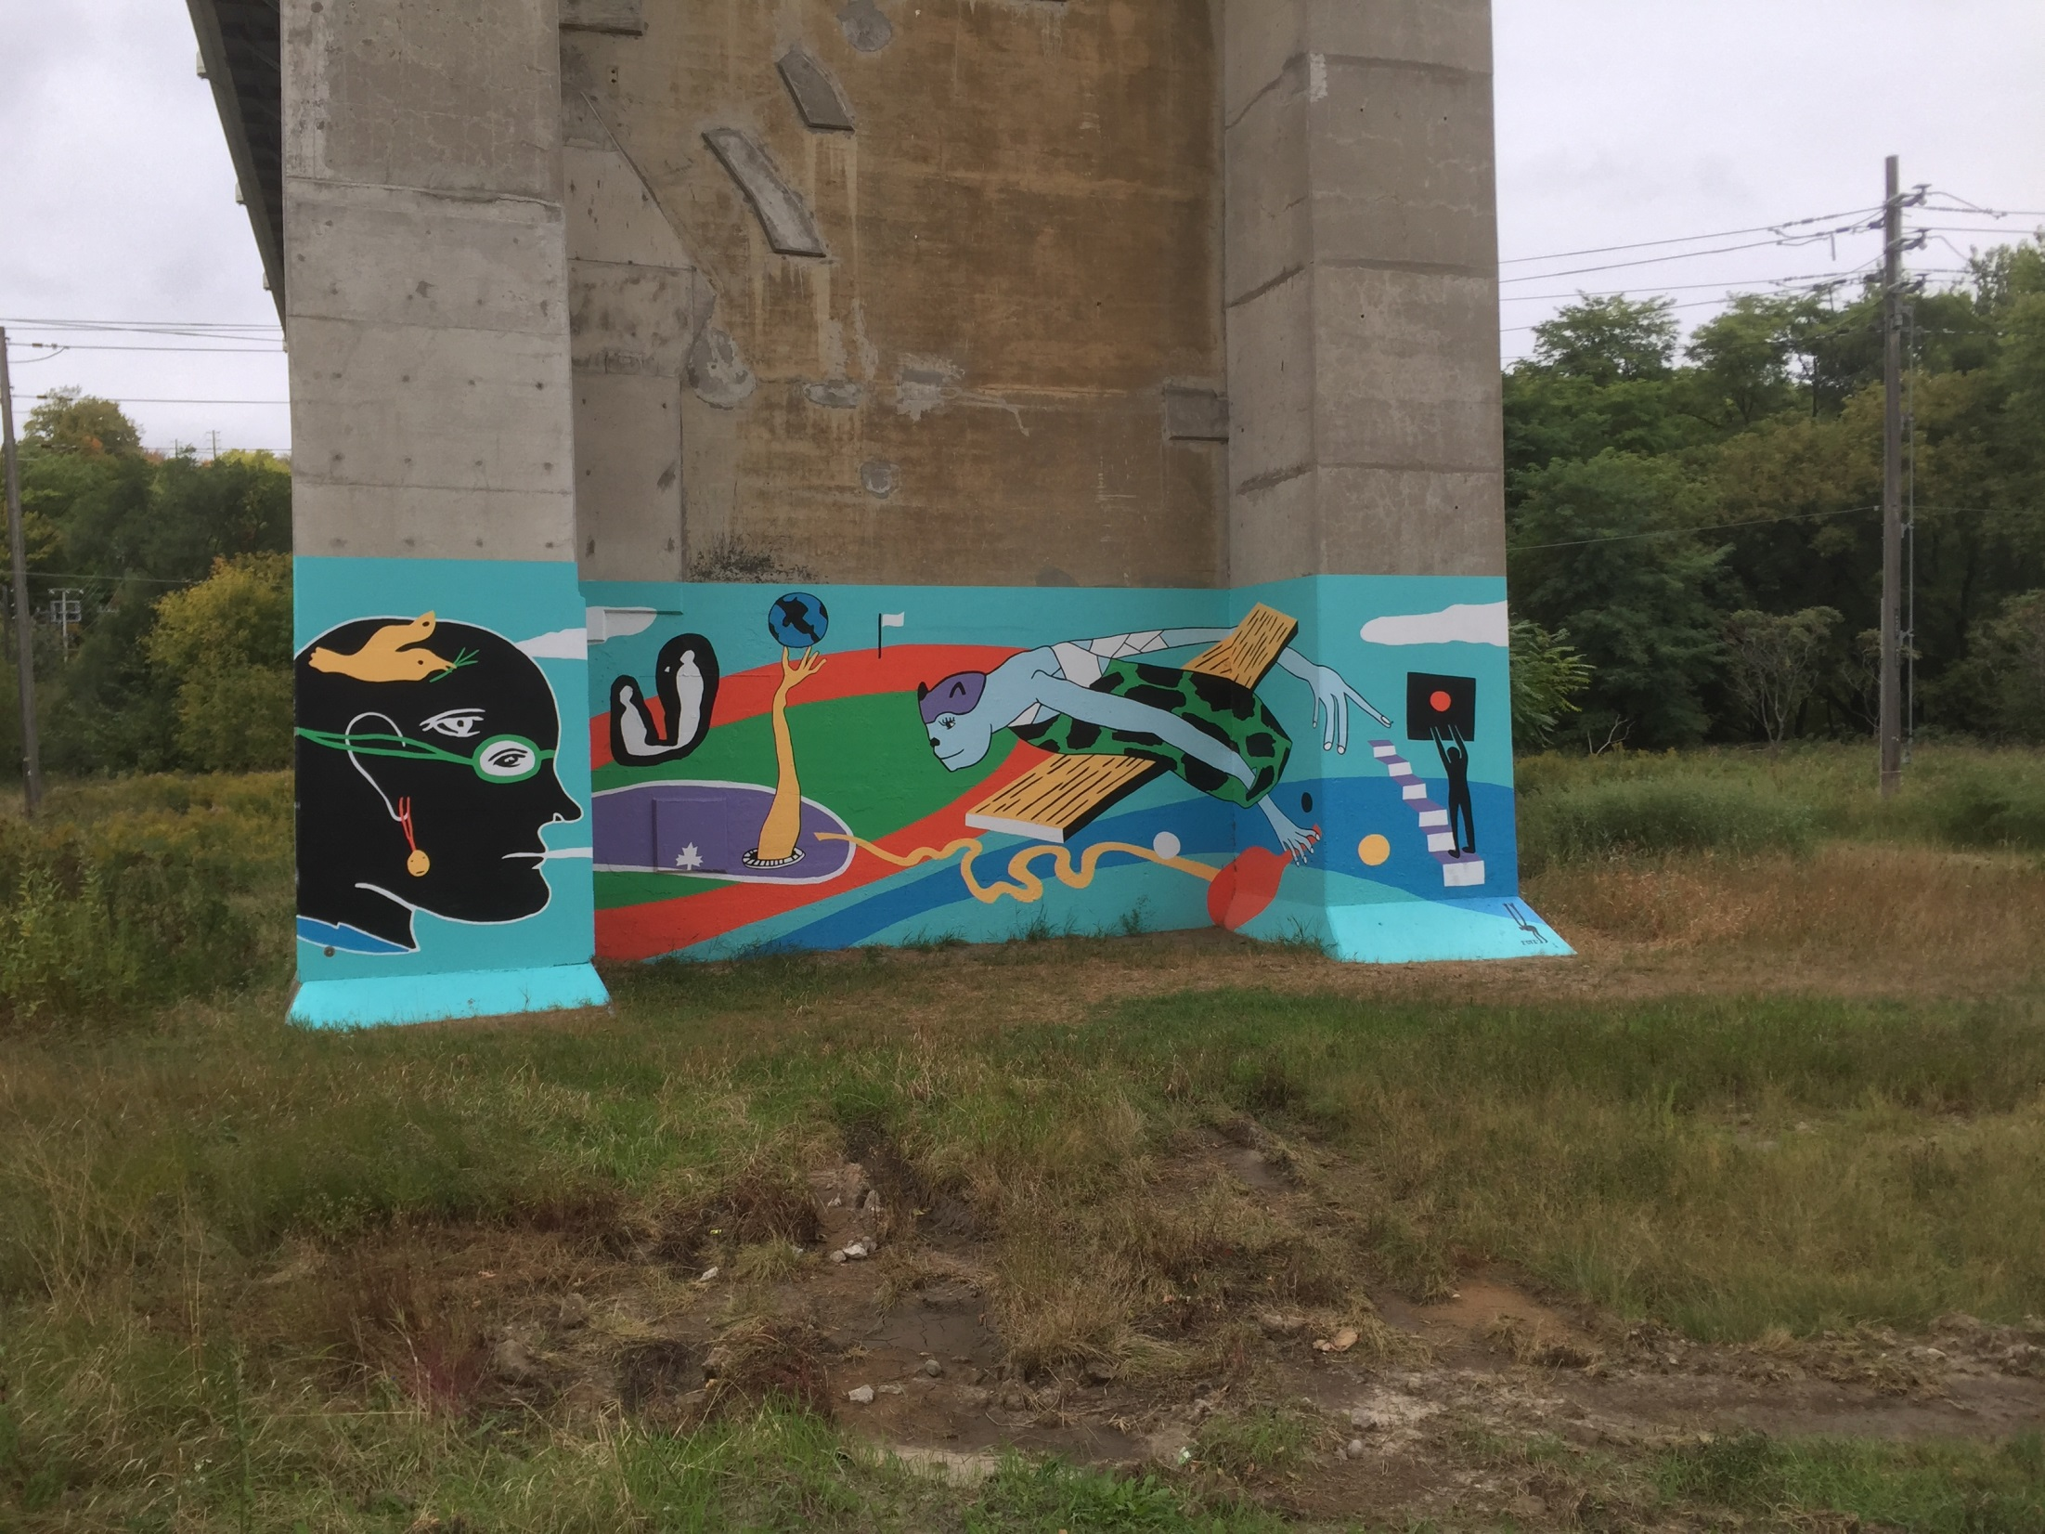

Slide 52
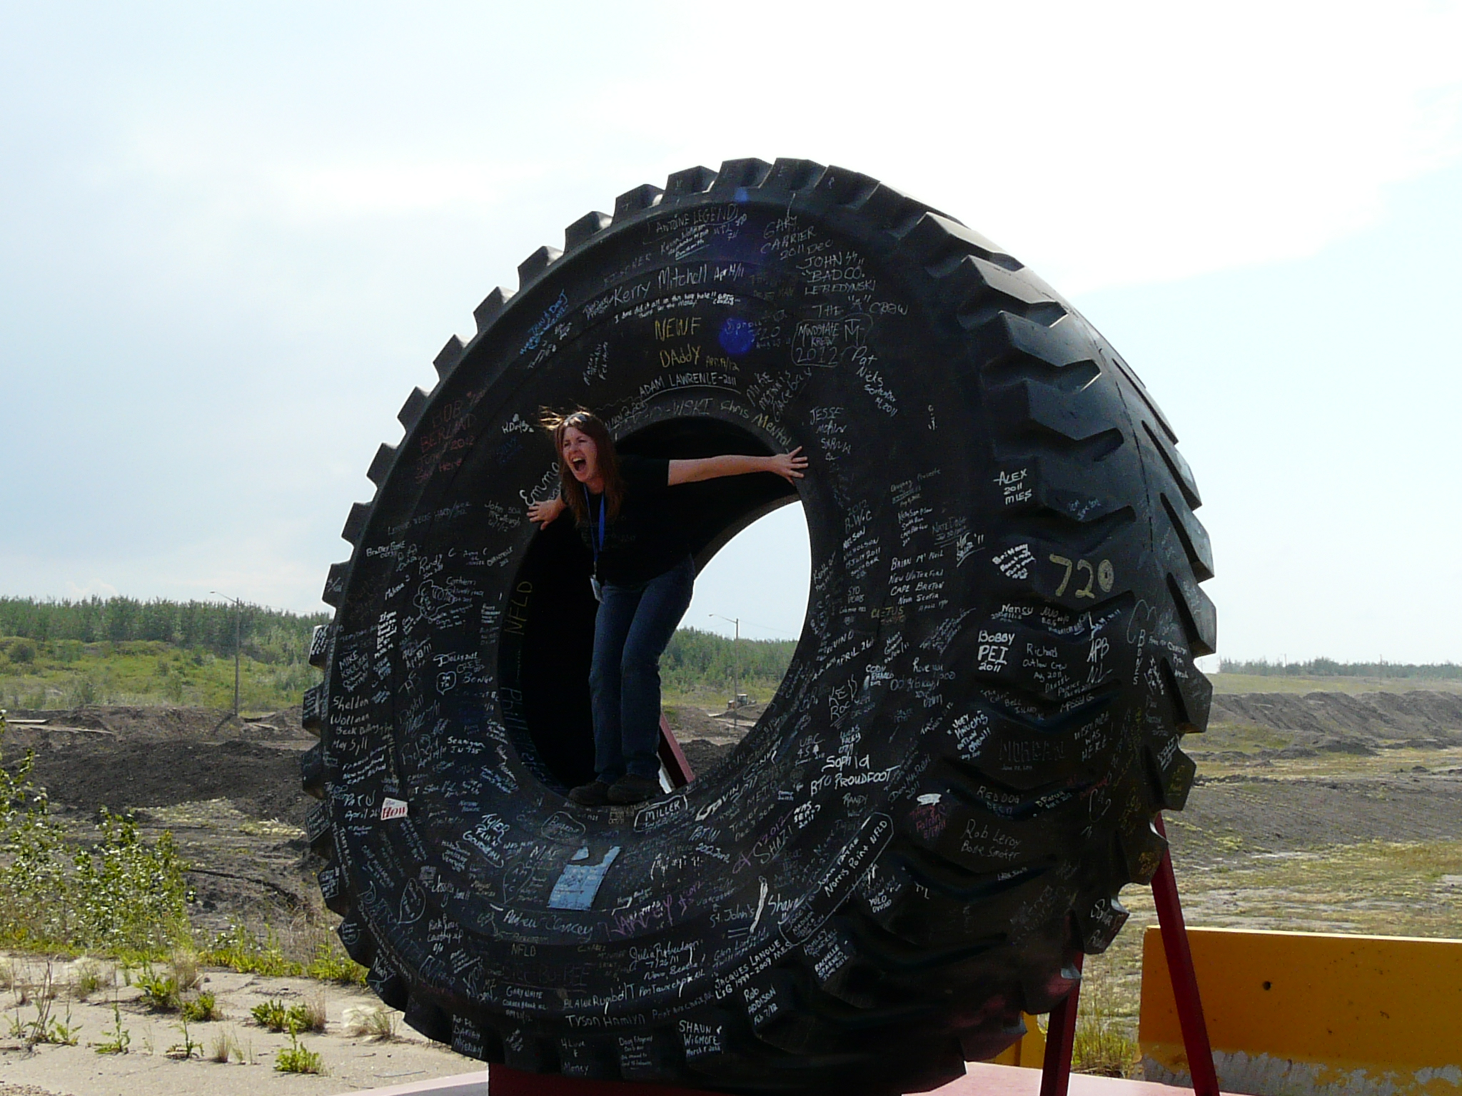

Slide 53
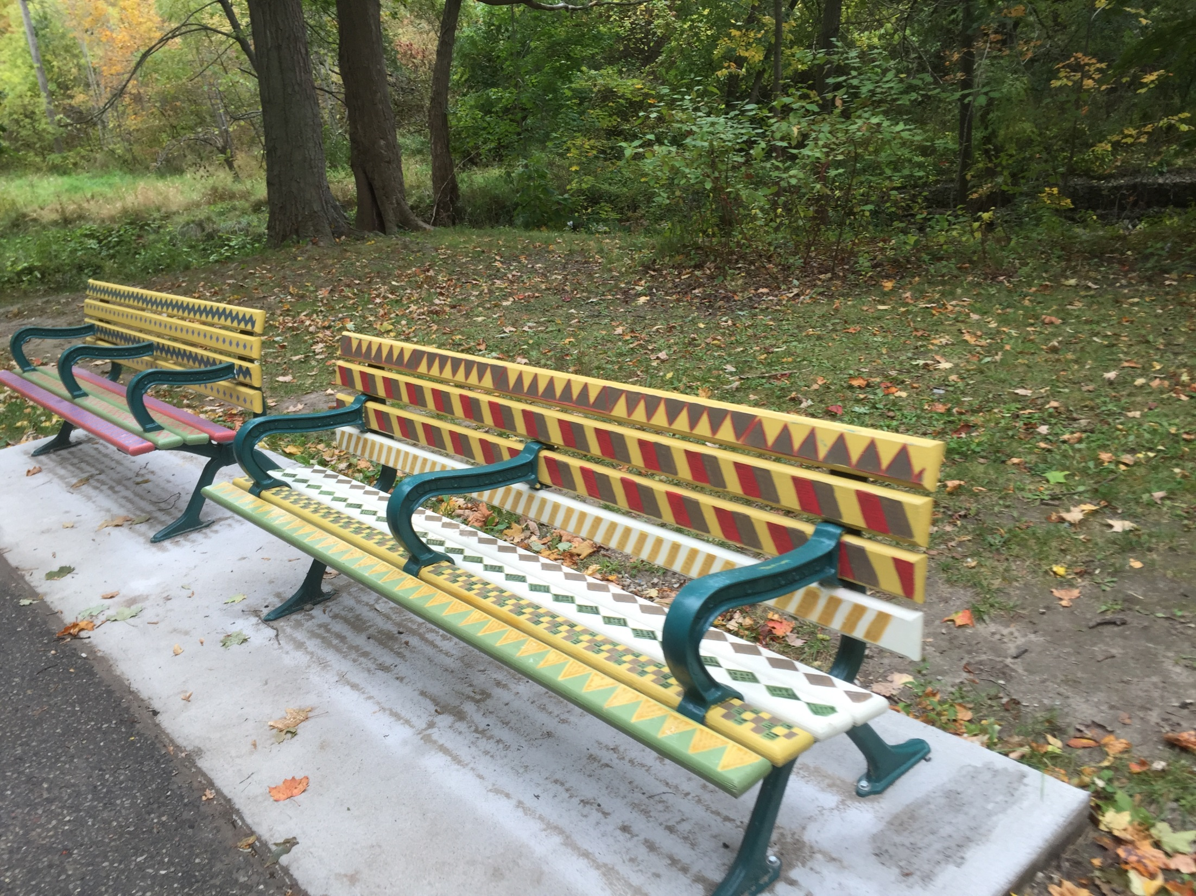

Slide 54
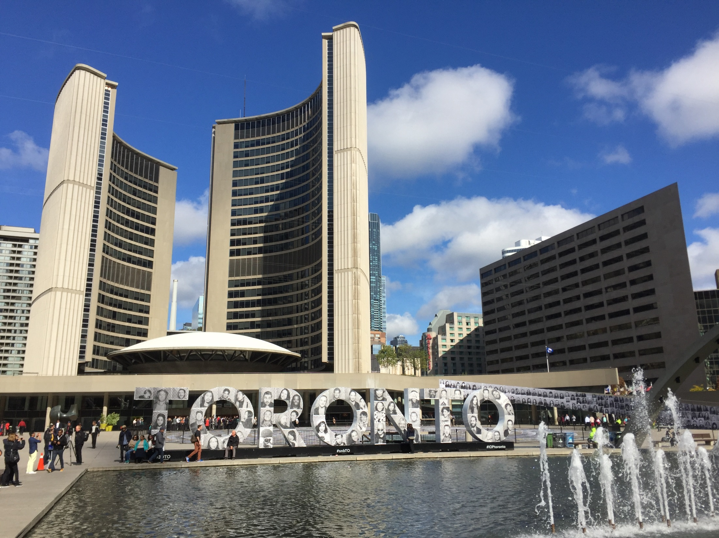

Slide 55
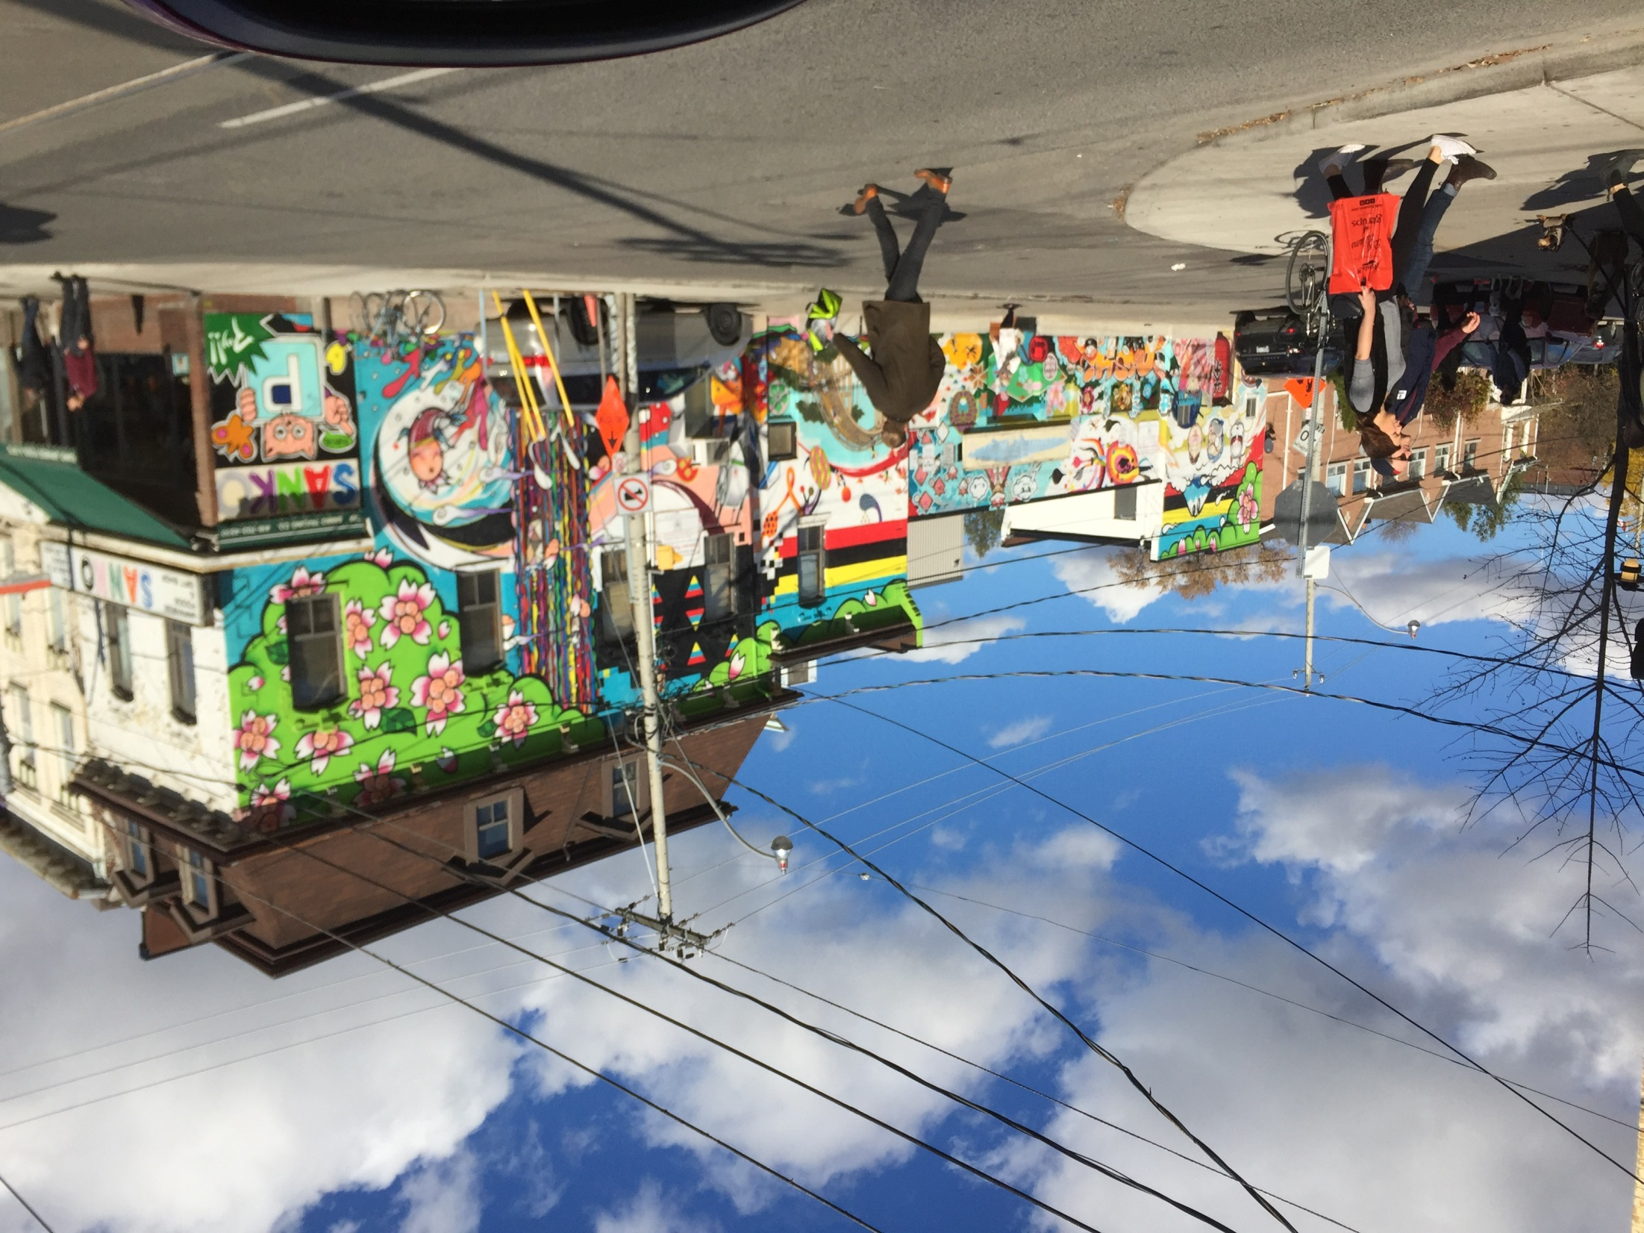

Slide 56
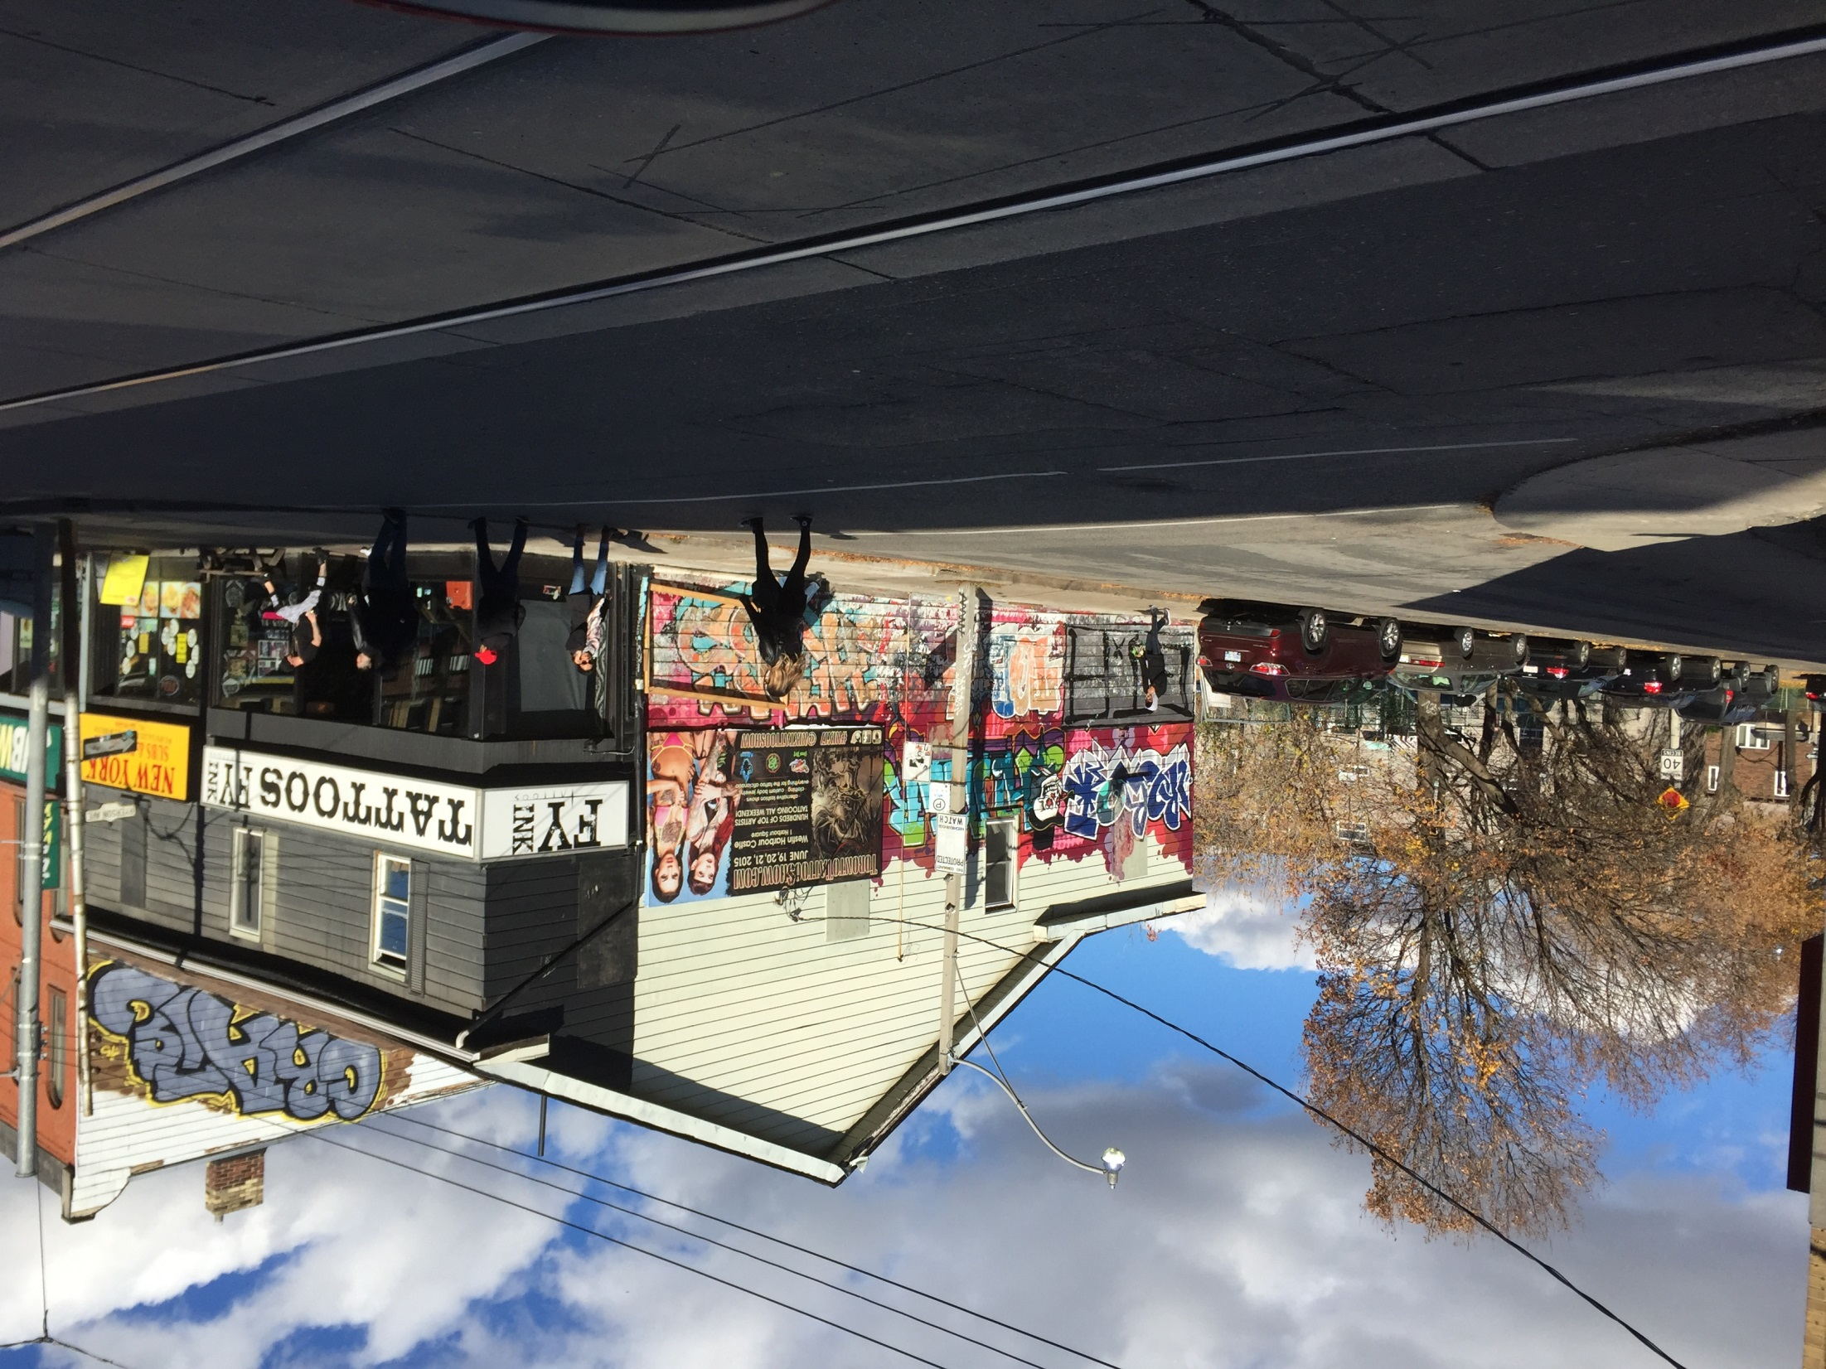

Slide 57
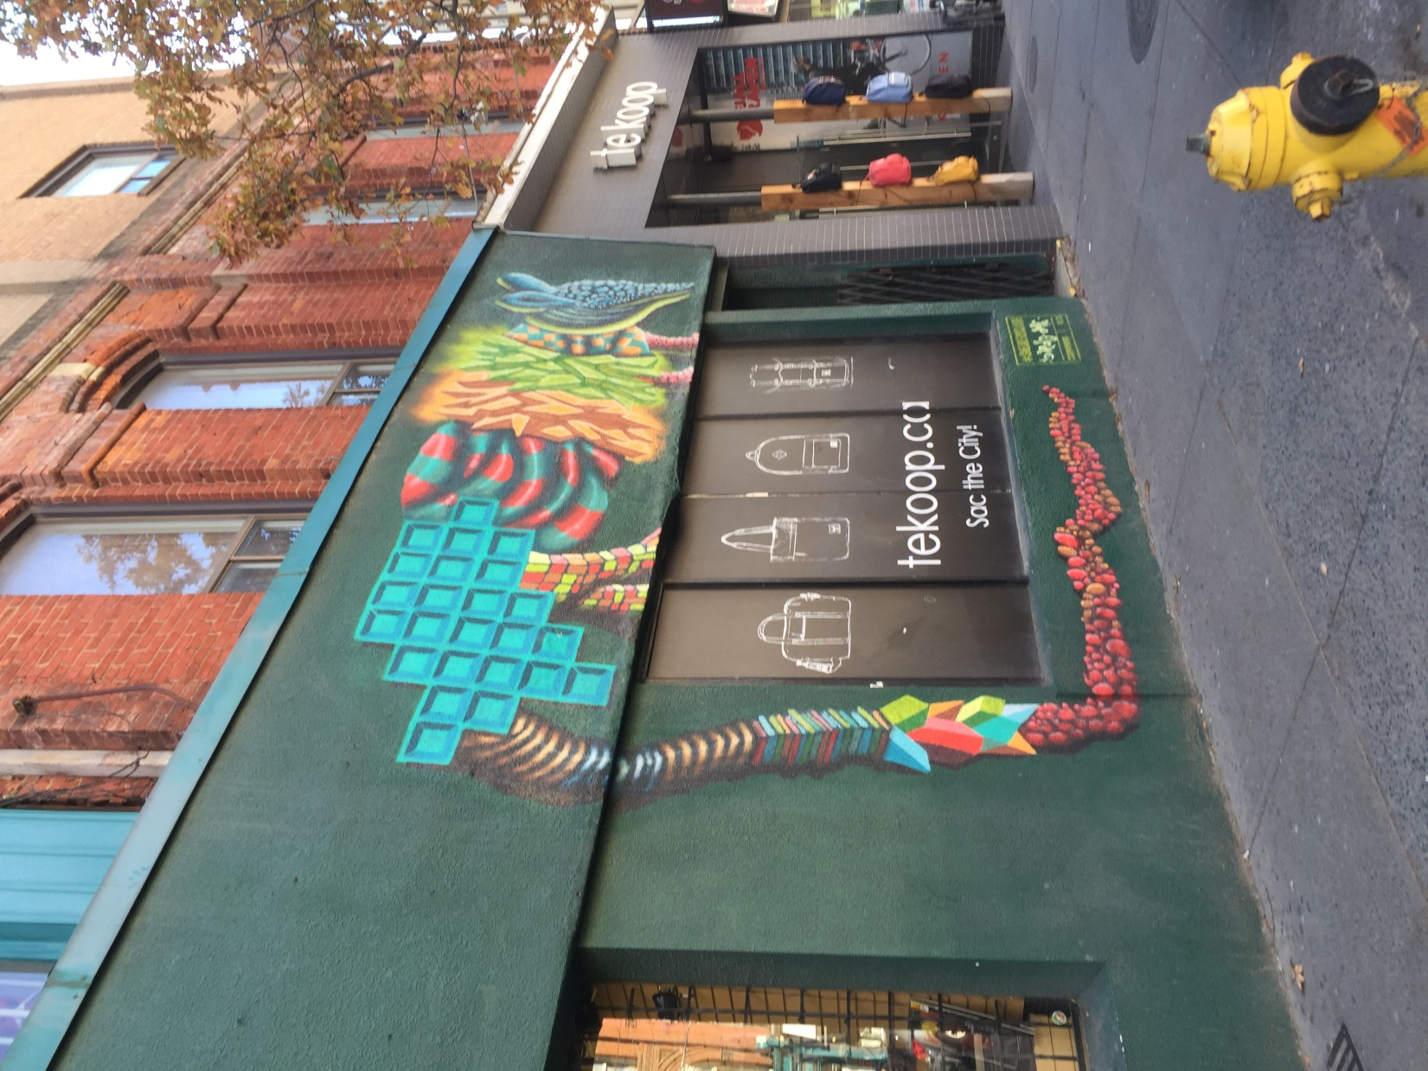

Slide 58


Slide 59


Slide 60


Slide 61


Slide 62


Slide 63
Now that you have examined the images, let’s discuss the questions:
Is there a common thread to the images?
How do I feel looking at these images? Note any reactions or feelings that they evoke.
How is the graffiti different in each of the countries?
How do you view the country given the images you have seen?
Would seeing these images have any influence on people living within the given society? If so, explain.
Does this form of art have value?

Slide 64
Final thoughts…
What are the images you see on the street in your community?
What do these images say to visitors about your community?
How do these images influence the people who live in your community?
Are there images or changes you would make to your community to include more or less street art? Explain your response.

