Slide 1
Grassroots movements

Slide 2
A quick definition
Merriam-Webster defines grassroots as:
The very foundation or source
The basic level of society or of an organization especially as viewed in relation to higher or more centralized positions of power
In basic terms, a grass roots movement starts from nothing
Like actual grass roots, they start from the ground and grow up
Run by the people

Slide 3
Bottom up
Grassroots are not controlled or started by the people already holding power
The Civil Rights Movement of the 1960’s
Began by a small group of people with a common goal
Used methods like church meetings, sit-ins, letter writing, and marching to get their message across
The Occupy Wall Street Movement
Direct action by citizens who were upset by the growing inequality
Started with the idea of a few, but that idea resonated with many

Slide 4
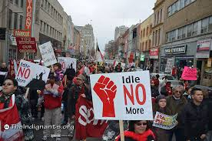
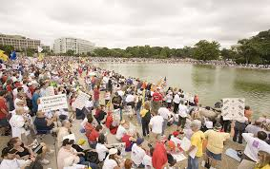
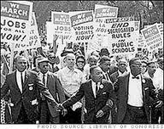
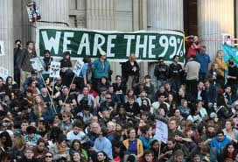
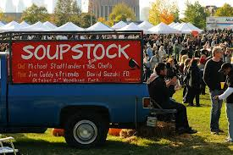

Slide 5
More common forms
Though things like the Civil Rights Marches and Occupy are very popular, they are only a tiny proportion of what makes a grassroots movement
Most organizations are focused individuals who start with a basic idea and expand from there

Slide 6
What can you do?
Participating in a grassroots movement seems daunting at first
Just take your time, and think about issues in your community that you feel should be improved/change (ie. Bike lanes, affordable housing, later start to the high school day!)

Slide 7
Can you make a difference?
Absolutely.
Keep in mind, most grassroots organizations are non-profits and need all the help they can get
Most welcome volunteers and people willing to donate time and energy

Slide 8
Essentials
Grassroots organizations are generally started by individuals and small groups with a focused idea
They may broaden or narrow their focus after starting, but always have a specific mission in mind
(i.e., bettering education, feeding the hungry, helping the impoverished)
Built on ideas but kept running by dedicated workers and tons of volunteers

Slide 9
Questions
What are some major grassroots organizations you can think of?
What good can these small movements do?
Are grassroots movements ever effective?
Do the movements have to be big and popular to effect change or can a small group do just as well?

