Slide 1
Access to social services

Slide 2
What are some services you expect from your community?
Think
Pair
Share

Slide 3
Clean air
Access to education
Access to medical care
Housing
Food
Clean water
Job opportunities

Slide 4
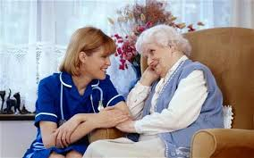

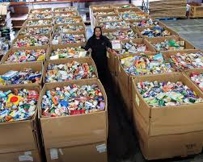
What is a SOCIAL SERVICE?
Social Services are activities or programs offered to promote well-being.
www.funboxcomedy.com
prc.dartmouth.edu
www.sharefoodbringhome.org

Slide 5
What are some examples
of social services?
Health care
Dental care
Education
Community Centres
Job training
Subsidized Housing

Slide 6
How do we access those things in our communities in Canada?
In major urban centres there are offices to access these services.
Not easily accessible in rural areas.

Slide 7
Are there disparities in these services provided in different parts of Canada?
Where?
Why?

Slide 8
Start timeline exercise…

Slide 9
Milestones in building Canada’s current safety net
Up until the early 20th century, the family, and the church were expected to care for its members. Children, the elderly, and the ill needs were met by the community.
As industrialization drew people into urban areas away from farms, a need for social services was identified by the government.
Provincial governments began funding private and church charities, as well as, providing some services directly.

Slide 10
In 1914 the Workmen’s Compensation Act of Ontario came into law.
This act provided financial compensation for workers who were injured on the job site and could no longer participate in the work force.

Slide 11
In 1927 the Old Age Pension Act is brought into law.
The federal and provincial governments fund pensions for citizens 70 years and older. This law excludes First Nations people.
This law demonstrated that the government had an obligation to provide a network of social services for its citizens.

Slide 12
In 1940 Unemployment Insurance Act is Canada’s
first national social insurance program.

