Slide 1
Student PowerPoint worksheets
Name:

Slide 2
How does your diet affect the carbon footprint?
How is the quantity of meat that a person consumes connected to carbon footprint?
How is the quantity of meat that a person consumes connected to food sustainability?
What is a definition for sustainable food system?
Sustainable Food System
Text
Text
Text
Text
Text
Text
Text
Text
What are the Threats to Genetic Diversity?
*
*
*
How can you reduce your food miles?

Slide 3
Carbon footprint of food
Carbon footprint relates to “the emission of greenhouse gases such as Carbon Dioxide (CO2), Nitrous Oxide (N2O) and Methane (CH4) that are released to the atmosphere during the growing, rearing, farming, processing, transporting, storing, cooking and serving the food on your plate. ……. By buying and using locally grown or produced food we reduce our carbon footprint, helping the environment.” Amcglasson 2015.

Slide 4
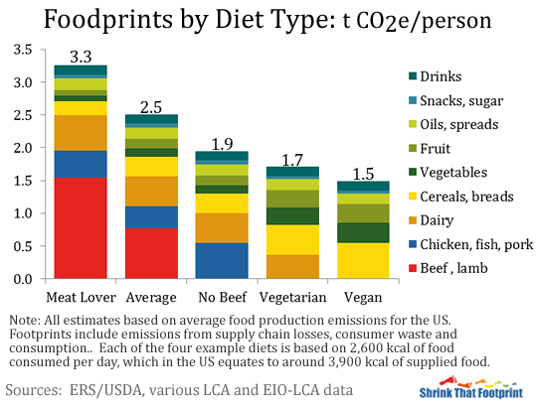
Carbon footprint of food
How does your diet affect the carbon footprint?
http://shrinkthatfootprint.com/wp-content/uploads/2013/01/foodprint5.gif11

Slide 5
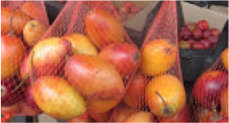
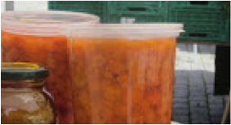
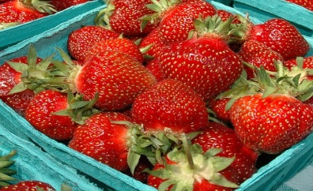
Use the food miles calculator to determine how far the food has travelled www.foodmiles.com/results.cfm
Food | Name | Located in the following country | Food Miles (to Ottawa Canada)
 | Tomate de arbol – tamarillo or Tree Tomato | Venezuela
 | Cloud Berries | Norway
 | Strawberries | Canada

Slide 6
Compare Venezuela food system to Canada’s
Venezuela
Canada
Food security
What do these statistics tell you?
What is the meaning of food insecurity?
Name one environmental factor to consider for a sustainable food system
Name one ethical factor to consider for a sustainable food system
Do you think that Canada should have a national food policy? Why or why not?
How is growing Organically different?

Slide 7
Canadian food policy by Diana Bronson Coming up with a Canadian food policy at: www.youtube.com/watch?v=FmSpD862bgw
1. What are the three criteria for changing the Canada’s Food System for the well being of the planet?
*
*
*
2. On the planet
a. there are more over feed people than under feed people.
b. There are less over feed people than under feed people.
c. There is the same over feed people as under feed people.
d. The number of over feed people is the same as under feed people.
The UN defines food security: when all people at all times have access to sufficient, safe, nutritious food, to maintain an active and healthy life.
a. What is one location in Canada with high food insecurity
b. What is one reason that this location has high food insecurity?
4. Fill in some of the changes in how we grow, process, transport, store, sell and eat our food?
The number of farms has ______________ and there is in __________________ in the size of the farm.
The number of stores have _______________ and there is an ____________________ in the surface area.
4 or 5 retailers sell ________________ of our food.
96 % of our meat supply is controlled by _______________ companies
75% of the world seed supply is controlled by _____________ companies.
There is an exploding growth of _____________________, _______________________ and _____________________________ food.
Roughly _____________ of our greenhouse gas emissions is connected to our food system.
Canada wastes more than __________________________________ dollars each year. 1/3 of all food is wasted.
Canada does not have a _______________________ policy
5. What are 6 things you can do :
*
*
*
*
*
*

Slide 8
The 5 Ws and H
Who | Factor | When
What |  | Why
Where |  | How

