Slide 1
Sustainable food systems

Slide 2
Introduction
Hungry Planet: What the World Eats in One Week By Peter Menzel and Faith D’Alusio
Peter Menzel and Faith D’Aluisio traveled the world documenting everything that an average family consumes in a given week–and what it costs from Time.com —http://time.com/8515/hungry-planet-what-the-world-eats/
What is something you noticed about how other countries eat and how much they pay for their food?

Slide 3
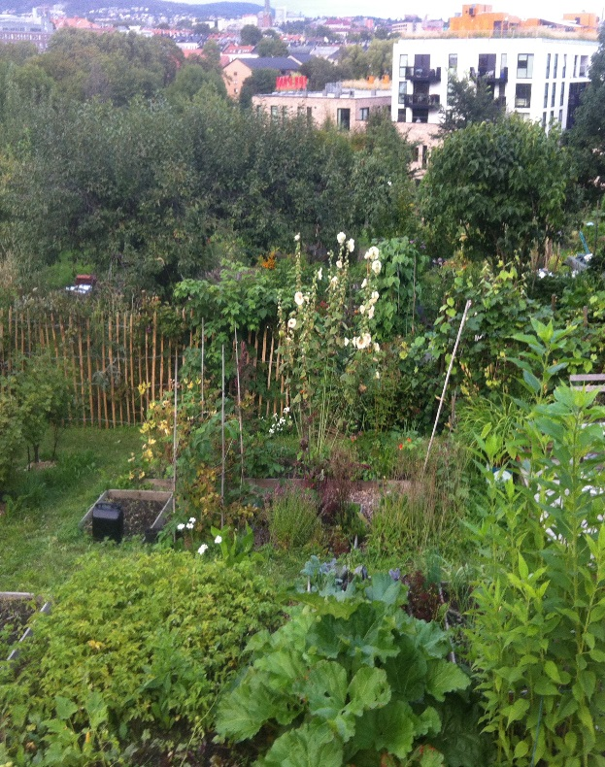
The goal is to become aware of many of the aspects of sustainability in our food system.
Write down what you think is a sustainable food system?
One definition:
“A sustainable food systems values and cares for the earth. It produces food that is grown and processed close to those who consume it in such a way as to conserve natural resources and biodiversity. A sustainable food system supports social inclusion, as well as economic, environmental and nutritional well-being for all citizens.”
Taken from http://www.foodshedproject.ca/pdf/foods%20sustainability%20checklist.pdf

Slide 4
Sustainable Food System
Organic Methods
Ethical Factors
Environmental Factors
Food Wastage
Food Security
Genetic Diversity
Carbon Footprint of Food
Food Miles

Slide 5
Carbon footprint of food
Carbon footprint relates to “the emission of greenhouse gases such as Carbon Dioxide (CO2), Nitrous Oxide (N2O) and Methane (CH4) that are released to the atmosphere during the growing, rearing, farming, processing, transporting, storing, cooking and serving the food on your plate. ……. By buying and using locally grown or produced food we reduce our carbon footprint, helping the environment.” Amcglasson 2015.

Slide 6
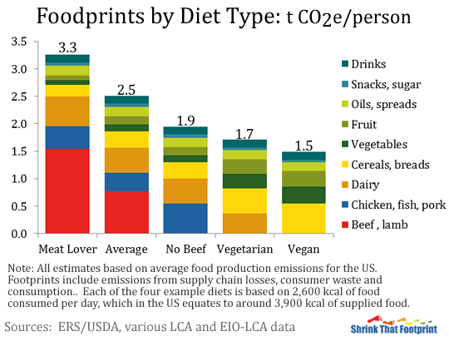
Carbon footprint of food
How does your diet affect the carbon footprint?
http://shrinkthatfootprint.com/wp-content/uploads/2013/01/foodprint5.gif11

Slide 7
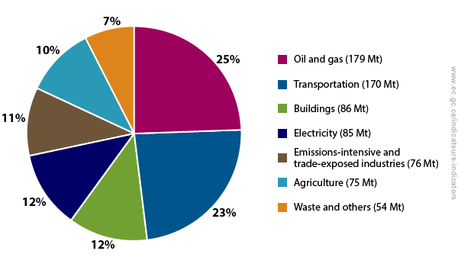
Greenhouse gas emissions
Taken from Environment Canada 2013.
https://www.ec.gc.ca/indicateurs-indicators/default.asp?lang=en&n=F60DB708-1
Notice the percentage of greenhouse gas emission from Agriculture in Canada!

Slide 8
Carbon footprint
Meat production represent 18 % of global climate gas emissions.
The environmentally friendly approach to meat consumption is pretty straight forward–just eat less meat
Check out the meat consumption for Norway, Canada and Venezuela at
ChartsBin :
http://chartsbin.com/view/12730
Norway meat consumption in 2009 was 66kg per person
Canada meat consumption in 2009 was 94.3kg per person
Venezuela in 2009 was 76.8 kg per person
http://sciencenordic.com/norwegians-dark-red-meats-carbon-footprint
http://www.carbonjar.com/carbonfootprints

Slide 9
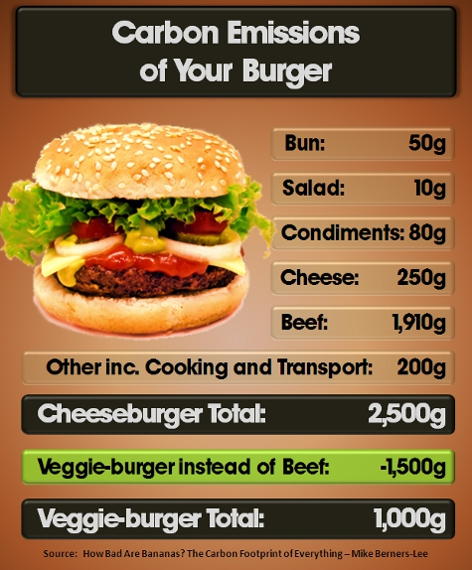
Carbon footprint
How is the quantity of meat that a person consumes connected to carbon footprint?
How is the quantity of meat that a person consumes connected to food sustainability?
http://sciencenordic.com/norwegians-dark-red-meats-carbon-footprint
http://www.carbonjar.com/carbonfootprints

Slide 10
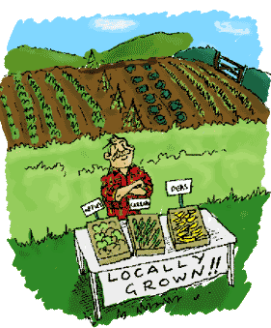
Food miles
Food miles refer to the distance that food is transported from the site of production until it reaches the consumer. This is also referred to as the distance from “field to fork.” Food miles make us aware of the environmental impact of transporting food around the world.
How Can you Reduce your food miles?
Graphic taken from http://www.politicallyincorrect2.com/sus2.gif

Slide 11
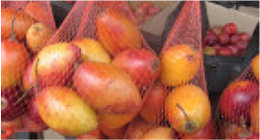
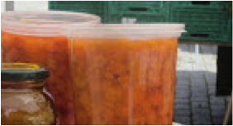
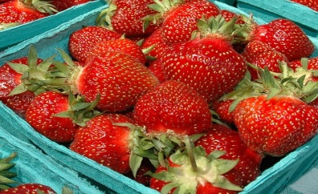
Use the food miles calculator to determine how far the food has travelled www.foodmiles.com/results.cfm
Food | Name | Located in the following country | Food Miles (to Ottawa Canada)
 | Tomate de arbol – tamarillo or Tree Tomato | Venezuela
 | Cloud Berries | Norway
 | Strawberries | Canada

Slide 12
Use the food miles calculator to determine how far the food has travelled www.foodmiles.com/results.cfm
Food | Name | Located in the following country | Food Miles (to Ottawa Canada)
 | Tomate de arbol – tamarillo or Tree Tomato | Venezuela | 2468 miles (3971km)
 | Cloud Berries | Norway | 3479 miles (5597km)
 | Strawberries | Canada | 0 miles (0km)

Slide 13
Genetic diversity
Genetic diversity refers to a wide range of genetic variation within a species to help them adapt to changing environmental conditions and new pests and diseases
Background Information
Show the following two videos to contrast and compare Genetic Diversity
USC Canada on Banking Diversity (8:29 min) http://usc-canada.org/resources/videos
The Eyes of Nye - Genetically Modified Foods by Bill Nye Disney Educational Productions 2005
Taken from…http://www.fao.org/docrep/004/v1430e/V1430E04.htm

Slide 14
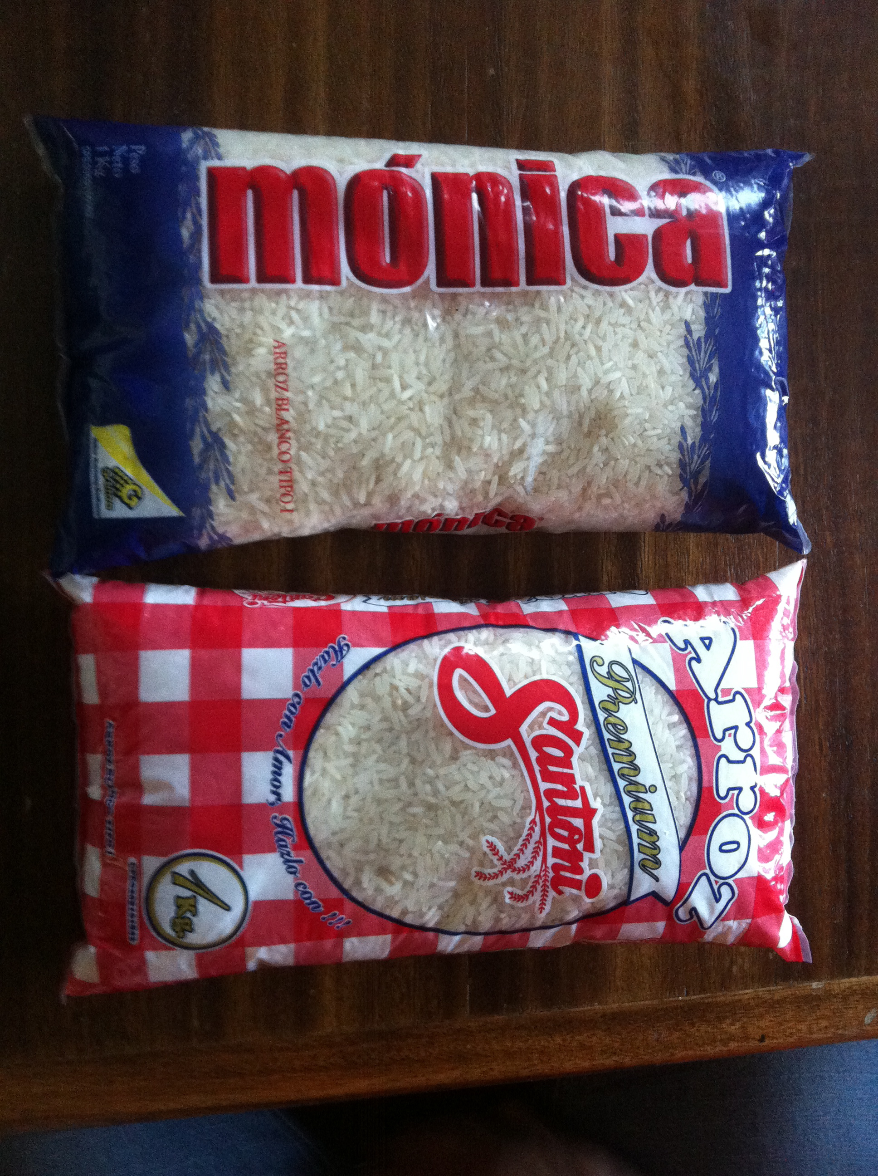
Food security
The Global Food Security Index compares countriesin regards to issues of affordabiity, availability and quality, across 109 countries.
Compare Canada to another country such as Venezuela.
http://foodsecurityindex.eiu.com/Country/
Look at the picture of similar rice……One of the rice packages is subsidized by the government of Venezuela to cost less. This rice is sold to people with less wealth at a reduced cost. What do you think of this? Share with a partner.
For Further information on Venezuela and it subsidized food system check out:
http://laht.com/article.asp?ArticleId=344198&CategoryId=10717

Slide 15
Interesting…
Five million Venezuelan receive free food, four million of them are children in schools and 6,000 food kitchens feed 900,000 people. The population of Venezuela in 2013 was roughly 30 million people
Turn to a partner and tell them how you think this compares to Canada.
Watch the video at Food Banks Canada 1: 26 minutes
Hunger Count 2014 at http://www.foodbankscanada.ca/HungerCount
For more information Food Banks Canada – HungerCount 2014 report on hunger and food bank use. Retrieved From
For more information Food Banks Canada – HungerCount 2014 report on hunger and food bank use. Retrieved From https://www.foodbankscanada.ca/getmedia/7739cdff-72d5-4cee-85e9-54d456669564/HungerCount_2014_EN.pdf.aspx?ext=.pdf

Slide 16
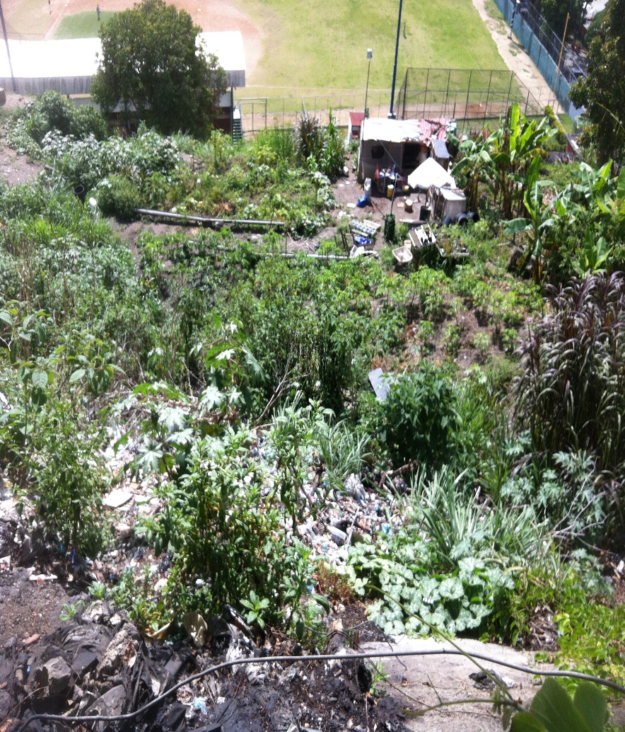
Questions on video:
Hunger Counts 2014
What do these statistics tell you?
What is the meaning of food insecurity?
Compare Venezuela food system to Canada’s
Venezuela
Canada

Slide 17
Food wastage
According to an article in the Toronto Star by Jennifer Bins Food waste: An unappetizing, $27B problem
We throw away 40 per cent of our food every year, worth about $27 billion. It’s a crisis, and green bins alone can’t solve it. Nearly half of the food we produce in Canada
Watch Food Wastage Footprint 2 by the Food and Agriculture Organization of the United Nations (3:38 minutes)
Turn to a partner and explain the problem with food wastage?
http://www.thestar.com/life/food_wine/2011/01/14/food_waste_an_unappetizing_27b_problem.html
https://www.youtube.com/watch?v=Md3ddmtja6s

Slide 18
Organic food
Video from the Organic Council of Ontario (4:24 min) on Organic Food Production in Ontario https://vimeo.com/36299613
How is growing Organically different?
protects soil
protects water
no synthetic chemicals

Slide 19
Environmental factors
What are some of the Issues:
Food packaging produces A LOT of waste.
Transporting the food releases greenhouse gases into the air.
Water waste by irrigation practices
Loss of biodiversity by farming
Purchasing products that must travel long distances.
Using food grown in greenhouses heated with fossil fuels during cold months
Fertilizer–its source, use and depletion in soil
Herbicide use and pesticide use
Amcglasson. National 5/4 Hospitality – Food Sustainability. (2015. Oct 15.)

Slide 20
Ethical practices in food choices are things that can be seen as morally right
Fair trade food production aims to provide fair prices and better working conditions for farmers and farm workers.
Farm assured means that the farms and food companies meet high standards of food safety and hygiene, animal welfare and environmental protection.
Free range is a method of farming where animals are allowed to roam freely.
Genetically modified food is grown with genetic manipulation technology.
Food sovereignty—defined as "the right of peoples to healthy and culturally appropriate food produced through ecologically sound and sustainable methods and their right to define their own food and agriculture systems"—is a concept coming from social movements in response to the injustices of the global food system.
Taken from http://www.resilience.org/stories/2015-03-10/the-venezuelan-food-sovereignty-experiment

Slide 21
Ethical practices in food choices are things that can be seen as morally right
What are some ethical issues you can think of?
Who owns and has rights to the use of the Land and Water?
What are the implications of cheap food?
Who has the power in the food chain? The farmer, retailer, consumer?
Taken from http://www.resilience.org/stories/2015-03-10/the-venezuelan-food-sovereignty-experiment

Slide 22
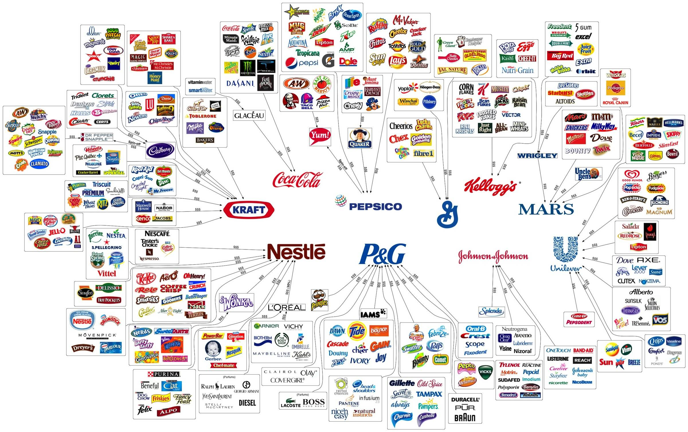
The 10 corporations control almost everything you buy
by PolicyMic at http://

Slide 23
Food security in a climate perspective from Norway
“In 2010 almost one billion people did not have enough food to meet their basic nutritional needs. This is a serious human rights violation, because the right to food is a universal human right that is embodied in the International Covenant on Economic, Social and Cultural Rights.
In its policy platform for the period 2009–13, the Government therefore emphasized the need to intensify Norway’s efforts to promote global food security by focusing on climate-resilient agriculture, fisheries and aquaculture in development cooperation.” p 3.
Taken from the Food Security in a Climate Perspective: A strategy developed in cooperation with Ministry of Agriculture and Food, Ministry of Fisheries and Coastal Affairs, Ministry of the Environment. January 2013- English Summary

Slide 24
Norway’s solution
“We will give priority to increasing food production, especially by strengthening small-scale climate-resilient agriculture, and to the development of competence about the importance of ecosystems for climate resilience and access to water. We intend to promote research and private-sector engagement in African countries and to support measures to reduce wastage in food production. We also intend to promote the rights of smallholders, particularly women, and to strengthen the fisheries and aquaculture sector and the efforts of regional organisations in the agricultural sector. This will require close cooperation with national authorities and support for their plans for boosting production and food security. It will also mean intensifying international cooperation on improving the global framework conditions for achieving food security's. 3
Taken from the Food Security in a Climate Perspective: A strategy developed in cooperation with Ministry of Agriculture and Food, Ministry of Fisheries and Coastal Affairs, Ministry of the Environment. January 2013- English Summary

Slide 25
Venezuela’s national policy on food sovereignty
Sowing the Seeds of Food Sovereignty
The foundation for Venezuela's current food sovereignty efforts was laid in a series of articles in its newly reformed constitution, passed by popular referendum in 1999. Article 305 states:
The State shall promote sustainable agriculture as the strategic basis for overall rural development, and consequently shall guarantee the population a secure food supply, defined as the sufficient and stable availability of food within the national sphere and timely and uninterrupted access to the same for consumers….Food production is in the national interest and is fundamental to the economic and social development of the Nation.6
http://www.thesolutionsjournal.com/node/237281

Slide 26
Canadian food policy by Diana Bronson Coming up with a Canadian food policy at: (16:58 min) https://www.youtube.com/watch?v=FmSpD862bgw
1. What are the three criteria for changing the Canada’s Food System for the well being of the planet?
*
*
*
2. On the planet
a. there are more over feed people than under feed people.
b. There are less over feed people than under feed people.
c. There is the same over feed people as under feed people.
d. The number of over feed people is the same as under feed people.
The UN defines food security: when all people at all times have access to sufficient, safe, nutritious food, to maintain an active and healthy life.
a. What is one location in Canada with high food insecurity
b. What is one reason that this location has high food insecurity?
4. Fill in some of the changes in how we grow, process, transport, store, sell and eat our food?
The number of farms has ______________ and there is in __________________ in the size of the farm.
The number of stores have _______________ and there is an ____________________ in the surface area.
4 or 5 retailers sell ________________ of our food.
96 % of our meat supply is controlled by _______________ companies
75% of the world seed supply is controlled by _____________ companies.
There is an exploding growth of _____________________, _______________________ and _____________________________ food.
Roughly _____________ of our greenhouse gas emissions is connected to our food system.
Canada wastes more than __________________________________ dollars each year. 1/3 of all food is wasted.
Canada does not have a _______________________ policy
5. What are 6 things you can do :
*
*
*
*
*
*

Slide 27
Factors that affect food sustainability
Carbon Footprint
Food Miles
Genetic Diversity
Food Security
Food Wastage
Organic methods
Environmental Factors
Ethical Factors
In small groups, select one of these factors and complete the worksheet.
Answer the 5 W’s and H
Who – the people involved
What – the problem, thing, ideas
Where- the places involved
When- past, present, future of the topic
Why-should I care?
How- can I make a difference?

Slide 28
The 5 Ws and H
Who | Factor | When
What |  | Why
Where |  | How

Slide 29
Select one factor that affects Food Sustainability and create an awareness campaign that could include posters, billboards, newspaper articles, Ad jingle, radio announcement etc.
“A sustainable food systems values and cares for the earth. It produces food that is grown and processed close to those who consume it in such a way as to conserve natural resources and biodiversity. A sustainable food system supports social inclusion, as well as economic, environmental and nutritional well-being for all citizens.”
People
Planet
Profit
Taken from http://www.foodshedproject.ca/pdf/foods%20sustainability%20checklist.pdf

Slide 30
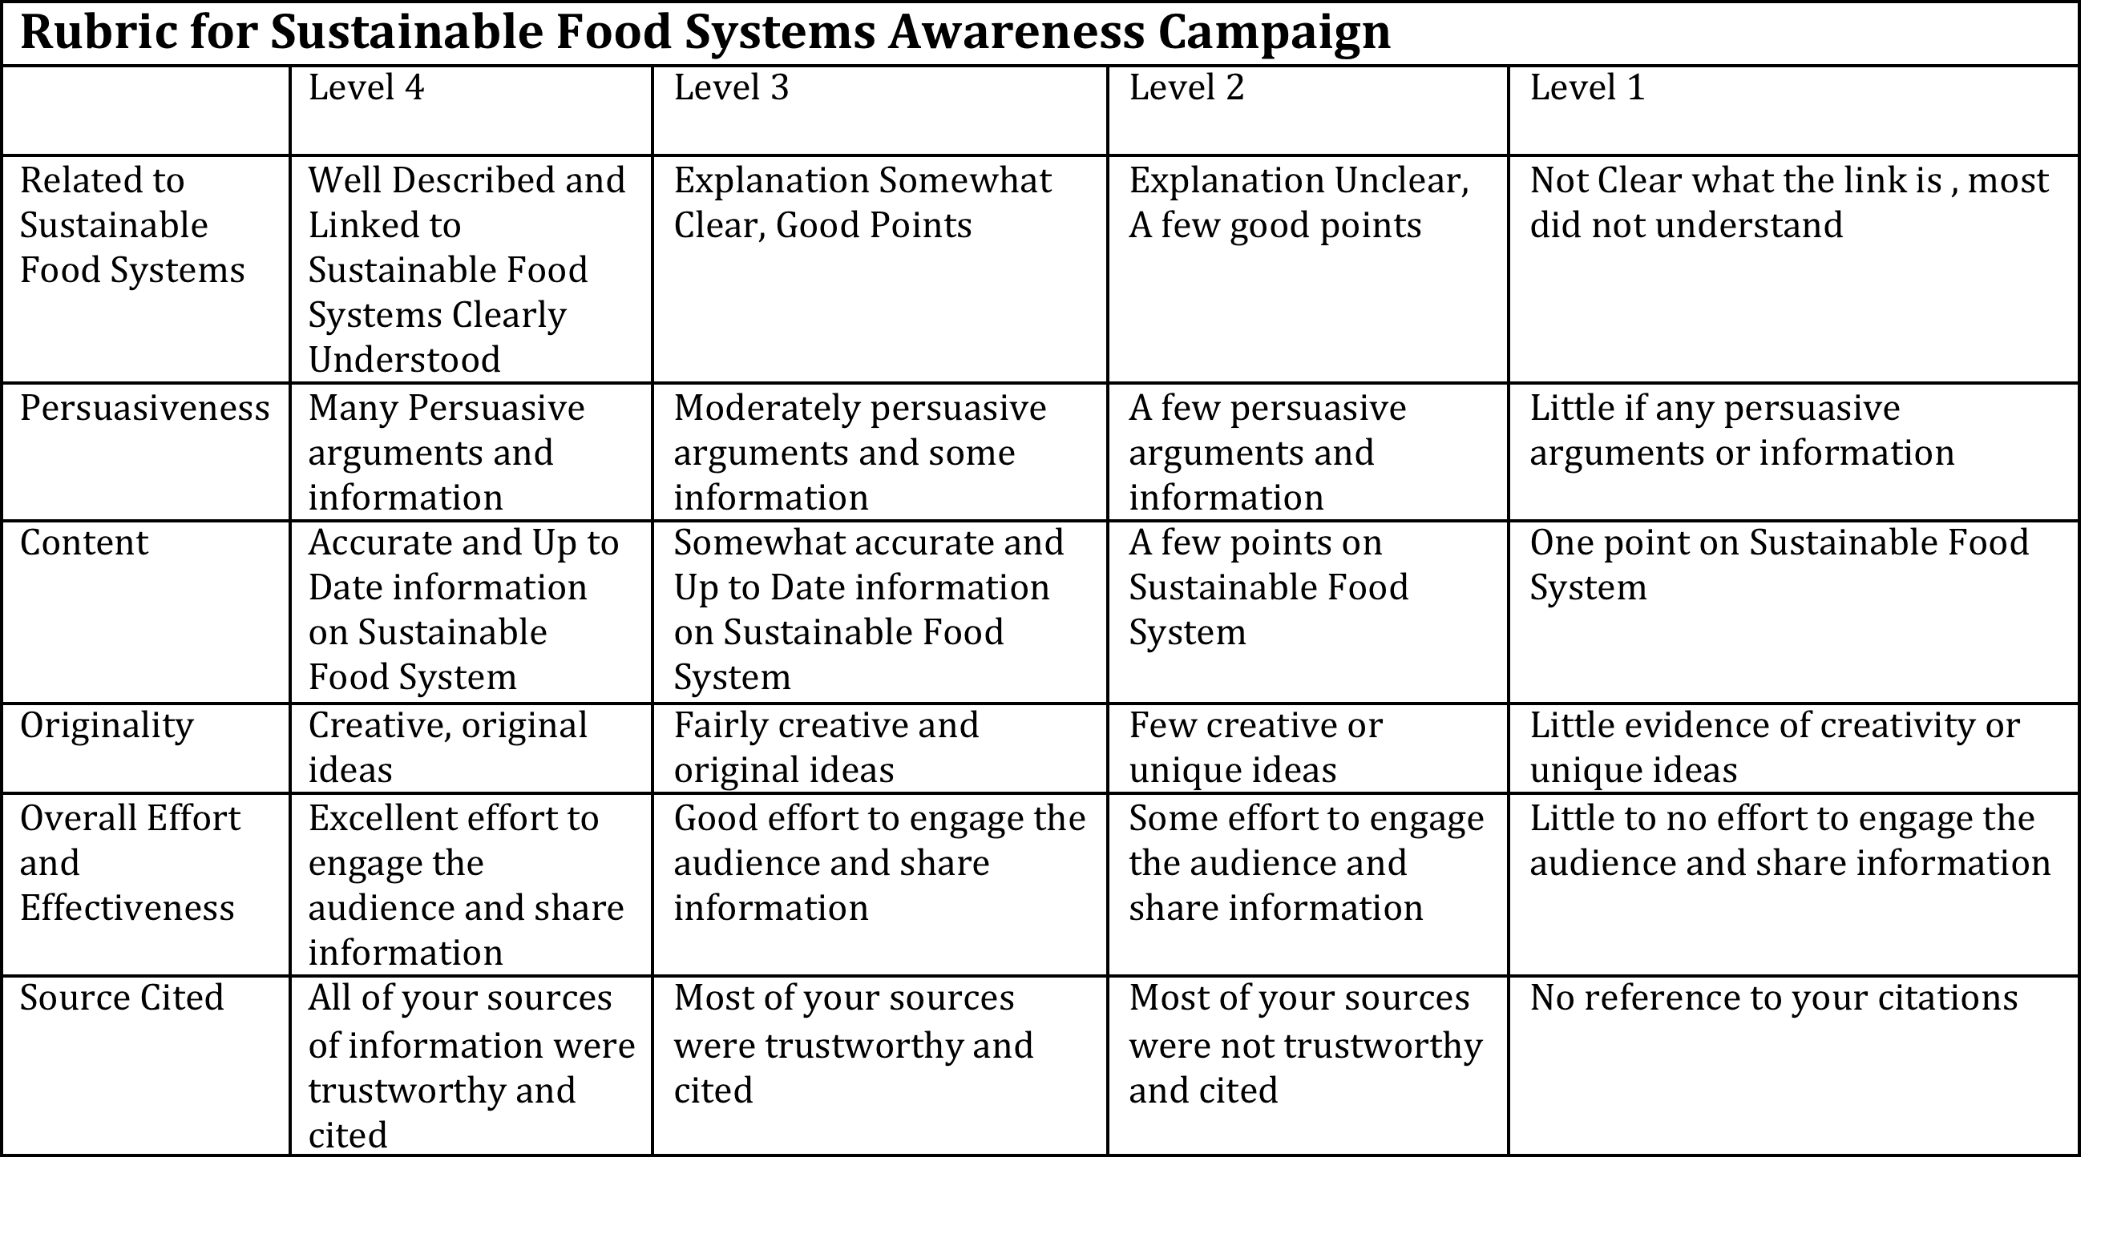
Taken from http://www.foodshedproject.ca/pdf/foods%20sustainability%20checklist.pdf

