Slide 1
Life after oil

Slide 2
Humans know oil is a non-renewable resource. We also know we have an oil addiction.
There are an extensive number of books, articles, blogs and documentaries on the topic of oil scarcity. How will we adapt to an oil free world?
It’s no longer a question of ‘if,’ but a question of ‘when.’
How will life on earth be different after oil?

Slide 3
Throughout this power point presentation you will analyze four cartoons.
For each cartoon you will identify these five elements:
1. Symbolism: using an object to stand for an idea.
2. Captioning & Labels: used for clarity and emphasis.
3. Analogy: a comparison between two unlike things that share some characteristics.
4. Irony: the difference between the way things are and the way things are expected to be.
5. Exaggeration: overstating or magnifying a problem or a physical feature or habit.

Slide 4
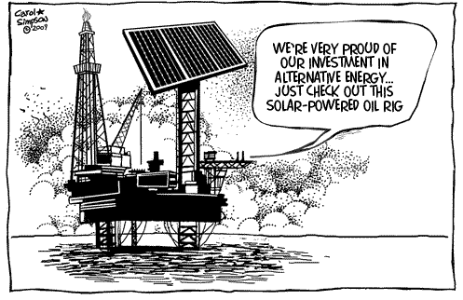
Cartoon #1
Source: Carol Simpson

Slide 5
Nobody knows exactly when the world will run out of oil, but a commonly accepted reference point does exist which helps us get a general sense of how much time we have left.
This reference point is known as ‘Peak Oil.’
Predictions of when we will reach global ‘Peak Oil’ vary. Some experts believe it has already happened, some believe it will happen in the near future, and some believe we can avoid it by investing in alternative energy sources.

Slide 6
‘Hubbert Peak Theory’ was developed by American geologist M. King Hubbert (1903–1989).
The term ‘Peak Oil’ refers to the point of maximum oil production on earth.
Hubbert used a bell shaped curve to illustrate his observation–the amount of oil under the ground in any region is finite (non-renewable), therefore the rate of production must reach a maximum and decline.

Slide 7
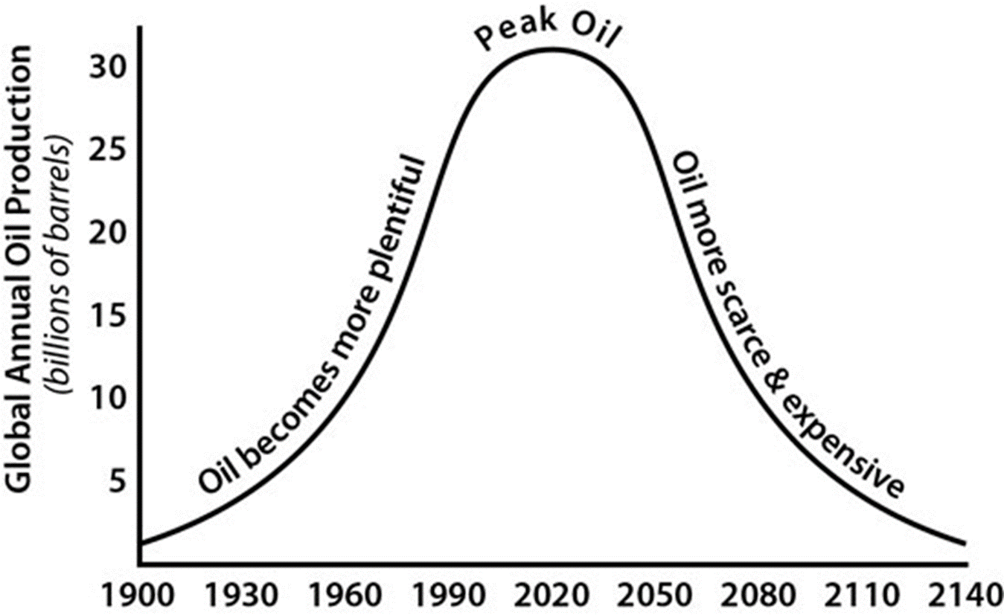
Source: www.explainingthefuture.com

Slide 8
Criticisms of peak oil theory
Estimates don’t account for unconventional oil sources (i.e. technology is constantly improving making the impossible possible).
Estimates are often underestimates, therefore the peak oil date keeps changing (i.e. in countries experiencing unrest it’s difficult to conduct a thorough exploration).

Slide 9
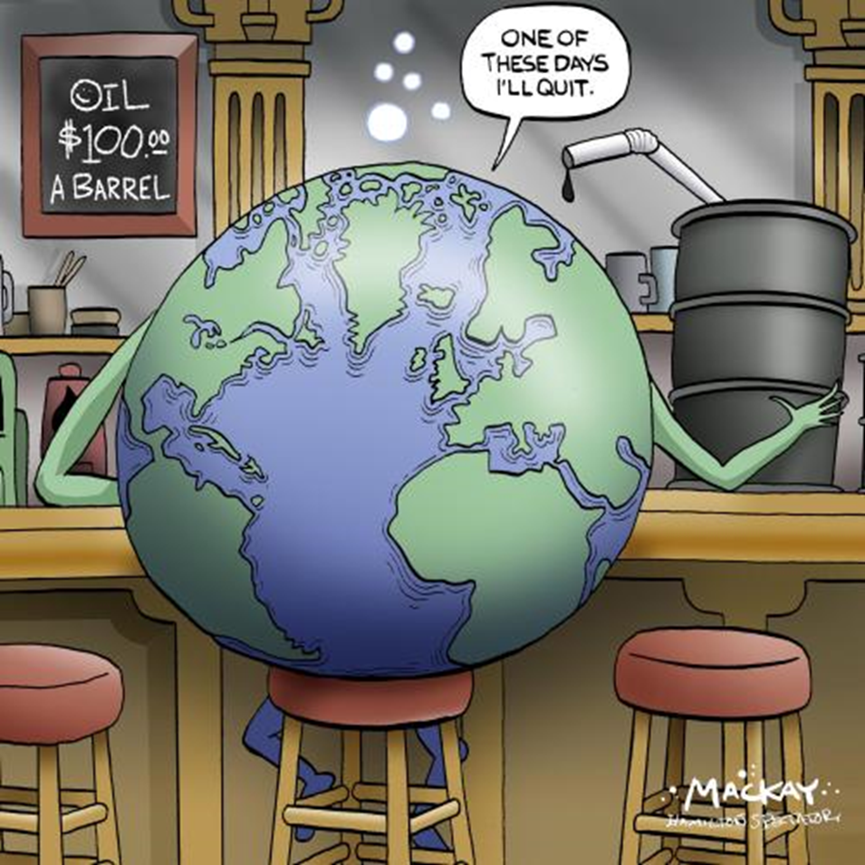
Cartoon #2
Source: Mackay cartoons

Slide 10
Think/pair/share
Who are the major stakeholders in the ‘Peak Oil’ debate? (Any group affected is a stakeholder)
Make a list on a scrap piece of paper.

Slide 11
Major stakeholders
1 – Oil industry
2 – Oil rich (exporting) countries
3 – Oil dependent countries
4 – Alternative energy sector
(solar, wind, hydroelectric)
5 – Environmentalists
6 – Indigenous Peoples

Slide 12
Governments of petroleum rich countries rely heavily on their oil exports as a source of revenue.
How will their economies fare in a post-oil world?
What are these governments doing to ease the transition?

Slide 13
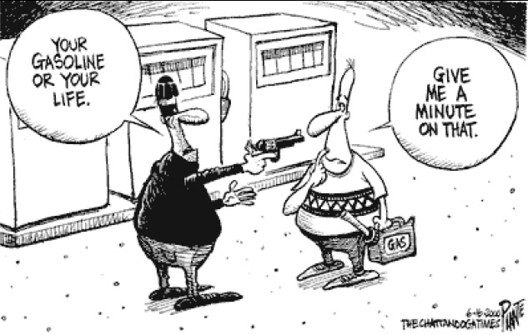
Cartoon #3
Source: The Chattanooga Times

Slide 14
Think/pair/share
Other than oil, what are some other significant energy sources?
Make a list on a scrap piece of paper.

Slide 15
Major energy sources
1 – Oil
2 – Coal
3 – Natural Gas
4 – Nuclear
5 – Solar
6 – Wind
7 – Hydroelectric

Slide 16
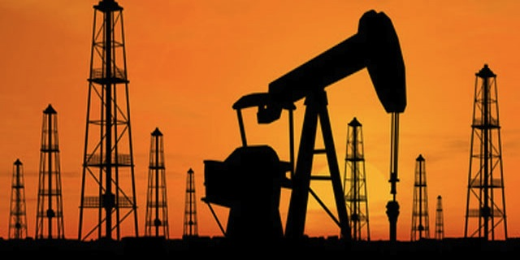
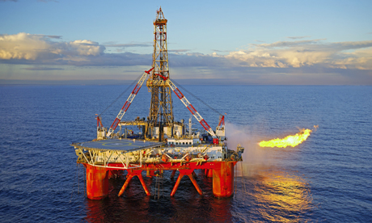
Oil
Source: http://www.calenergyinvestment.com/project_fueloil.php1
Source: http://www.theguardian.com/business/2010/mar/07/oil-gas-production-north-sea

Slide 17
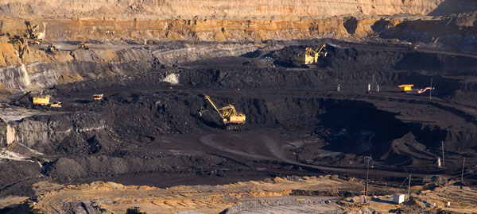
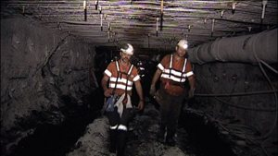
Coal
Source: http://www.chinacoalintl.com/news-735
Source: http://www.miningaustralia.com.au/news/hearing-into-hunter-miner-death-to-begin-next-week

Slide 18
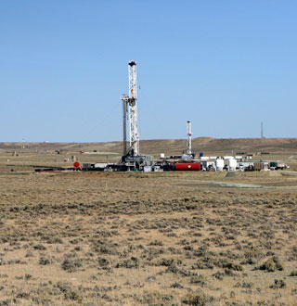
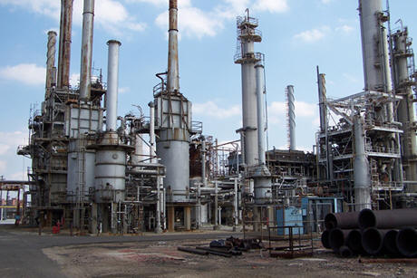
Natural gas
Source: http://www.scientificamerican.com/article/drill-for-natural-gas-pollute-water/
Source: http://www.totalenergy.com/SNGPlant/SNGPlant.htm

Slide 19
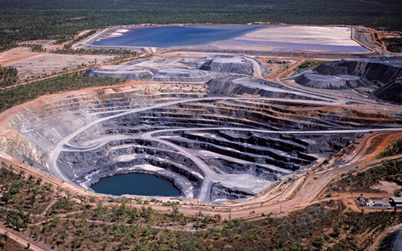
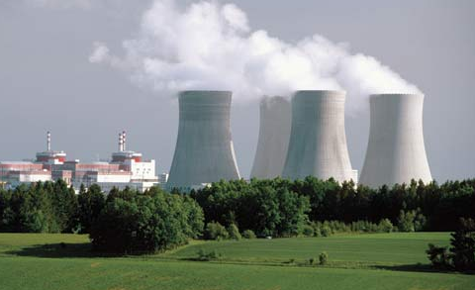
Nuclear energy
Source: http://www.acfonline.org.au/be-informed/northern-australia-nuclear/uranium-mining-australia
Source: http://www.britannica.com/EBchecked/topic/421763/nuclear-reactor/302452/History-of-reactor-development

Slide 20
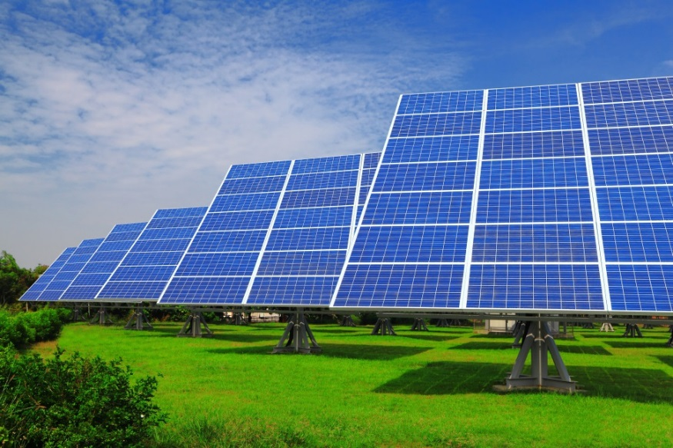
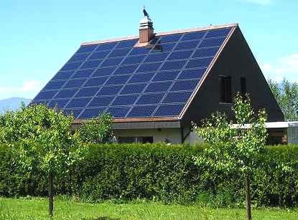
Solar power
Source: http://www.solarpowernrg.com/index.php/projects/featured-projects/146-tien-sher-richmond-project.html
Source: http://www.solar.excluss.com/solar-equipment/solar-panels/

Slide 21
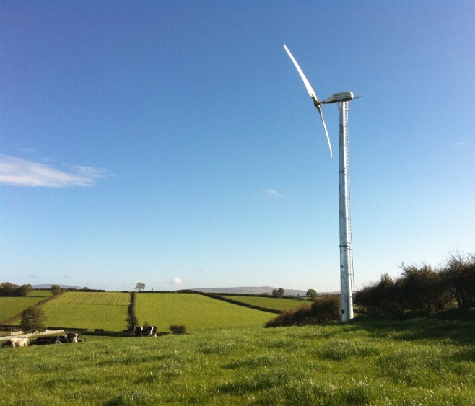
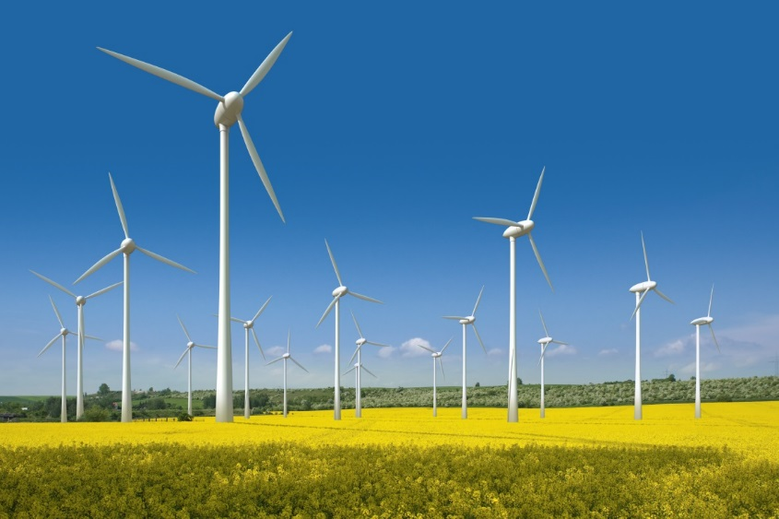
Wind power
Source: http://silverford.com/blog/?p=2555
Source: http://www.aedve.info/wind-turbines-to-provide-renewable-energy-at-honda-transmission-plant-in-ohio/

Slide 22
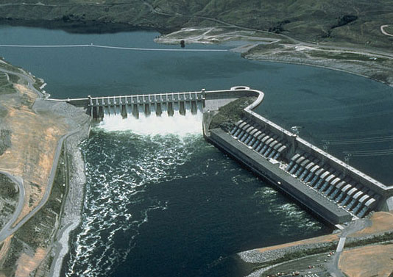
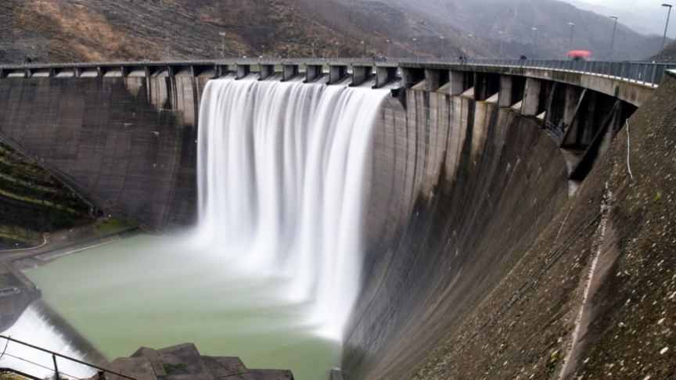
Hydroelectric power
Source: http://www.ucsusa.org/clean_energy/our-energy-choices/renewable-energy/environmental-impacts-hydroelectric-power.html#.VT5x_yFViko
Source: http://www.energydigital.com/renewables/3467/Hydroelectric-Power-Leading-the-Way-in-Pakistan

Slide 23
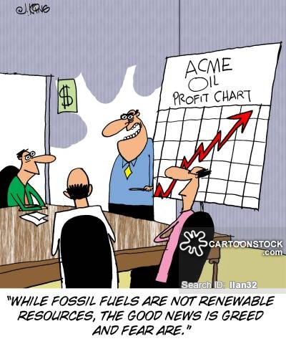
Cartoon #4

Slide 24
Think/pair/share
Describe how a world without oil would be different from life as we know it.
Compile a list of at least three significant changes.
Be prepared to share with the class.

Slide 25
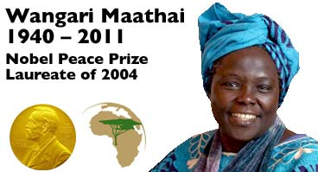
“When resources are degraded, we start competing for them, whether it is at the local level in Kenya, where we had tribal clashes over land and water, or at the global level where we’re fighting over water, oil, and minerals. So one way to promote peace is to promote sustainable management and equitable distribution of resources.”
– Wangari Maathi

